Slide 1
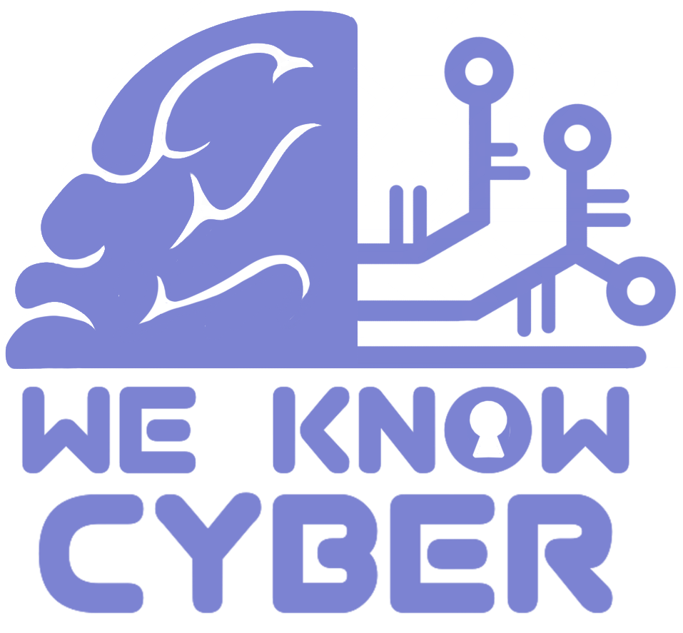
Cybersecurity for the Tourism Industry
Presented by Guy Bilyou and Mike Willburn
Translated by Munkhjargal Dorjgotov
We Know Cyber
“You know your business, we know cyber!”

Slide 2
Meet the Experts : Guy bilyou
Guy leads We Know Cyber with expertise in cybersecurity, organizational leadership, and creative insight. He has been working in cybersecurity for over 15 years in private and public sectors. Guy is a 24-year combat veteran of the Marine Corps Infantry and Army Officer Signal Corps. He has led information security projects in Apple Pay, Missile Defense, PCI/DSS Chip and Pin, Secure Video Conferencing, Rapid Cyber Assessment, Network and Data Migration, HIPAA Compliance, and many risk assessments and penetration tests. He is the go-to master of small business cybersecurity. His experience extends to network security, ransomware prevention and recovery, penetration testing, encryption, identity management, secure software development, risk assessments, and training and mentoring. Guy is a Certified Information Systems Security Professional (CISSP), Certified Ethical Hacker (CEH), and Certified CMMC Professional (CCP) and holds a Master of Cybersecurity and Information Assurance degree.

Slide 3
Meet the Experts : Mike Willburn
Mike Willburn is a CISSP-certified cybersecurity expert with a passion for leveraging emerging technologies to protect systems and drive innovation. He has a rich history with Mongolia including volunteer English teaching and building cybersecurity capacity. His expertise spans advanced fields such as artificial intelligence, machine learning, IoT, and post-quantum cryptography, enabling him to design resilient solutions for today’s complex digital threats. With extensive experience in risk assessment, policy development, and workforce training, Mike focuses on aligning technical advancements with organizational goals to deliver secure, scalable systems. He is dedicated to fostering adaptability and resilience in businesses, ensuring they remain prepared for the evolving cybersecurity landscape. Mike’s commitment to innovation and his dedication to nurturing the next generation of cybersecurity professionals make him a leader in the field, empowering organizations to stay secure while unlocking their potential for growth and success.

Slide 4
We Know Cyber, Inc.
We Know Cyber brings decades of cybersecurity experience, specializing in protecting small businesses from online threats
Led by certified experts, we provide tailored cybersecurity services and solutions to safeguard small businesses and empower them to thrive in the digital world
With years of proven experience and industry-leading certifications, the We Know Cyber team is committed to delivering the highest level of cybersecurity solutions tailored to your business needs
From risk assessments to proactive defense strategies, our expertise ensures your company is well-protected from evolving threats

Slide 5
Agenda
What is in the news?
Who are hackers?
How hackers operate
How they find your business
What makes you a target?
What you can do now to keep hackers out of your business
How to protect your business if you are attacked

Slide 6
What is in the news?
56% of small business owners said they are not concerned about being the victim of a hack in the next 12 months
59% believe they can quickly resolve any cyber attack
87% of small businesses have sensitive customer data that could be compromised in an attack
28% have a plan to recover from a cyber attack
51% of small businesses have no cybersecurity measures in place at all
More than half of small businesses are unable to recover after a cyber attack

Slide 7
Who are hackers?
Cybercriminal Gangs – Well-funded criminal groups who operate as businesses. They use ransomware, phishing, and data theft to make money
Insider Threats – Disgruntled employees or contractors with access to sensitive systems can be bribed or turn malicious
State-Sponsored Hackers – Some governments fund hackers to spy on rivals, disrupt businesses, or steal intellectual property
Hacktivists – These groups, like Anonymous, attack organizations for political or ideological reasons rather than financial gain
Lone Wolf Hackers – Independent hackers, ranging from hobbyists to skilled cybercriminals. They operate alone for personal profit, challenge, or notoriety. Some engage in fraud, identity theft, or exploit small businesses with minimal defenses

Slide 8
How hackers operate
How They Find Your Business – Reconnaissance
Automated Scanning
Websites
Open Source Information (OSINT)
How They Get In – Exploiting Vulnerabilities
Social Engineering
Software
Hardware
What Do They Do Once They are In
Add or Change User Access
Deny Access to Data
Steal Data

Slide 9
How they find your business
Automated Scanning
Internet Scanning Sites (Shodan)
Network Scanners (NMAP)
Malicious Tools
Social Engineering
Phishing
Malicious Links
Unauthorized Entry (physical or technology based)
Open-Source Information (OSINT)
AI marketing tools
Social Media
Market Data

Slide 10
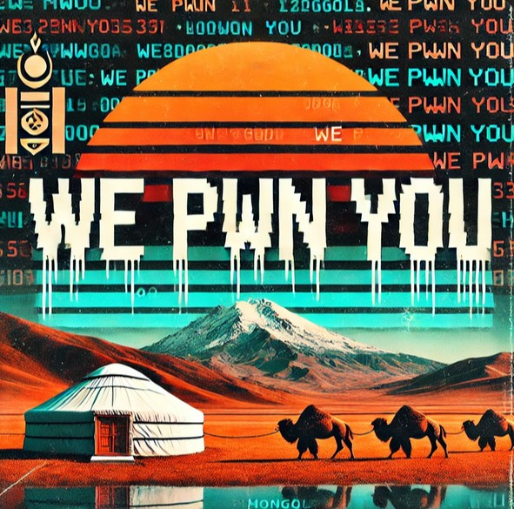
How they Get In
Malicious Programs (Software)
Viruses
Ransomware and Spyware
Crypto Mining and Botnets
Computers, Cell Phones, etc. (Hardware)
Outdated Systems and Actively Exploited Vulnerabilities
Internet of Things (IoT)
Network Devices and Cloud Services
Social Engineering (Hacking the People)
Deceiving Users
Phishing and Smishing
Malicious Links

Slide 11
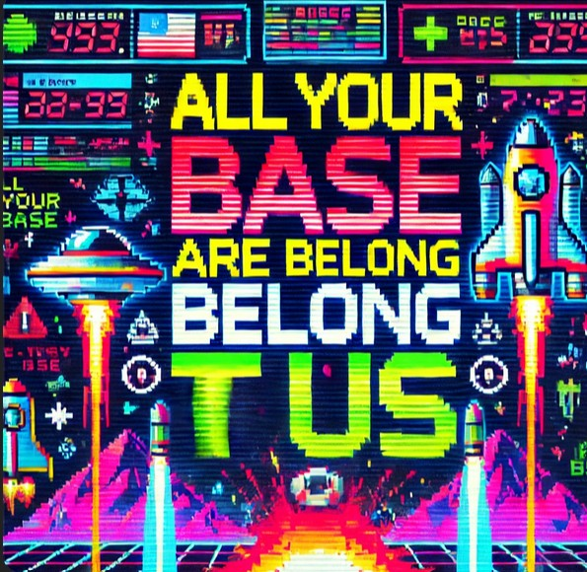
What do they do once they are in
Privilege Escalation
Infect Other Devices Inside Of The Organization
Move to Other Organizations (You may not be the intended target!)
Gain Administrative Privileges
Deny Access to Data
Disrupt Business/Deface Websites
Shut down your website, network, or systems
Encryption – Ransomware
Steal Data
Intellectual Property, Customer Information, Financial Information
Financial Fraud, blackmail, money laundering
Resell on the Dark Web for Identity Fraud or other malicious purpose

Slide 12
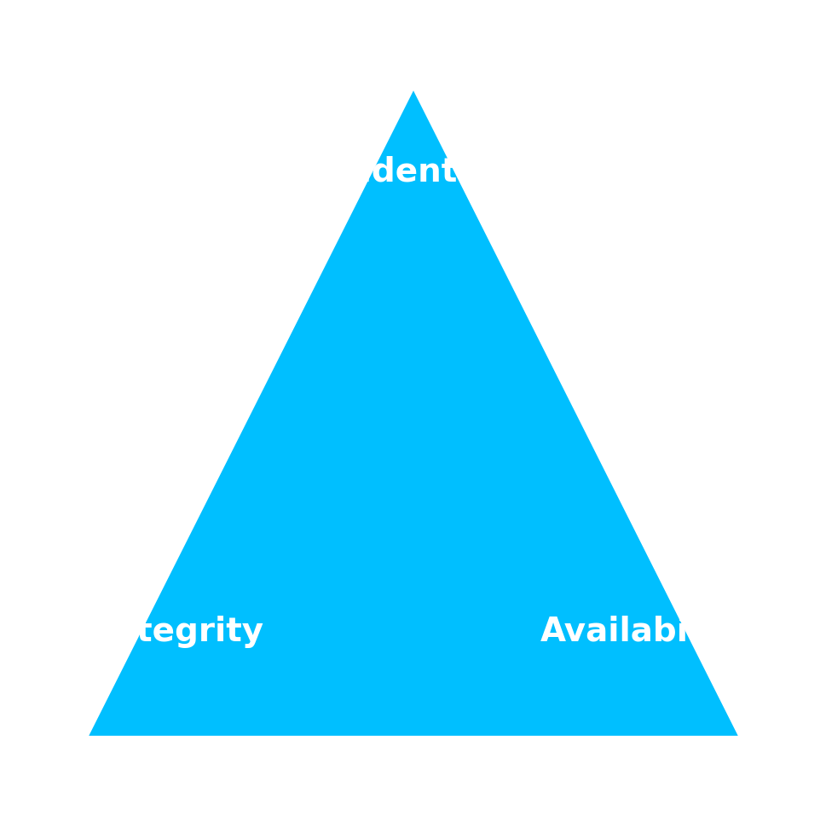
What makes you a target?
It hasn’t happened before, why would it happen now?
Many business owners believe hackers only target big business and governments
This leads to complacency and a lack of investment in security
Cybersecurity is too costly (but we can show you it doesn’t have to be)
Growing Use of Digital Tools
Cloud-based services
Online payment systems
We are all next-door neighbors on the internet
Limited IT Support
Trust in third party purchased products or vendors
Tech Support is usually focused on making sure the tech is available
Does your Internet Service Provider keep you safe?

Slide 13
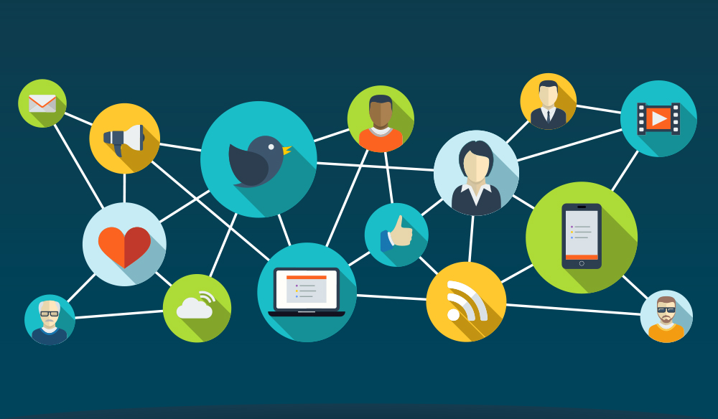
What makes you a target?
Your Business has Valuable Information
Credit Card Details and Customer Records
Partner and Vendor Data
Financial and Employee Data
Lack of Cybersecurity Awareness
Phishing Scams and Social Engineering Tactics
Default or Weak Passwords
99% of the problems happen between the keyboard and the chair
Vendors, Partners, and Large Business
You might not be the real target!
One of your customers or vendors might be
Your vendor or partner may be how they get to you!

Slide 14
What makes you a target?
Ransomware Vulnerability
Unencrypted Data
Limited or non-existent data backups
Cyber Insurance
Fear of Reputation Damage & Pressure to Pay
A data breach can destroy a small business’s reputation
This increases the pressure to pay hackers quickly to minimize damage
Without your data, you can’t do business
High Trust in Emails & Communications
Reliance on digital communication
Urgency and a false sense of criticality
Impersonation of company officers or fake invoice scams

Slide 15
What you can do now to keep hackers out of your business

Slide 16
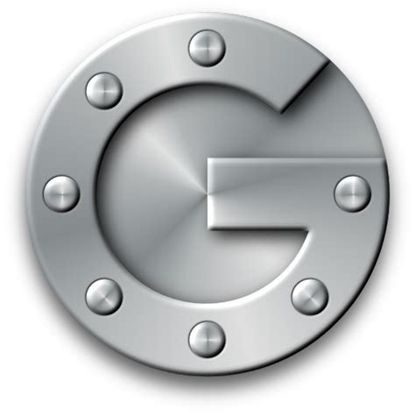
What Can you do now?
Multi-Factor Authentication
More than just a username and a password
Authenticator apps or text messages
Passkeys
Patches
Fixes the Vulnerabilities
Keeps your systems healthy and productive
Needs constant attention and maintenance
Vulnerability Assessment (scan and mitigation)
Detects the weaknesses and problems before the bad guys
Allows you time to fix the problem
Needs to be done often

Slide 17
What Can you do now?
Protecting Your Systems
Windows, MacOS, and other operating systems need secure configuration
Virtual Private Network (VPN)
Continuous Monitoring and Logs
Backups
3-2-1 Backup Rule
Need to backup often
Test recovery
Staff Training
Humans are the weakest link
Keep your staff on top of problems
Needs to be refreshed regularly

Slide 18
What to do if your business is attacked

Slide 19
What to do if you are attacked?
Incident Response Plan
Plan now to recover later
Test your response plan
Build resilient organizations
Cyber Insurance (The Good and the Bad)
Only 25% of claims pay out
Requires many of the steps described previously to qualify for coverage
You may not get your data back
Staff Training
Teach the staff what to watch out for
Clear reporting guidelines or requirements
What to do when something happens

Slide 20
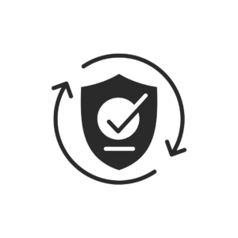
How We know cyber can protect you!
Web Site Security
Preventsomware
Securing Your Productivity Tools
Malware Recovery
Securing Online Payments
Cyber as a Service
Remote Work Security Solutions

Slide 21
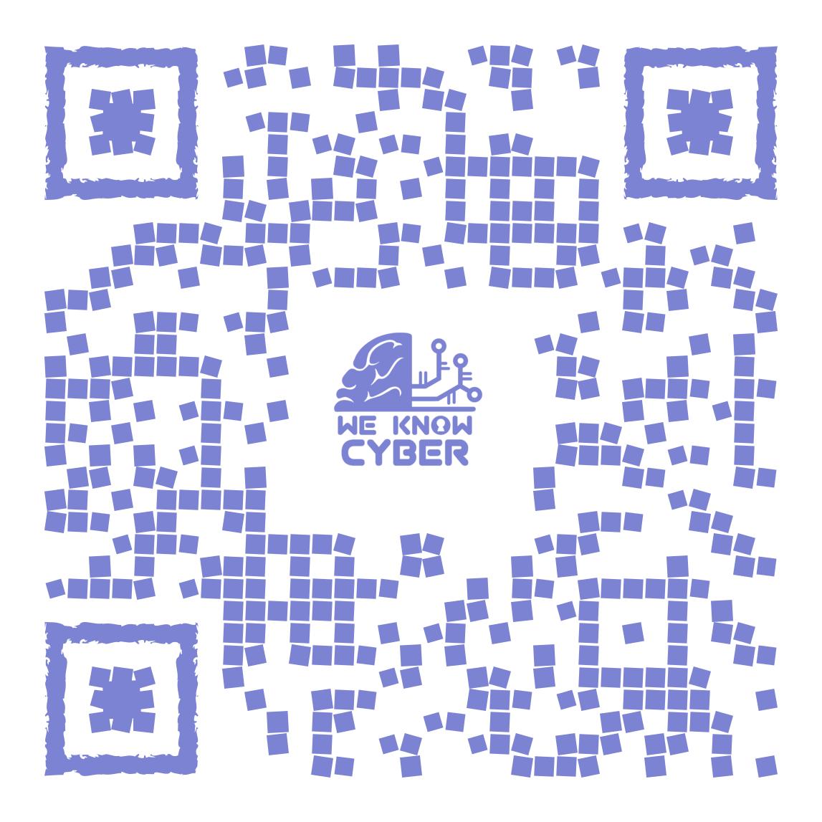
guy@weknowcyber.com mike@weknowcyber.com USA: +1 (888) 904-7011 Mongolia: +976 8657-0553 Weknowcyber.com

Slide 22
Questions

Slide 23
THANK you!!

