Slide 1
Implemented by
Obstacles and Challenges to CBT development in and around Protected Areas in Mongolia
Markus Pesch, GIZ SPACES Project
Markus Pesch, GIZ SPACES Project

Slide 2
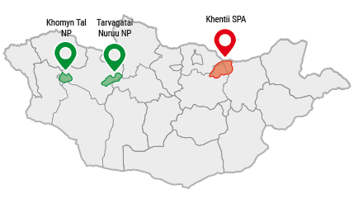
SUPPORTING PROTECTED AREAS FOR THE CONSERVATION OF ECOSYSTEM SERVICES, PHASE II (SPACES II)
Phase I (2019 –2024)
Phase II (2024 –2028)
Policy advice & Capacity-building: Protected Area Management, Sustainable Forest Management, Environmental Education & Communication
Commissioned by German Federal Ministry for Economic Cooperation and Development (BMZ)
Lead executing agency: Mongolian Ministry of Environment and Climate Change (MECC)
Project Area: Khan Khentii SPA, Tarvagatain Nuruu NP, Khomyn Tal NP

Slide 3
Selenge Aimag
Khüder
Yeruu
Mandal
Tuv Aimag
Batsümber
Erdene
Mungunmorit
Khentii Aimag
Umnudelger
Batshireet
Total Area: 1.748.103 ha

Slide 4
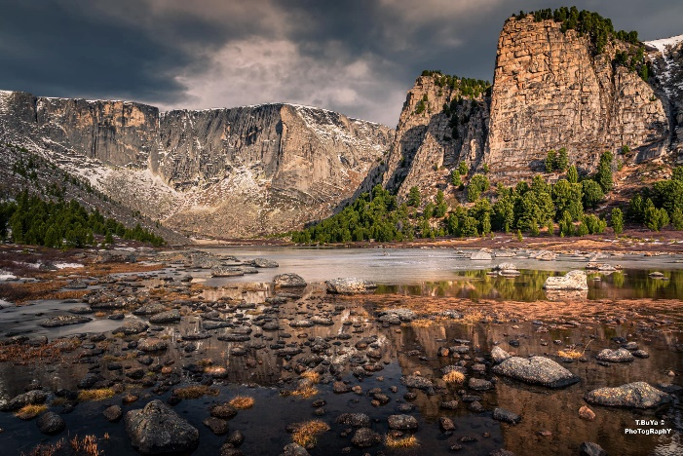
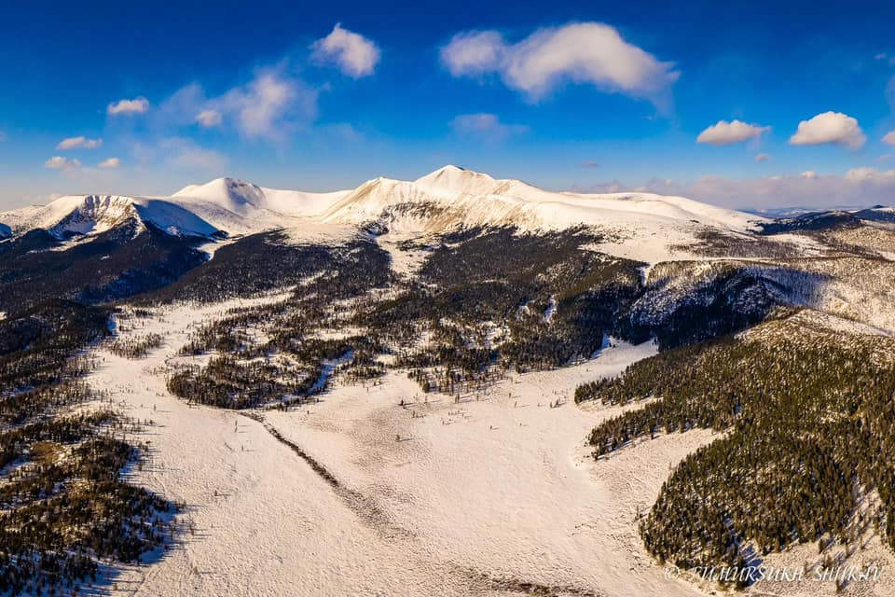
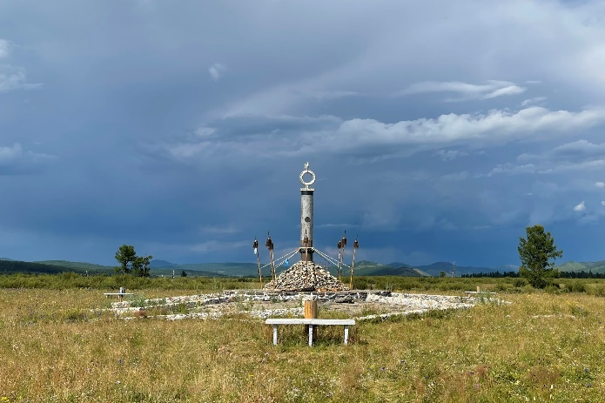
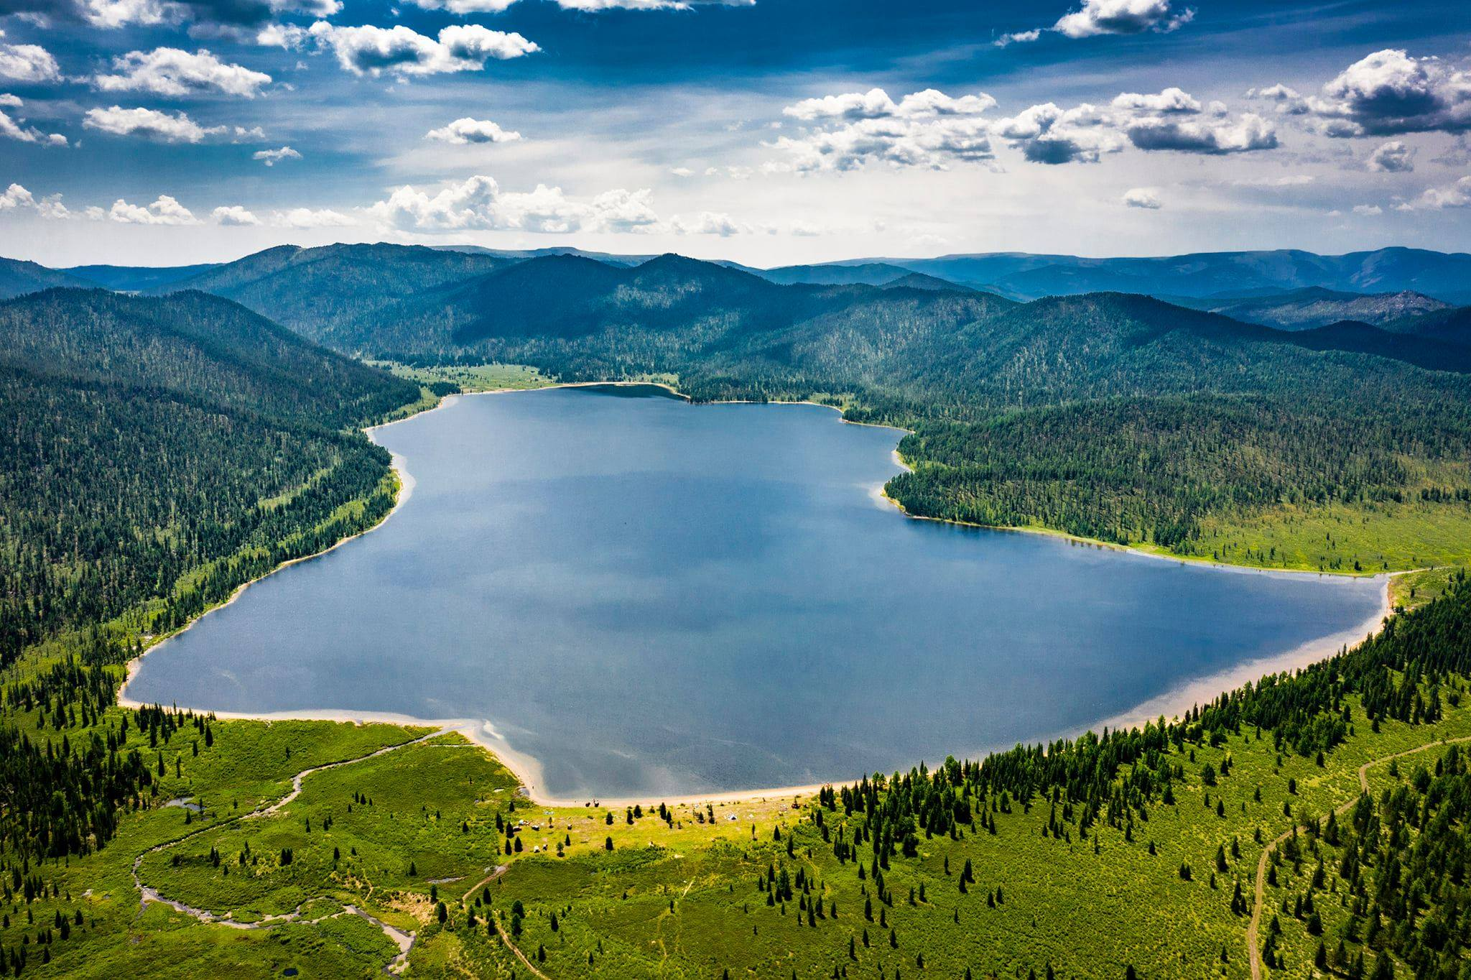
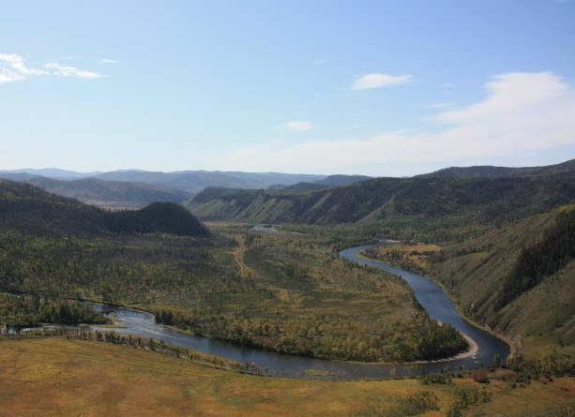
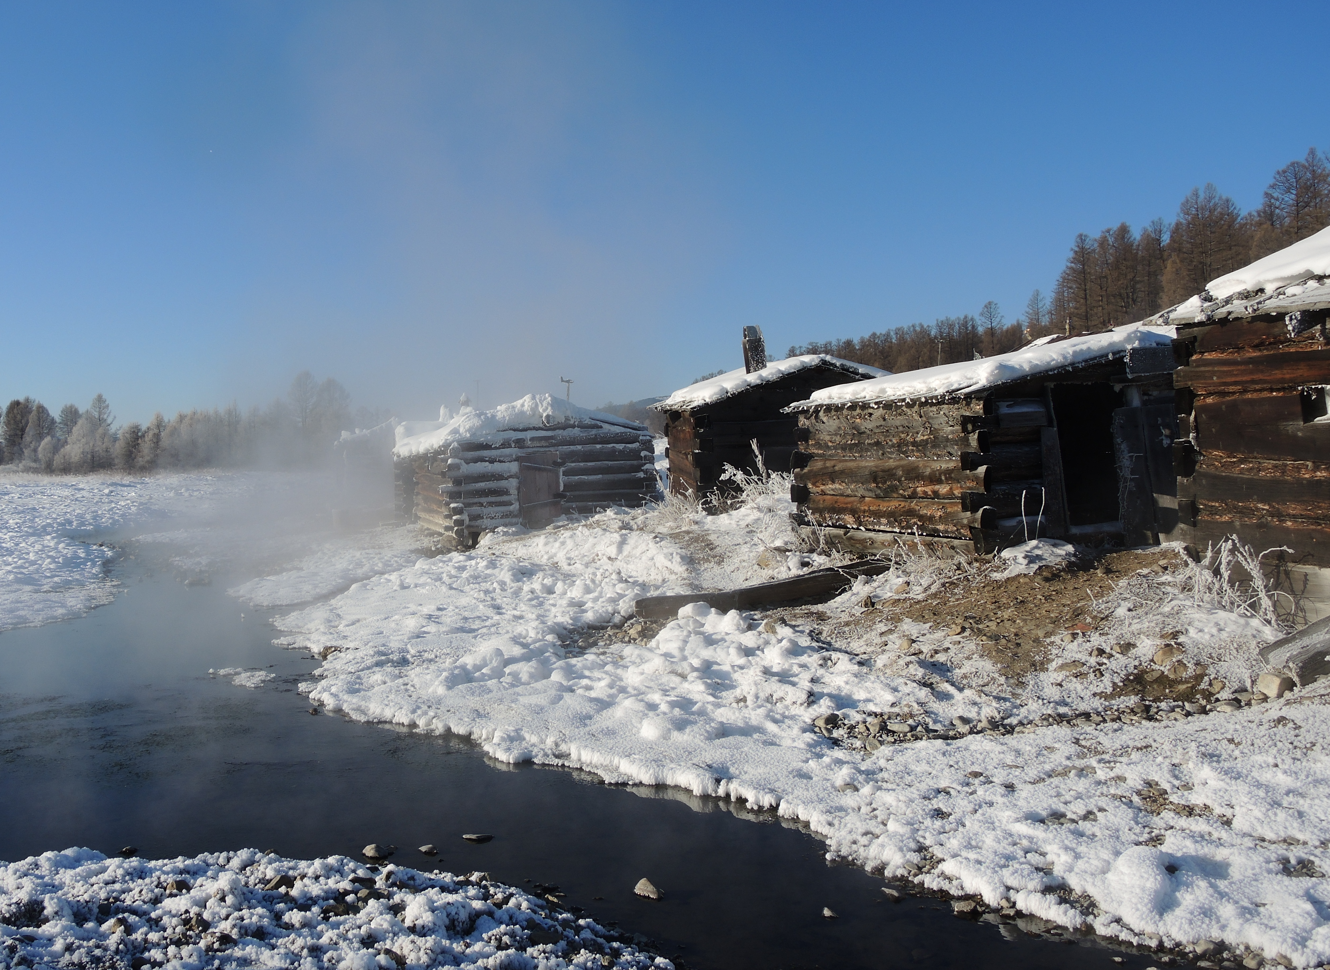
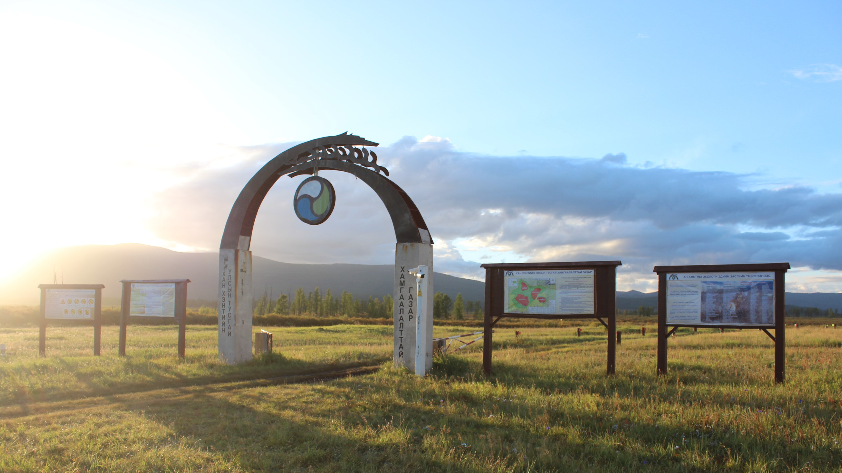
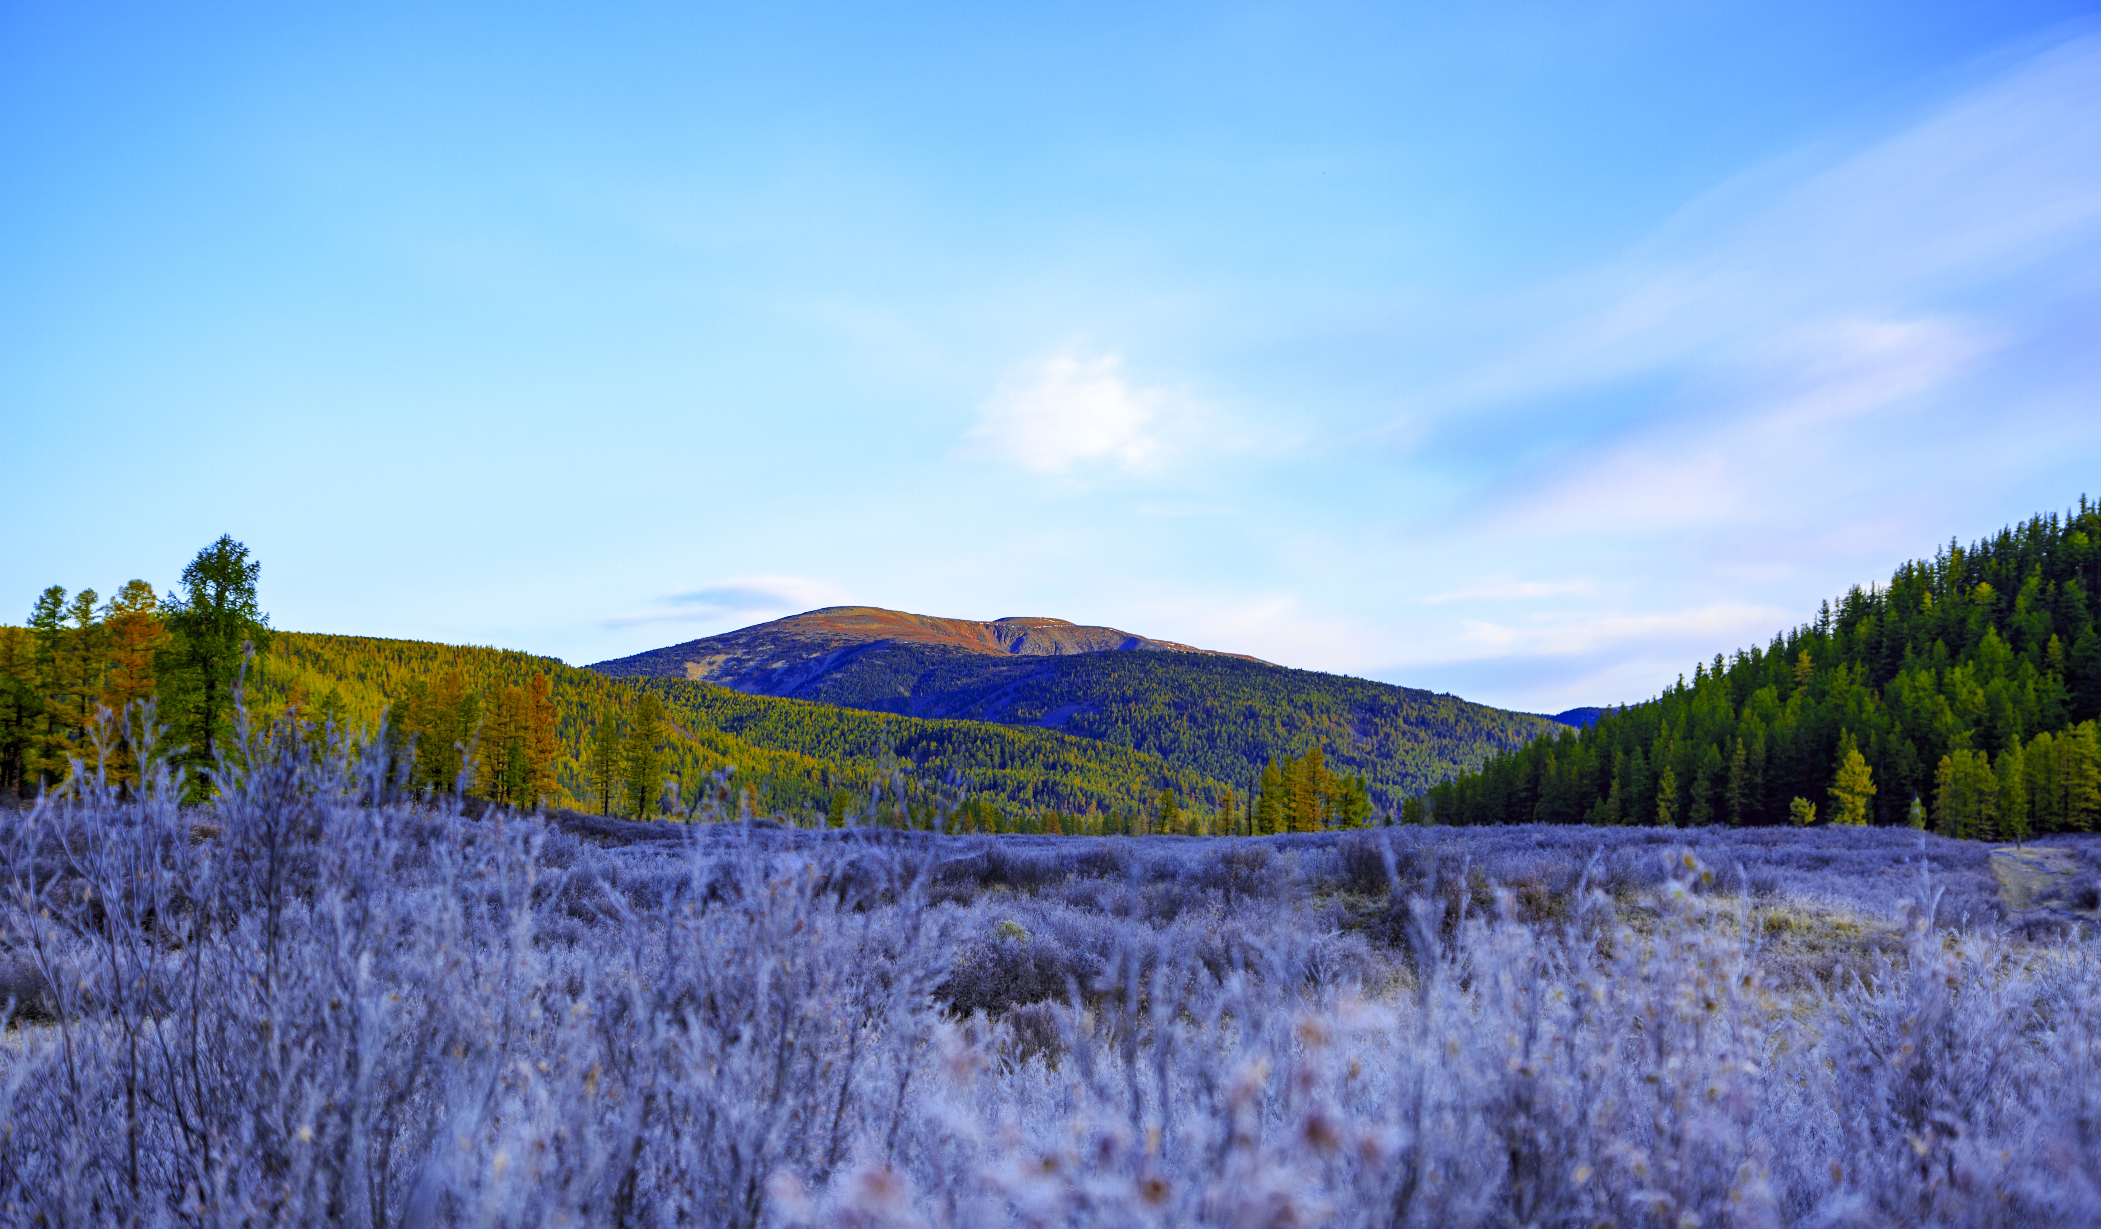
Touristic Highlights Khan Khentii SPA
Asralt Khairkhan
Khagiin Khar Nuur
Onon Hot Springs
Yestii Hot Springs
Burkhan Khaldun

Slide 5
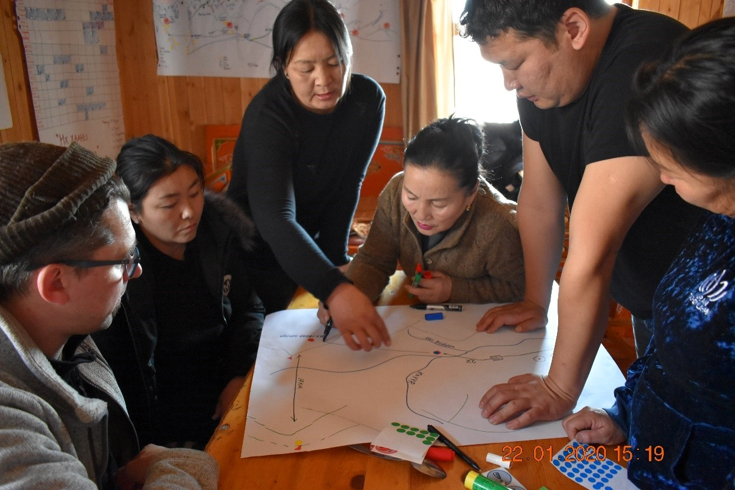
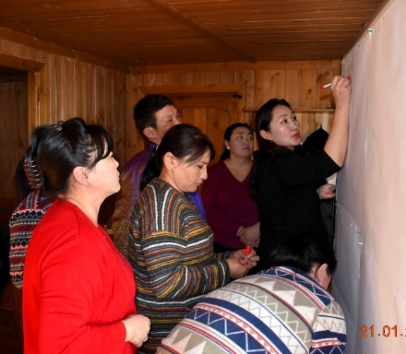
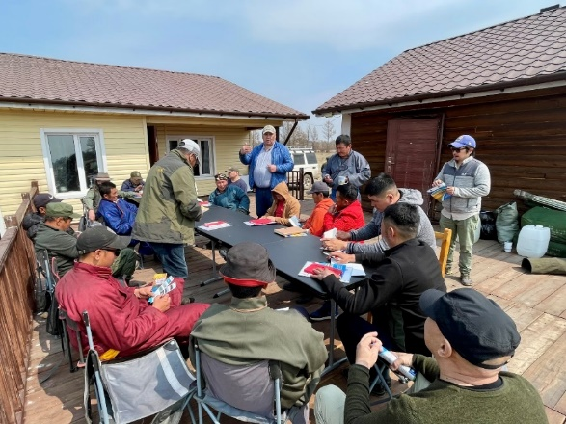
CBT Development as a tool of
International Development Cooperation
Premise:
Increase the acceptance of the protected area among the local population, by opening possibilities of additional income generation through Tourism
Decrease the pressure on natural resources through additional income generation (e.g. tourism)
Direct tourist streams out of the PA to the buffer zones

Slide 6
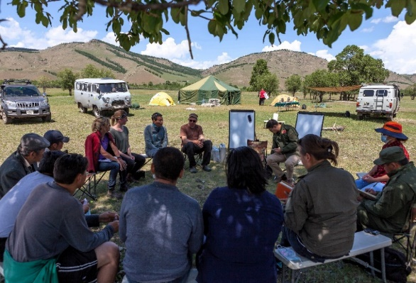
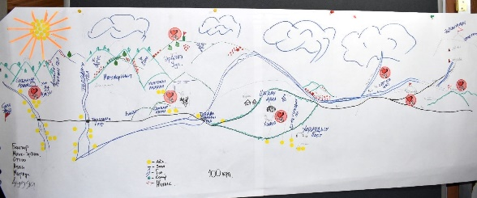
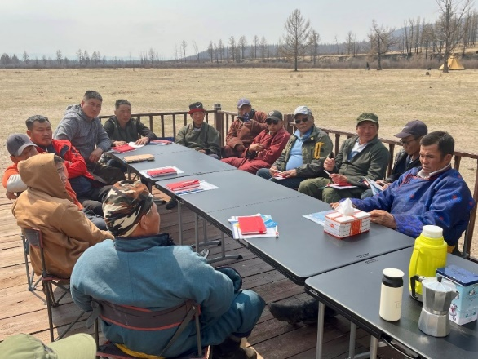
Initiating CBT Groups in the Eastern Buffer Zones
Initial enthusiasm among local community
Support from local government / Buffer Zone Council / PAA
Suitable location (access, natural beauty)
UNESCO World Heritage Site
Previous endeavors had moderate success
Changing conditions: Road Construction
Efforts by MET to promote Touristic Routes in the Eastern Aimags

Slide 7
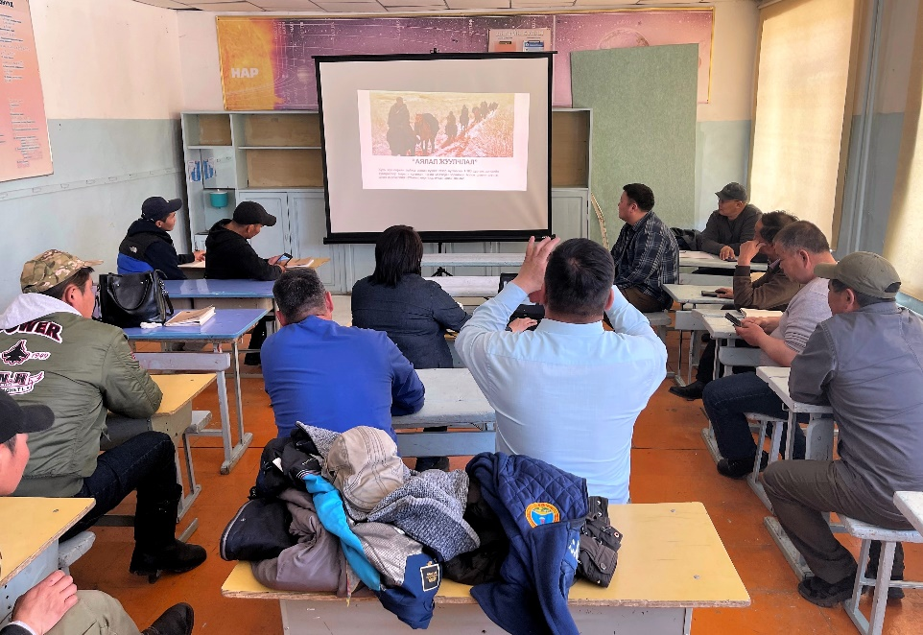
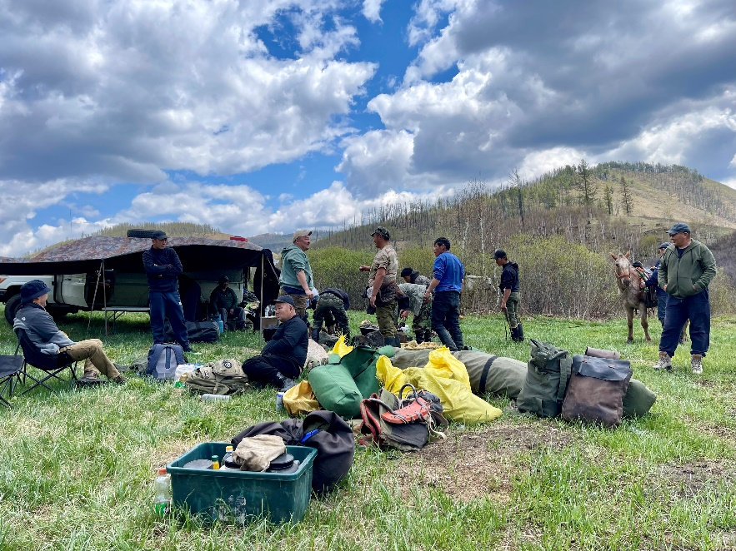
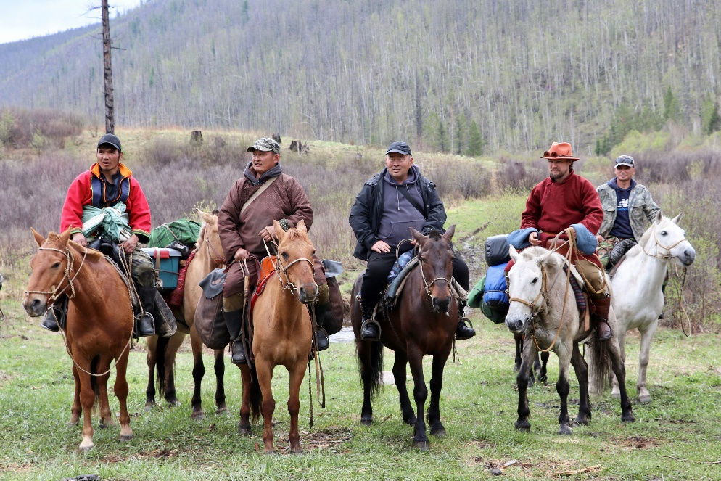
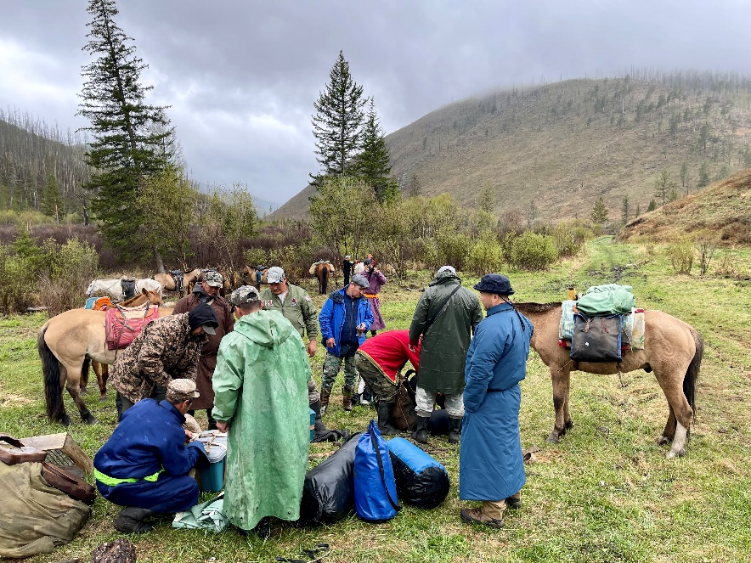
Success Factors
A group of motivated, capable local citizens
Support from local government, PAA and rangers, GIZ Project
Great location, very close to the target market (UB)
Well-known attraction (Asralt Khairkhan)
Increasing demand for shorter horse treks

Slide 8
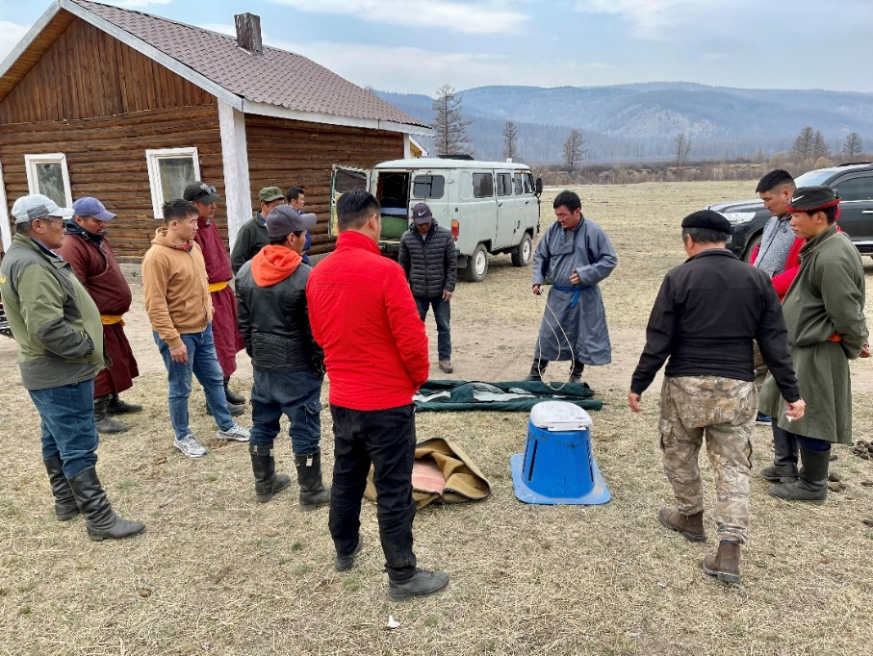
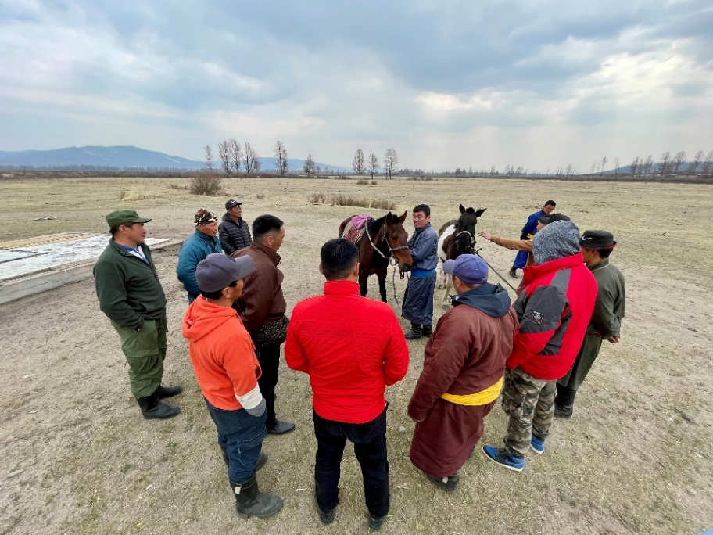
Reasons for lack of Success
Lack of motivation among local people
“Project Weariness” among local people
Distrust among governmental and non-governmental stakeholders
Lack of certain preconditions that Tourism Development relies on to be a successful development tool
Lack of business savviness
Lack of market access
Frustration due to exaggerated expectations
Challenging natural & climatic conditions
Need for Longer term support

Slide 9
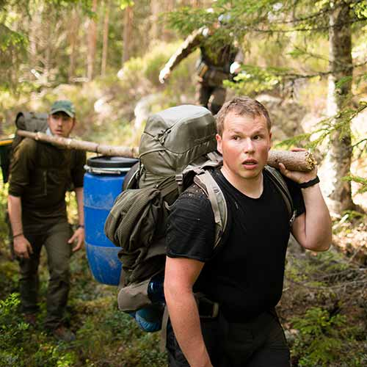
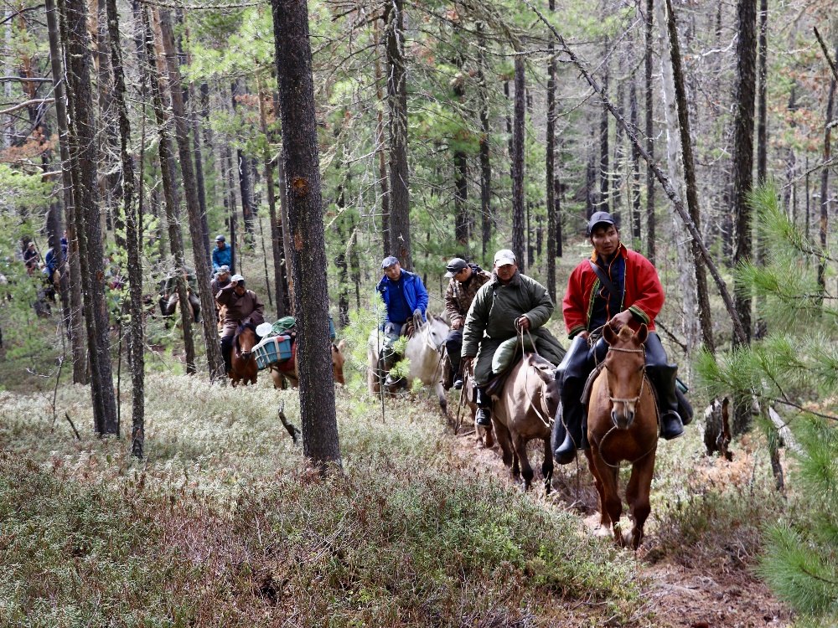
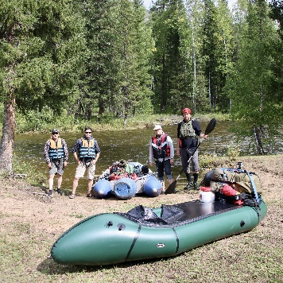
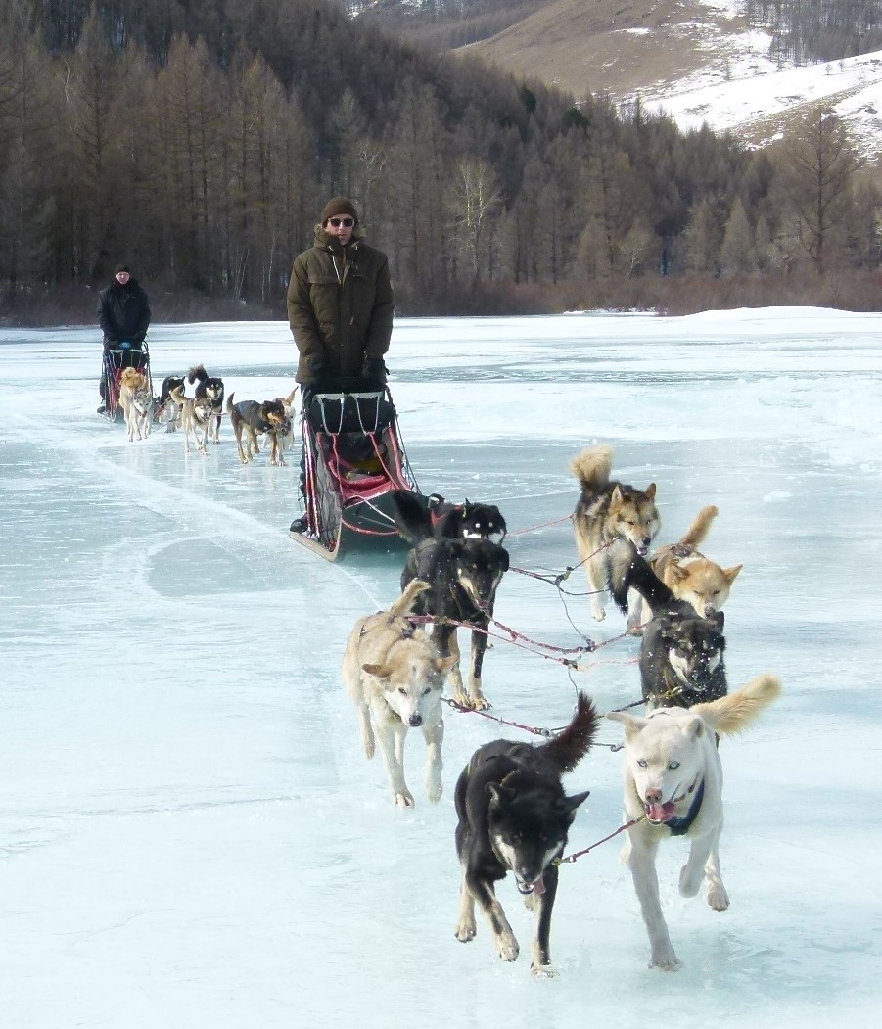
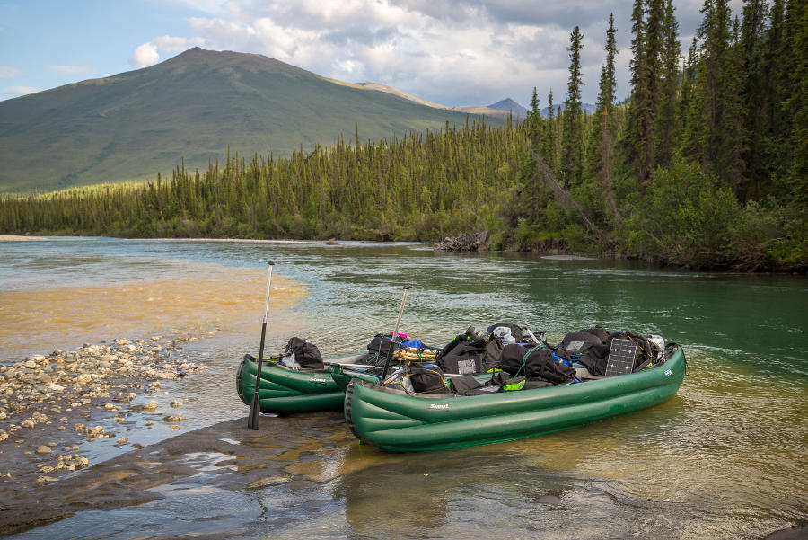
Special Interest Tourism in and around Khan Khentii Strictly Protected Area
Uninhabited taiga wilderness relatively close to Ulaanbaatar (no domestic flights)
Attractive forest-steppe landscapes in the Western & Eastern buffer zones
UNESCO World Heritage Site "Great Burkhan Khaldun Mountain and its surrounding sacred landscape"

Slide 10
What We can we offer?
Local knowledge
certain privileges (based on contractual agreements)
Good Contacts to local communities (in the Buffer Zone)
Rangers as local guides
What we expect?
Long term interest
Reliability
Commitment to Sustainability (LNT)

Slide 11
Roundtable Meeting on the
Potential of Special Interest Tourism
in and around
Khan Khentii Strictly Protected Area
… planned for Spring 2025
markus.pesch@giz.de

