Slide 1
Community Based Tourism
Business
Practice
Jan Wigsten
Sweden - Mongolia
2025

Slide 2
A private sector perspective
For herder-friendly tourism

Slide 3
CBT Business Practice
International case: Namibian conservancies.
Spatial Development Plans for Mongolia

Slide 4
What country is the least populated on Earth?

Slide 5
What country is the second least populated on Earth?

Slide 7
Namibia
842 290 sq.m.
Good road network
Coastal
Desert country
English language
Growing wildlife populations
Successful tourism
Few worldwide flights
Regional tourism market available by road

Slide 8
Mongolia
1 565 000 sq.m.
Arctic climate, seasonal tourism
Land-locked
Low proficiency of English
Few worldwide flights
Recent regional tourism market

Slide 9
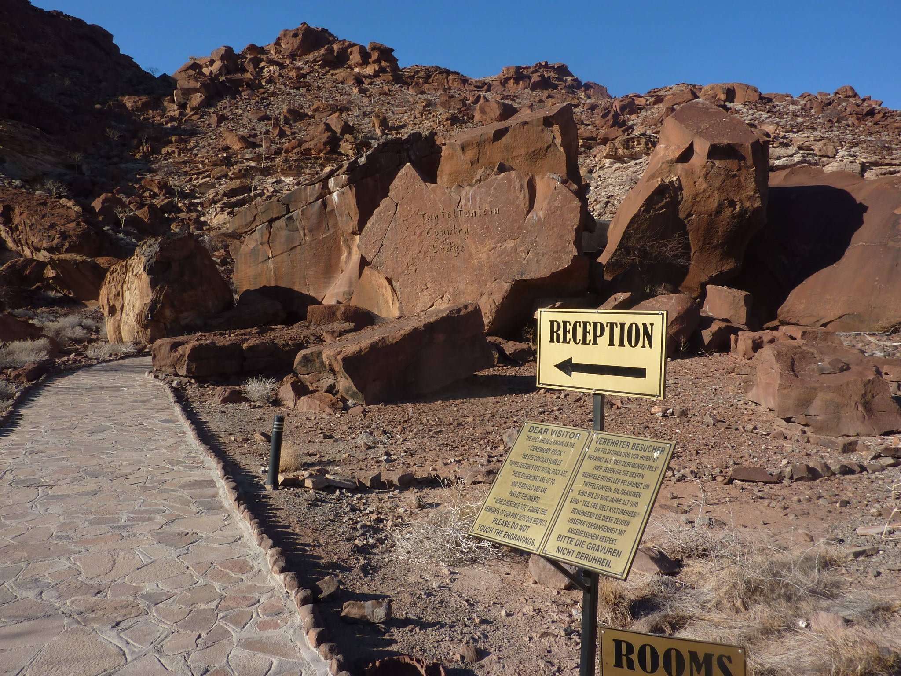

Slide 10
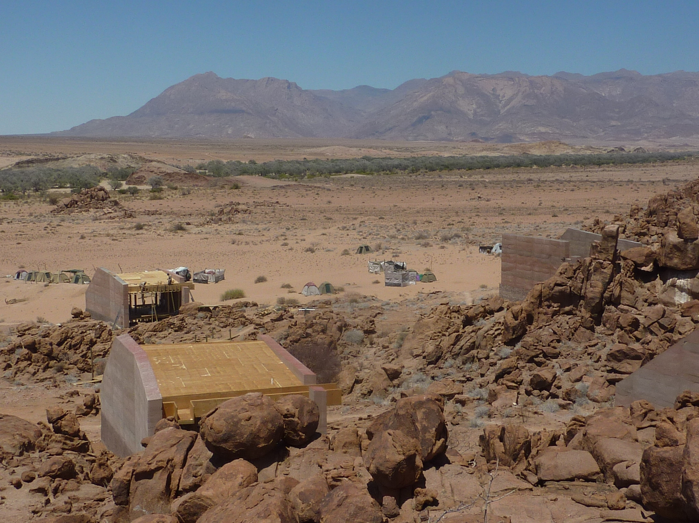

Slide 11
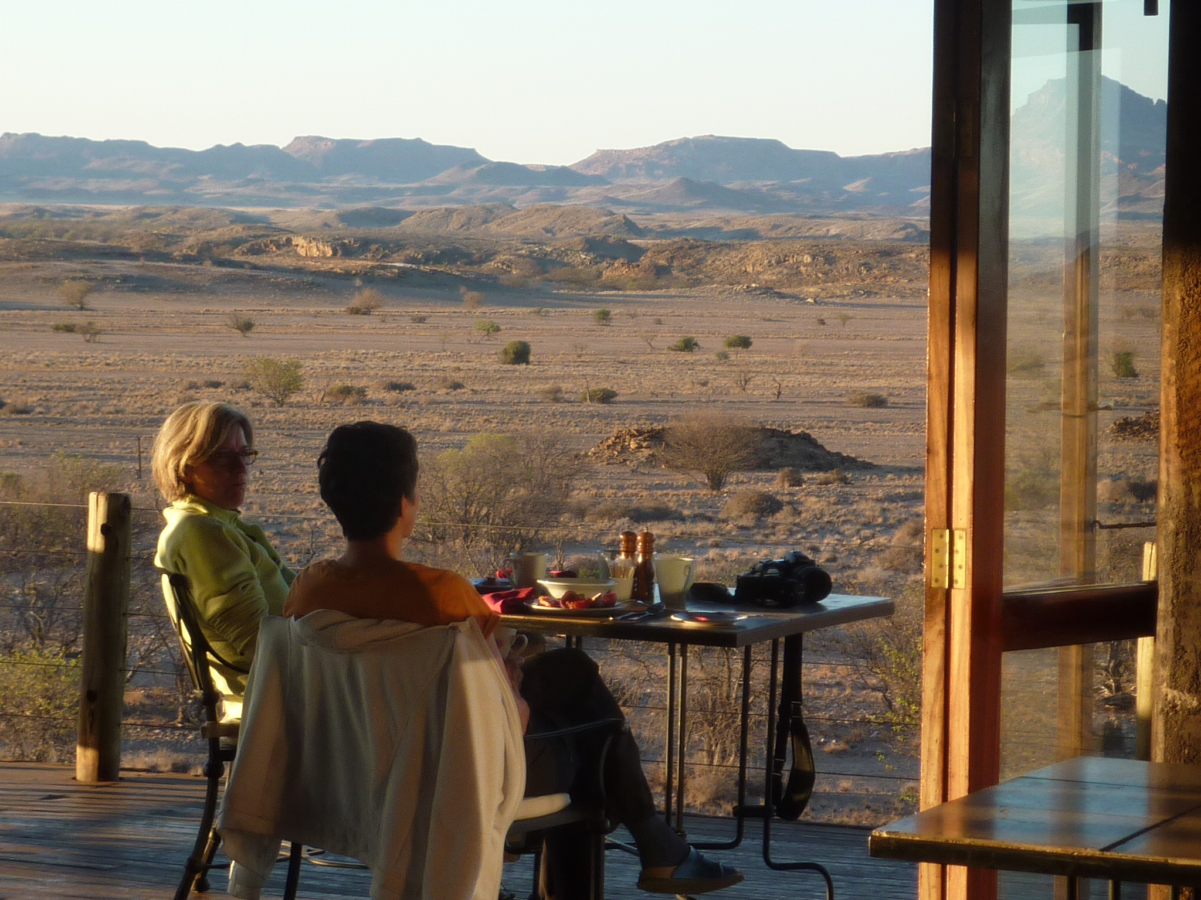

Slide 12
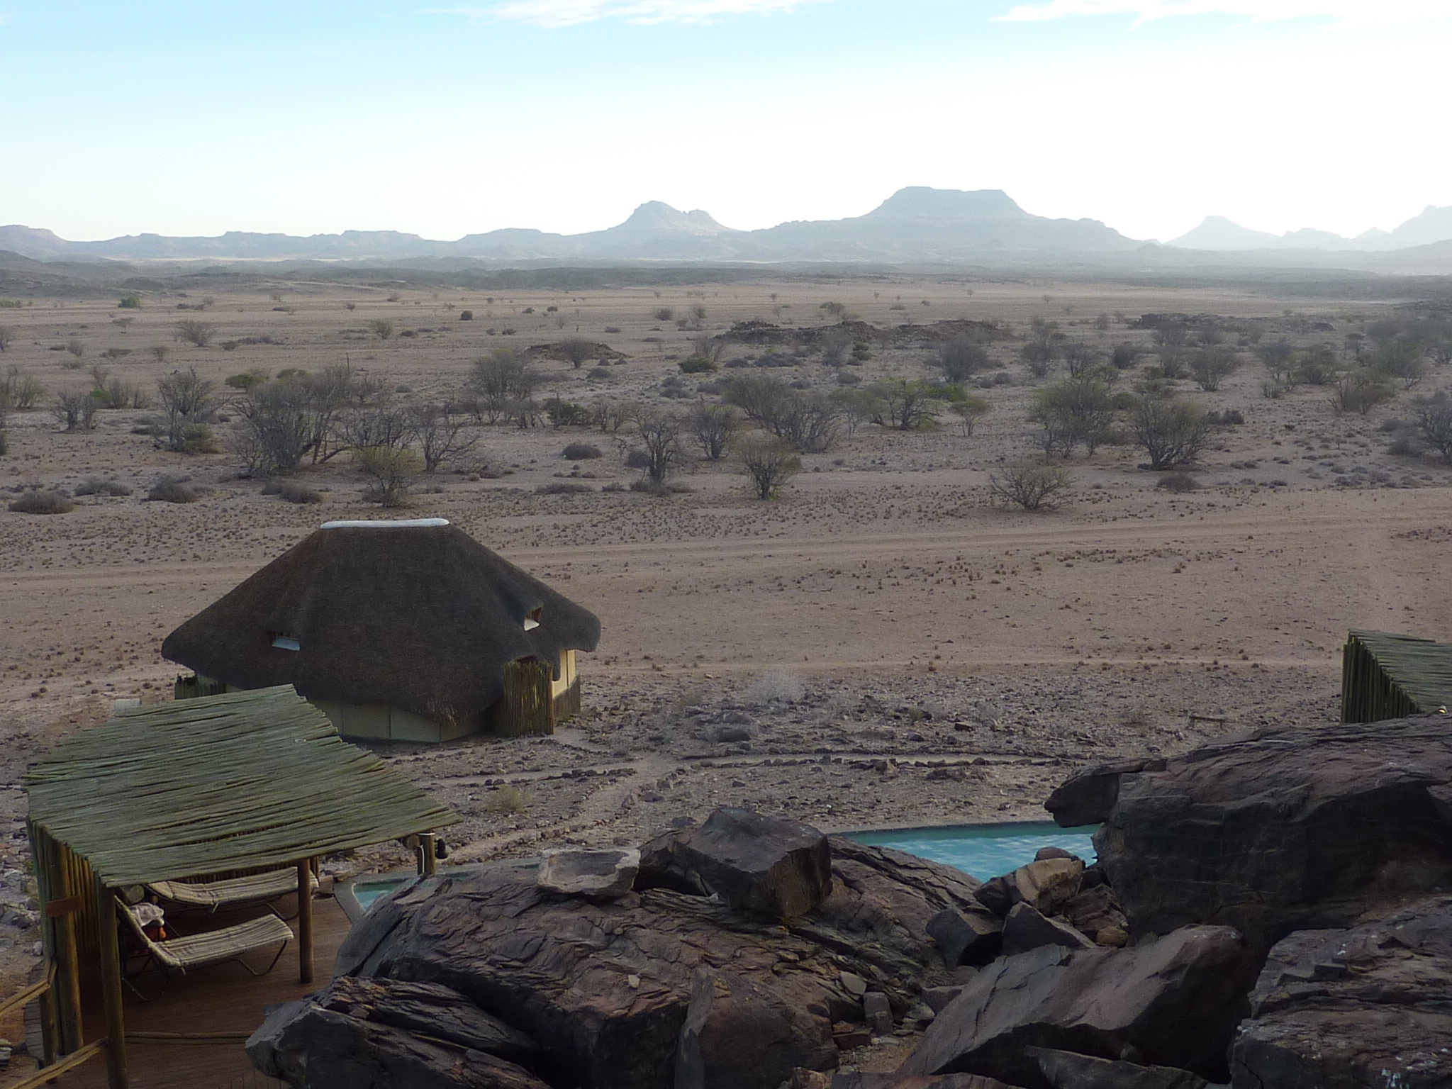

Slide 13
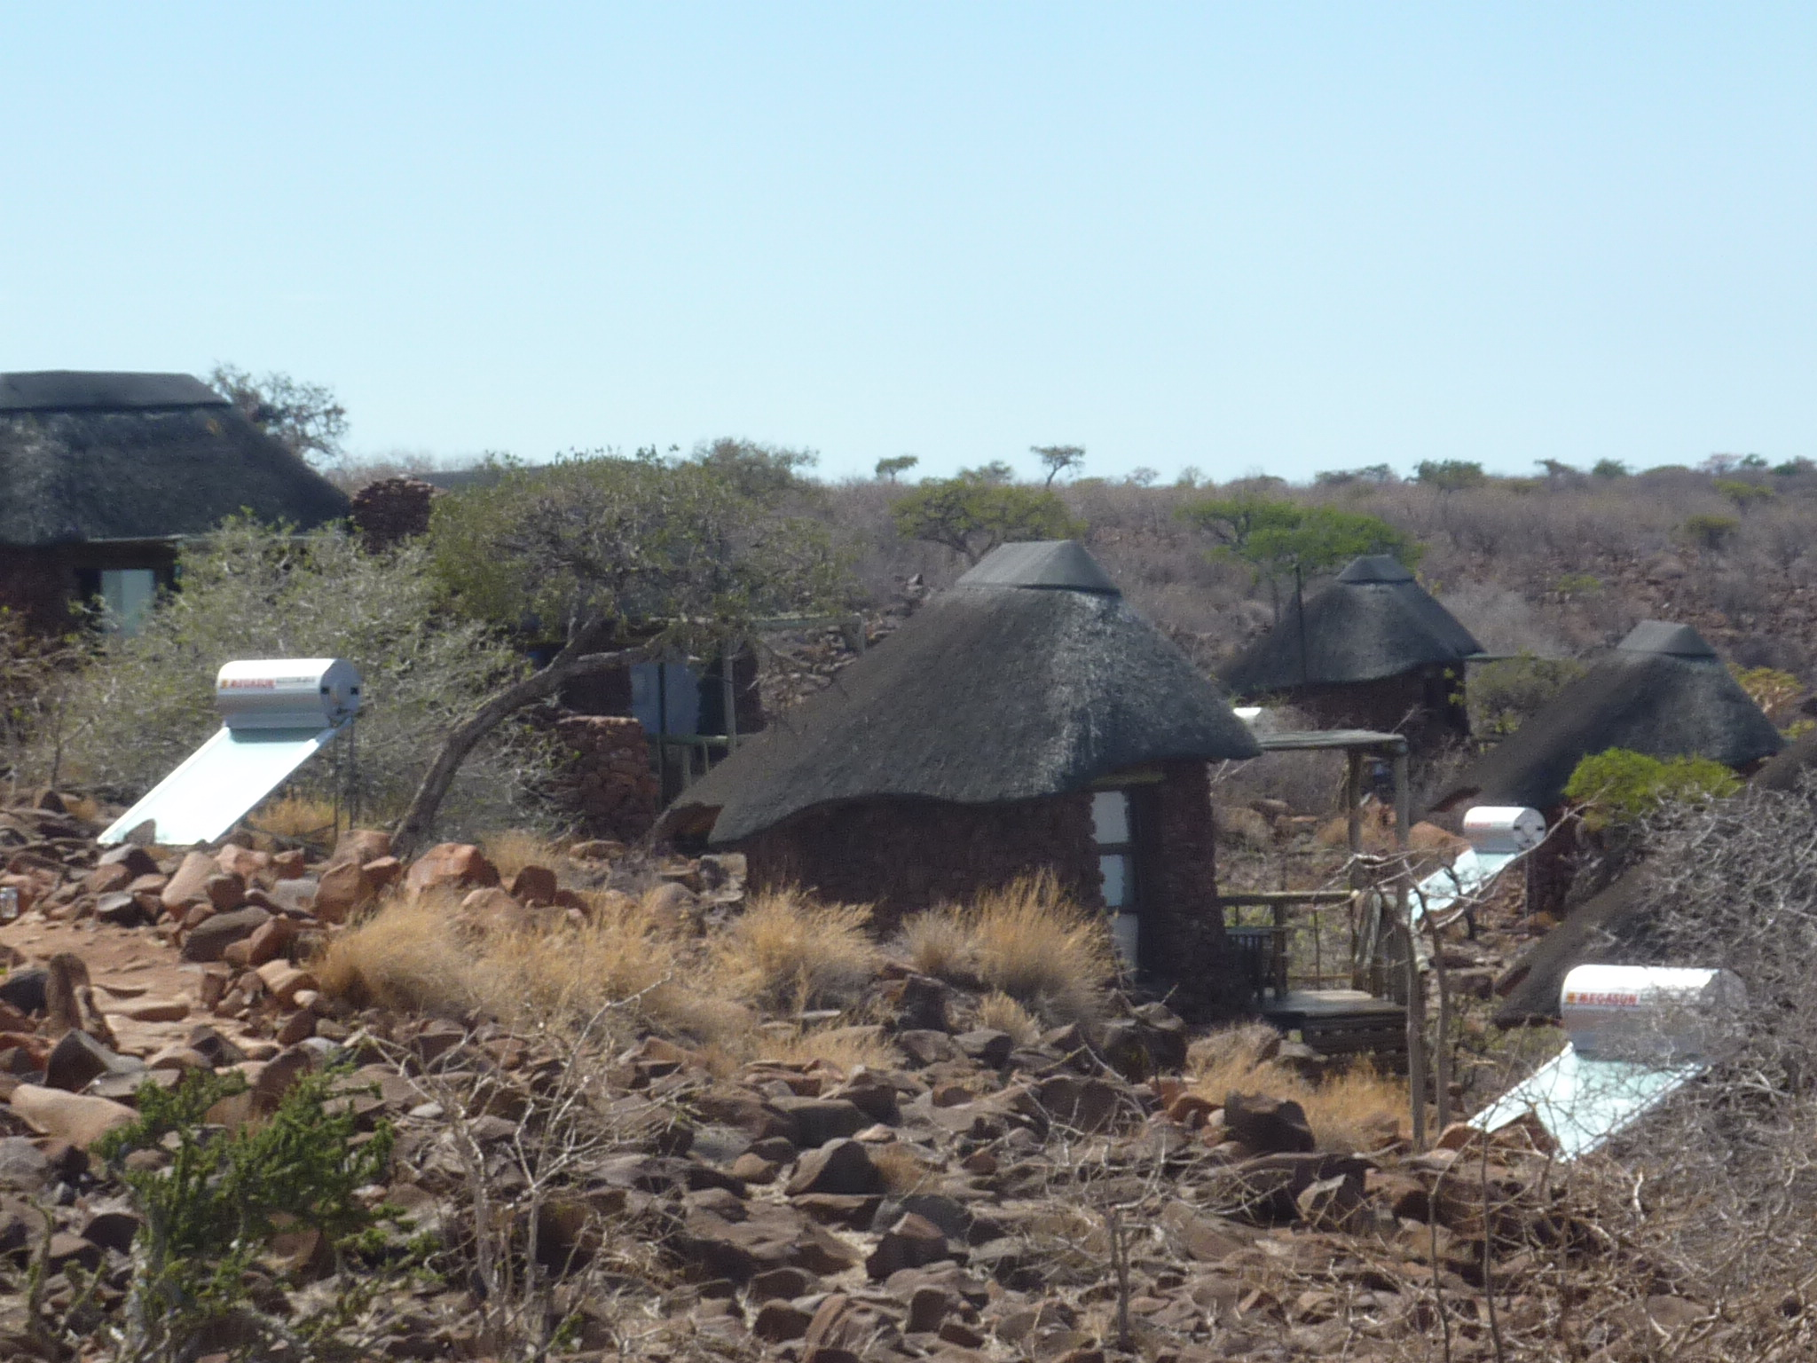

Slide 14
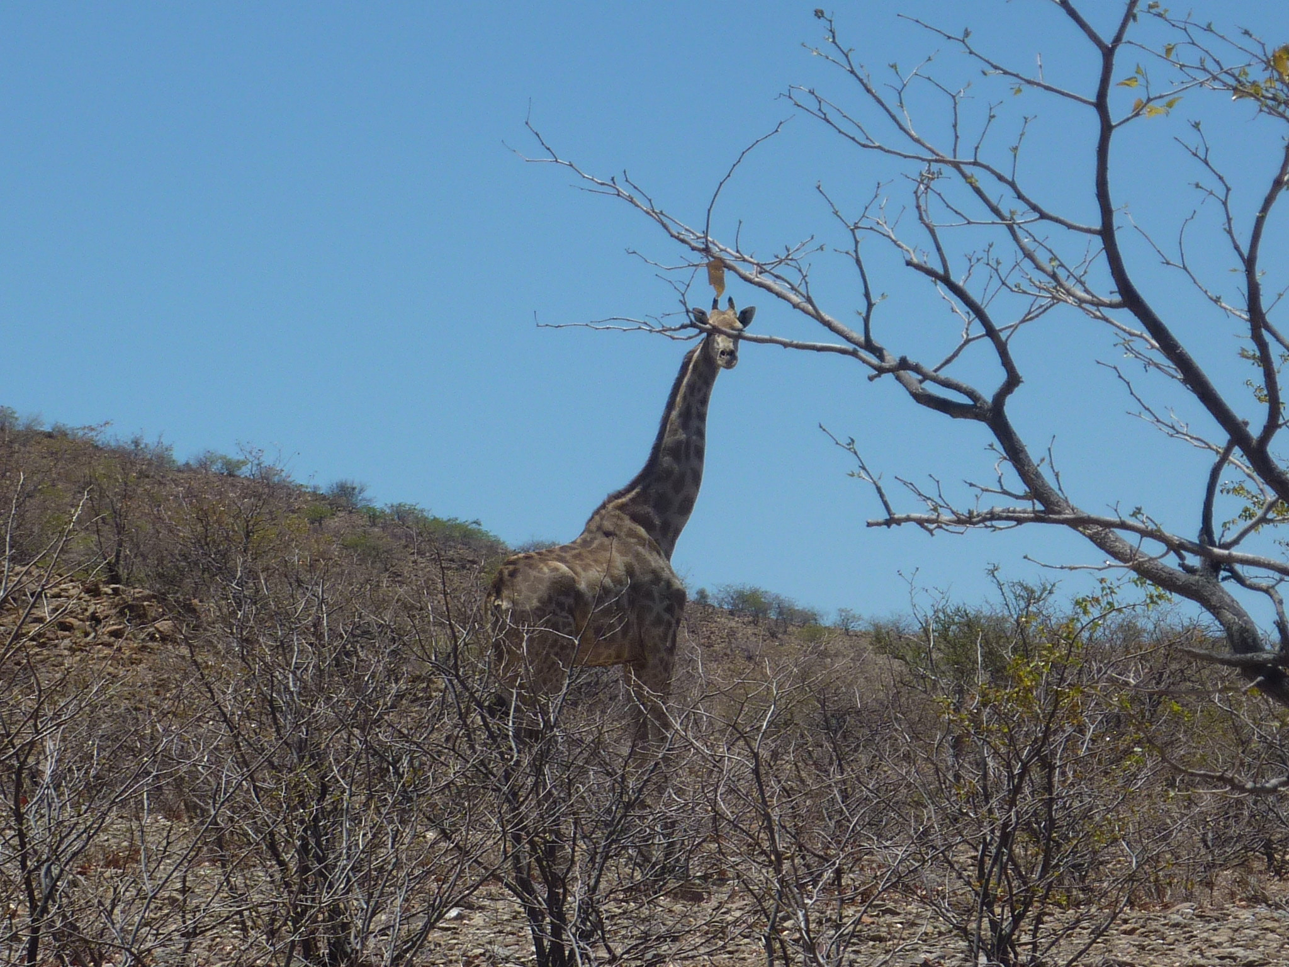

Slide 15
What is a Conservancy?
A voluntary community member association, residents of a specific land space for the purpose of sustainable harvest

Slide 16
Nökhörlöl!
Similar. But community cannot be signatories with private enterprise. Soum and aimag governor must be. (=max 4 years).
The space of land not well defined. I.e. no spatial developmen plan. (Орон зайн хөгжлийн төлөвлөгөө)
No head tax for tourism entry

Slide 17
Namibian conservancies
Community leaders are empowered to sign business deals with private enterprise.
Majority is for sustainable tourism use based on wildlife resource.
Business contracts are variable, often brokered by 3rd party NGOs such as WWF for legal advice.

Slide 18
Wildlife growth
Conservancy members are patrolling and protecting wildlife on their land.
Evidence of wildlife populations growth despite poor populations.
Desert lion, Desert elephants, Rhinos, Cheetah, Giraffes.

Slide 19
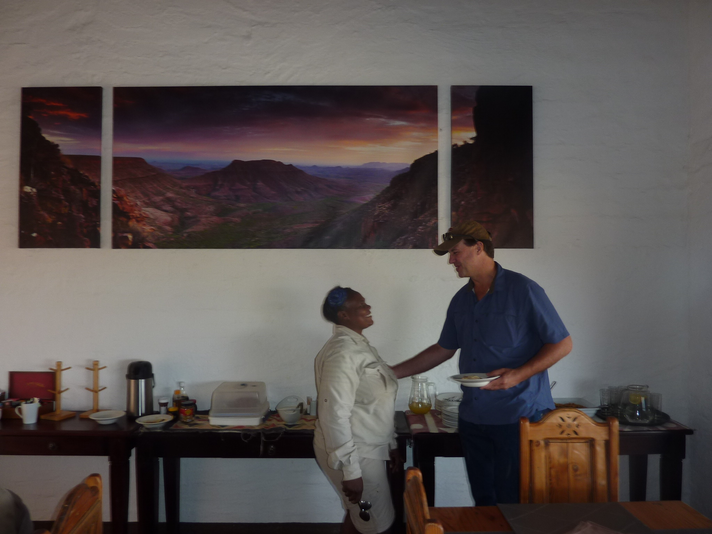

Slide 21
50 percent increase of room rate in 10 years. USD 112 per room per night in 2005

Slide 22
USD 226 per room per night in 2014

Slide 24
Small profit first seven years. Thereafter est. USD 130 000

Slide 27
Sustainable markets.......
may put sustainable dollars into good use

Slide 28
Connecting community enterprises to global markets
Contracting with customers across borders

Slide 29
Lake Hövsgöl

Slide 30
Lake Hövsgöl

Slide 31
Mongolia have so much space.
Why is tourism concentrated to so few places?

Slide 32
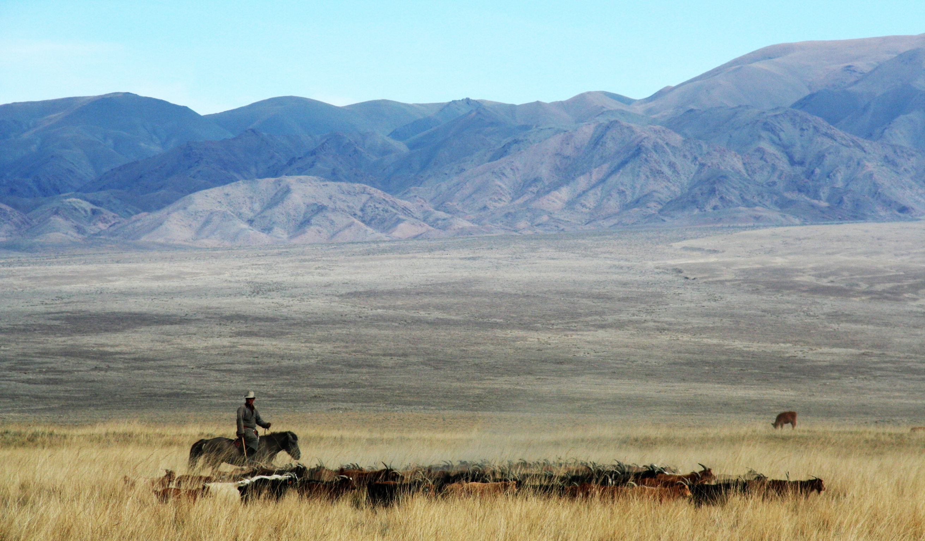

Slide 33
”Spatial Development Plan” Орон зайн хөгжлийн төлөвлөгөө
is not a Land Use Plan

Slide 34
Elsen Tasarkhai

Slide 35
Definition of Roles
Who will do what?
In what order?
On whose mandate?
With what money?
Timeline?

Slide 36
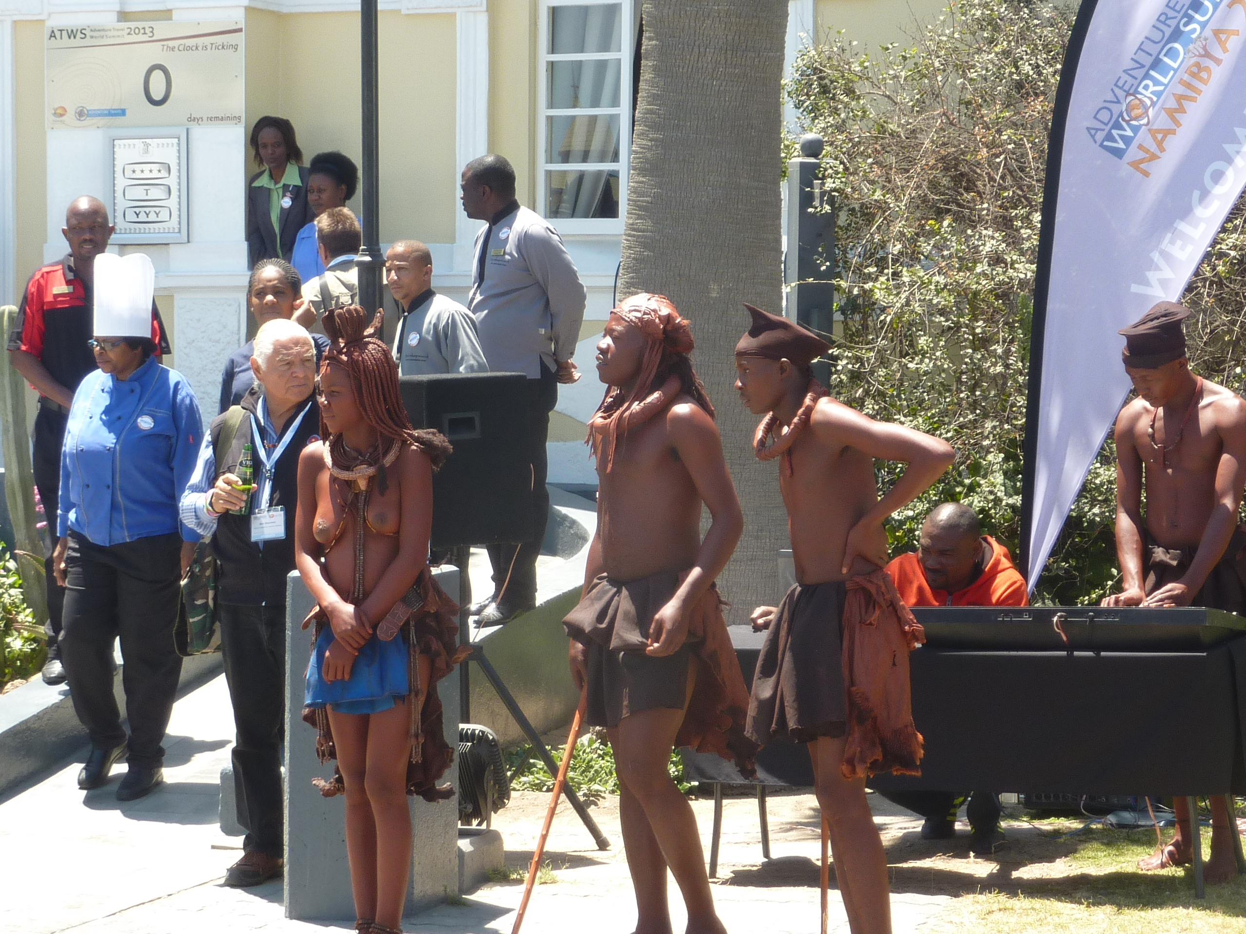

Slide 37
We work with sustainable dollars
They are also Green!

Slide 38
Thanx!

