Slide 1
Analysis of Source Markets
Hannah Pearson Regional Director APAC
Adventure Travel Trade Association

Slide 2
Why should we look to diversify source markets?
Case studies for destinations who have diversified
What to consider when looking at a new source market
Key global trends
Key trends by source market
Key takeaways
© ATTA / Daniel Santos

Slide 3
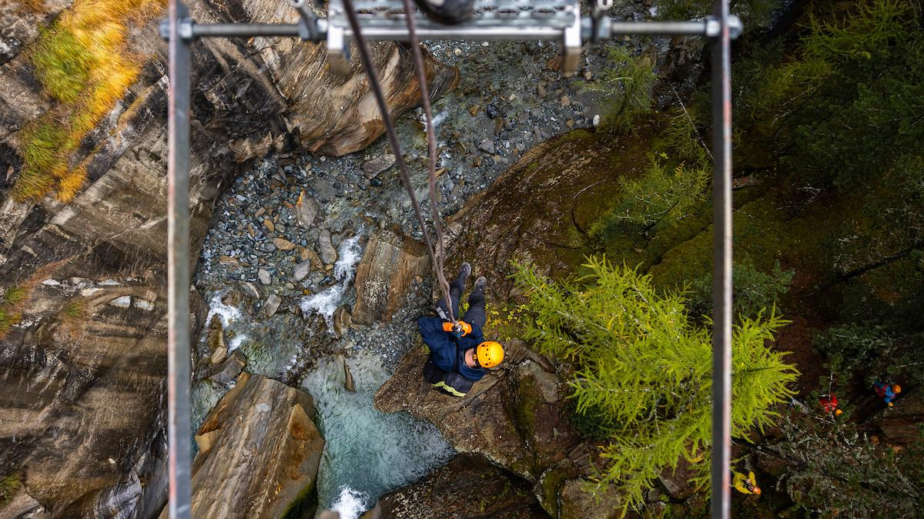
Part 1:
Why should we look to diversify source markets?
© ATTA / Hassen Salum

Slide 4
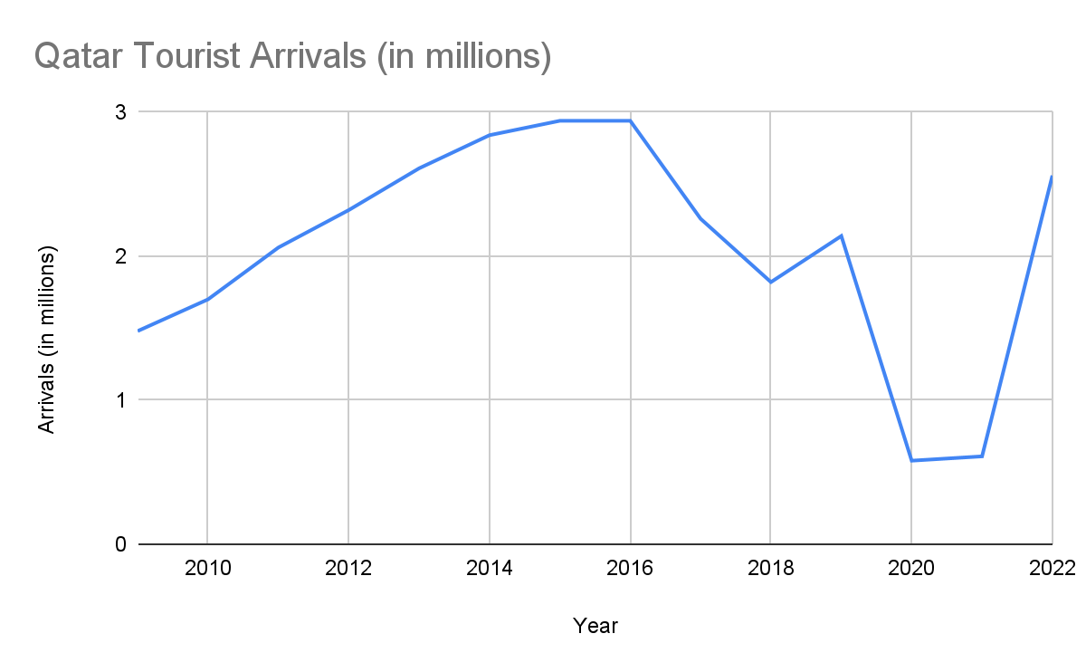
Makes you more resilient to unexpected scenarios
Notes:
QATAR and how blockade impacted tourism arrivals numbers.

Slide 5
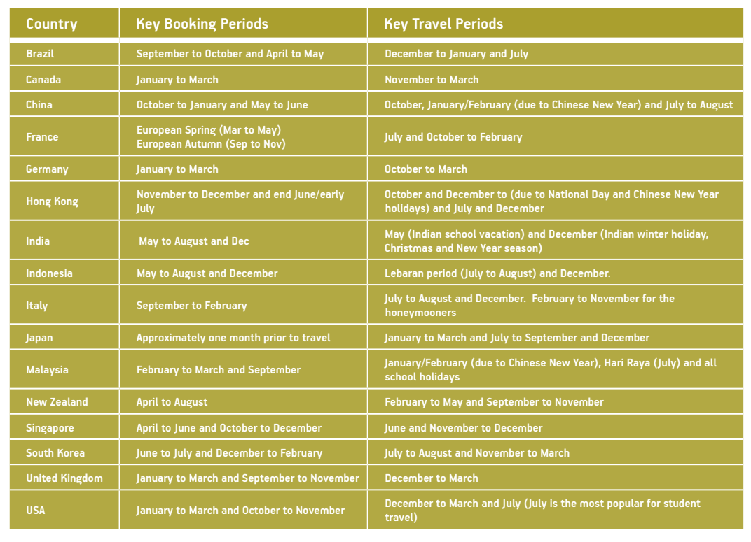
Extends the tourism season
Source: https://teq.queensland.com/content/dam/teq/corporate/corporate-searchable-assets/industry/learning/PlanforInboundSuccess.pdf
Notes:
Add source.

Slide 6
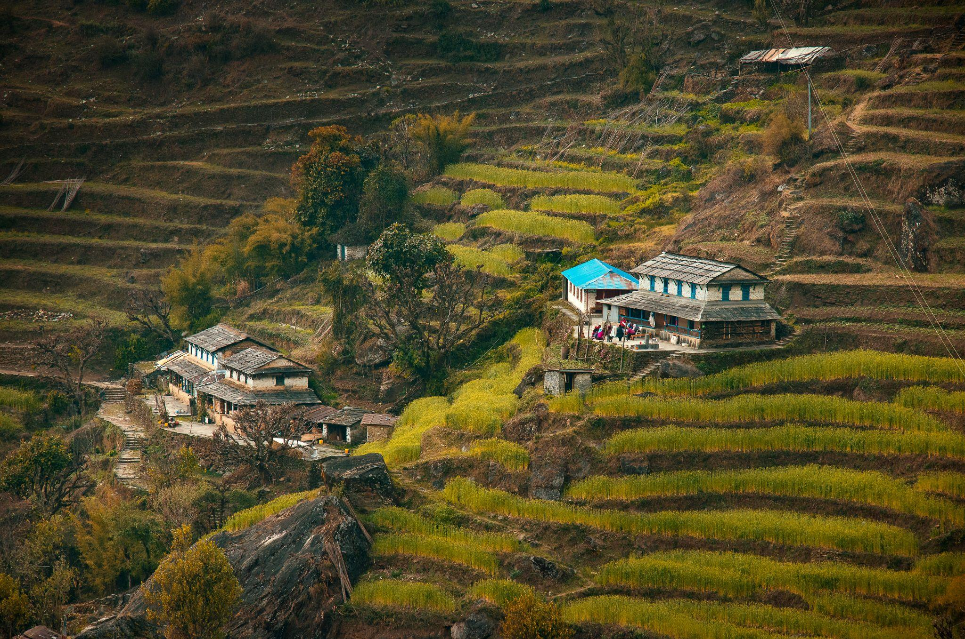
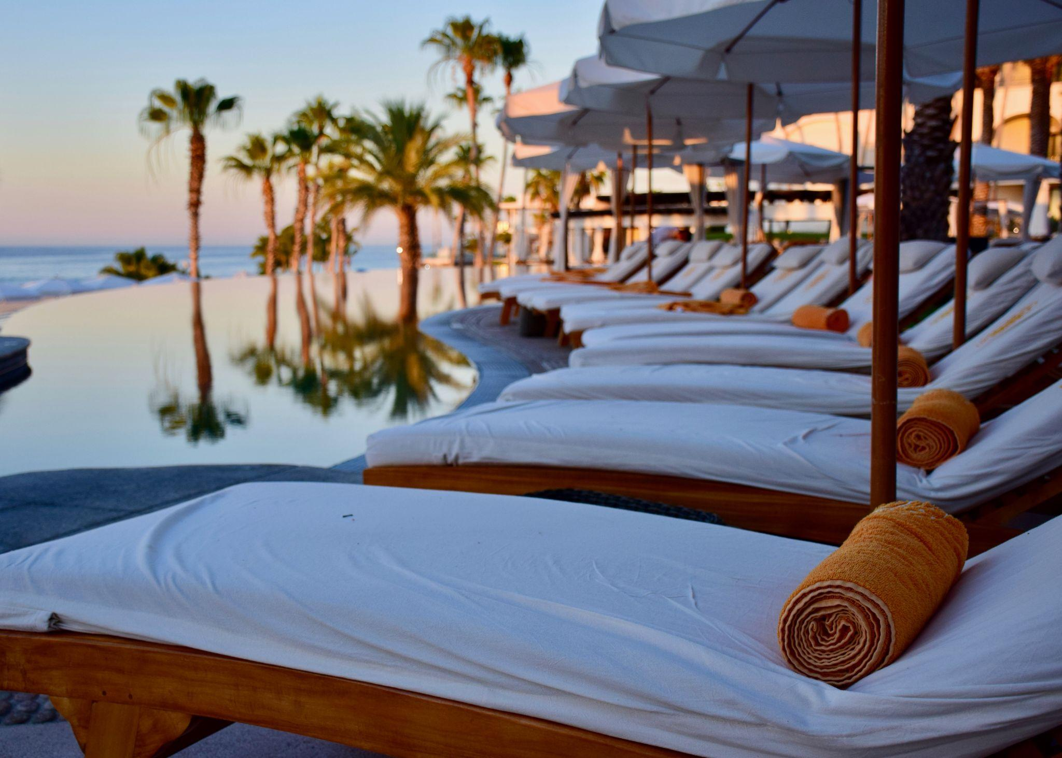
Provides opportunities for the whole tourism supply chain
Notes:
Image of homestay/ image of resort

Slide 7
Part 2a:
Case study: Japan’s many identities

Slide 8
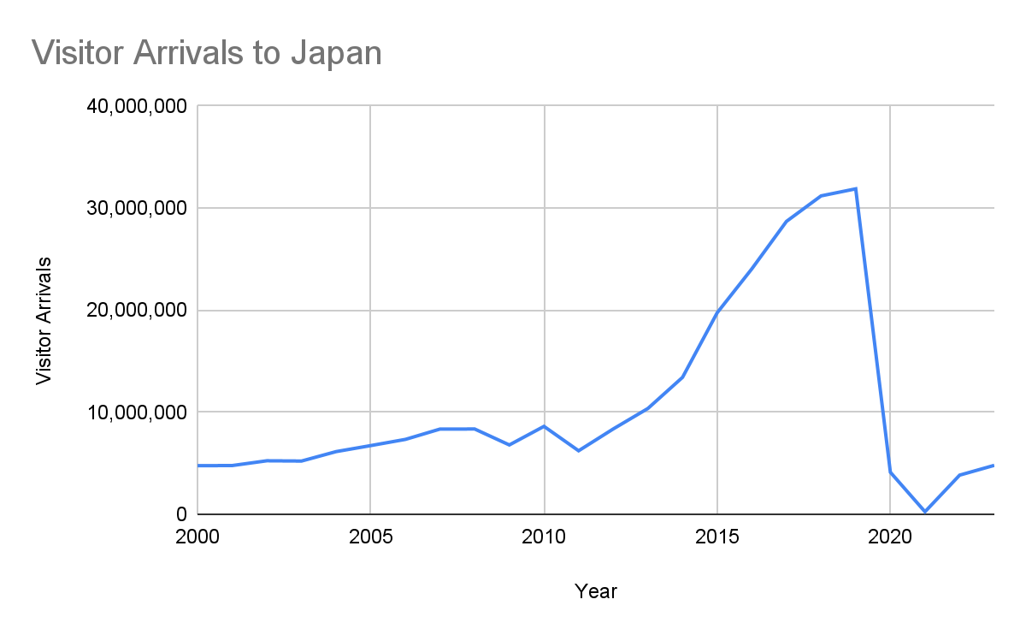
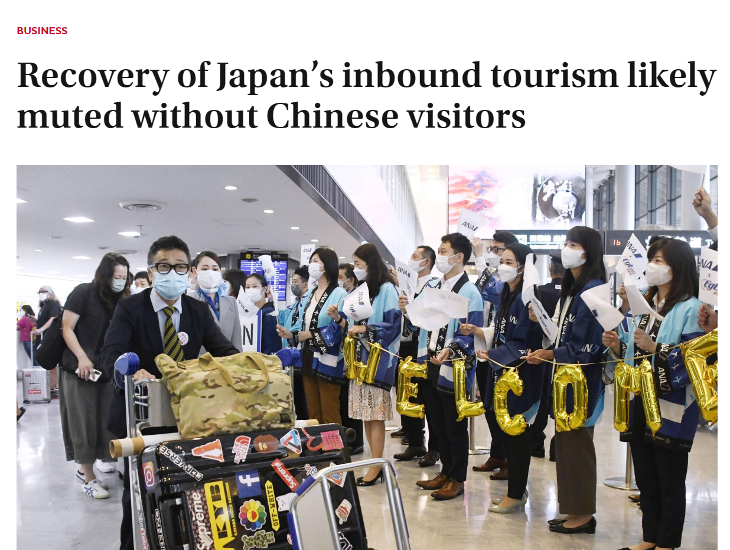
Japan’s international arrivals started to rocket from 2013
Notes:
Add graph of international arrivals in general. Then split it by nationality.

Slide 9
China gained a market share from 13% to 30% in 7 years
2013 | 2014 | 2015 | 2016 | 2017 | 2018 | 2019
Korea (24%) | Taiwan (21%) | China (25%) | China (26%) | China (26%) | China (27%) | China (30%)
Taiwan (21%) | Korea (21%) | Korea (20%) | Korea (21%) | Korea (25%) | Korea (24%) | Korea (18%)
China (13%) | China (18%) | Taiwan (19%) | Taiwan (17%) | Taiwan (16%) | Taiwan (15%) | Taiwan (15%)
United States (8%) | Hong Kong (7%) | Hong Kong (8%) | Hong Kong (8%) | Hong Kong (8%) | Hong Kong (7%) | Hong Kong (7%)
Hong Kong (7%) | United States (7%) | United States (5%) | United States (5%) | United States (5%) | United States (5%) | Thailand (5%)
Notes:
Add graph of international arrivals in general. Then split it by nationality.

Slide 10
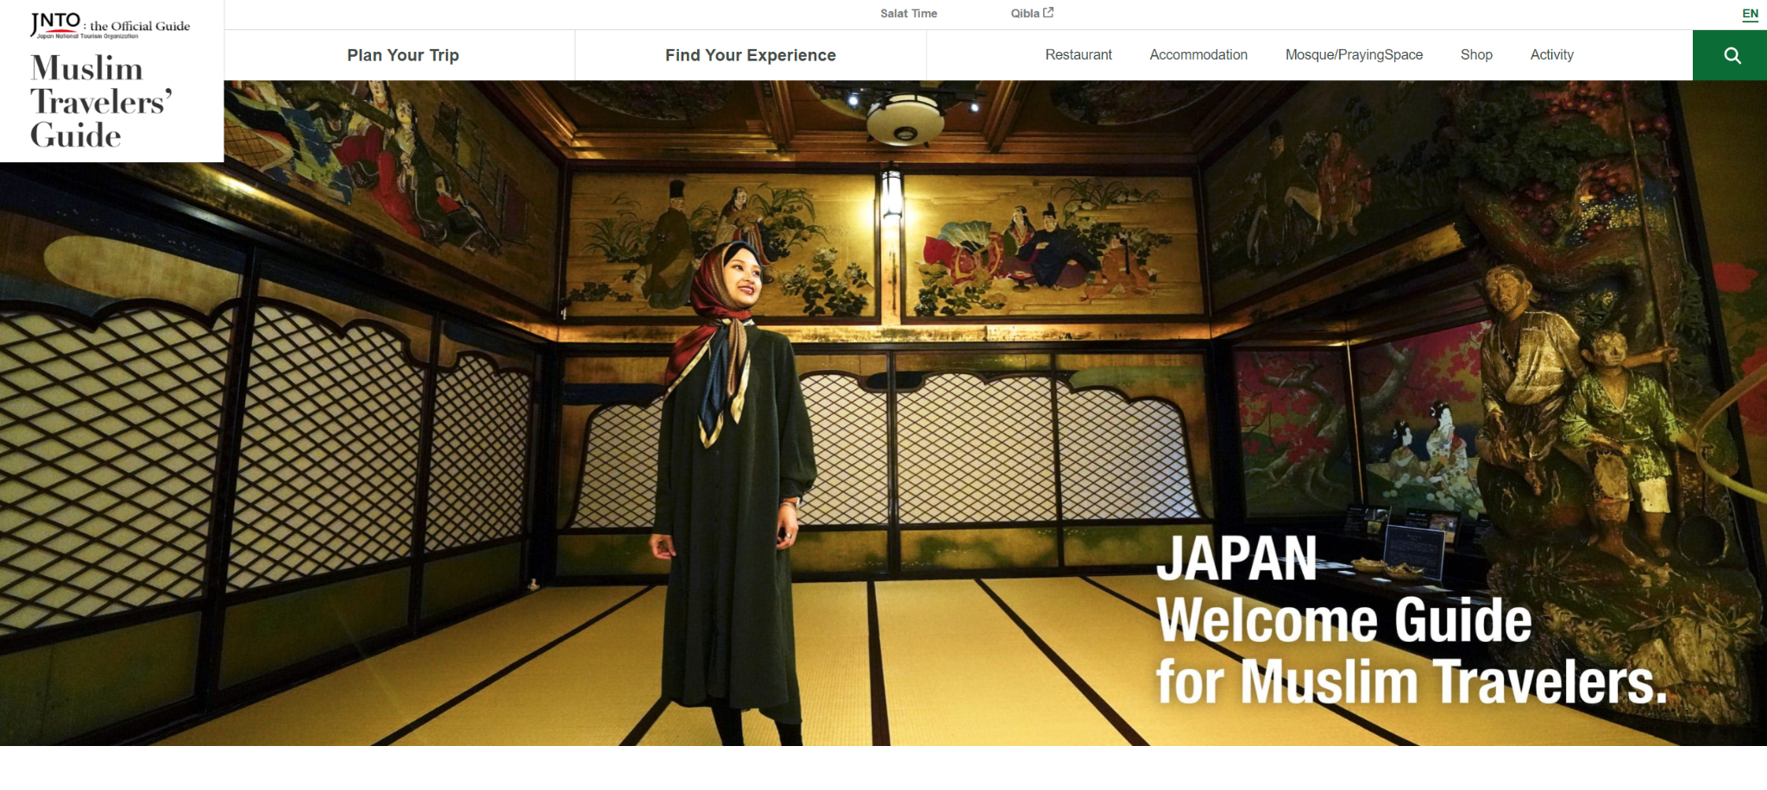
Targeting the Muslim Southeast Asian traveller
Notes:
Niches - Muslim friendly travel SEA

Slide 11
Targeting LGBT+ travellers from Latin America
Osaka Convention & Tourism Bureau attended the LGBT+ Turismo Expo 2022, one of the largest LGBT+ expos in Latin America, held in Rio de Janeiro, Brazil.
Notes:
International LGBTQ+ Travel Association (IGLTA) announced today that it has selected Osaka, Japan as the destination for its 2024 Global Convention, first ever convention in Asia
https://visitgayosaka.com/
https://www.iglta.org/articles/post/iglta-selects-osaka-japan-as-its-2024-global-convention-destination/

Slide 12
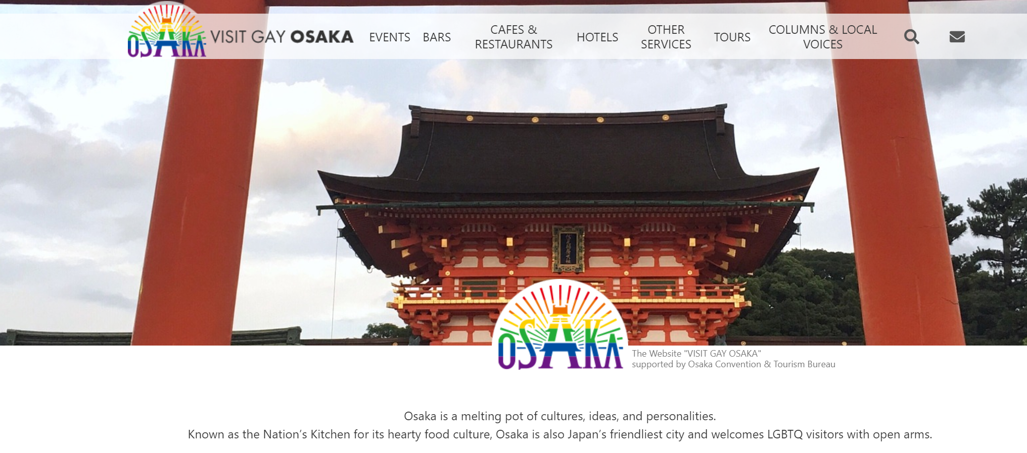
Osaka hosted the 2024 IGLTA Global Convention
Notes:
International LGBTQ+ Travel Association (IGLTA) announced today that it has selected Osaka, Japan as the destination for its 2024 Global Convention, first ever convention in Asia

Slide 13
Positioning itself as an adventure destination
Notes:
Adventure travel - ATWS, AdventureWEEKs, etc

Slide 14
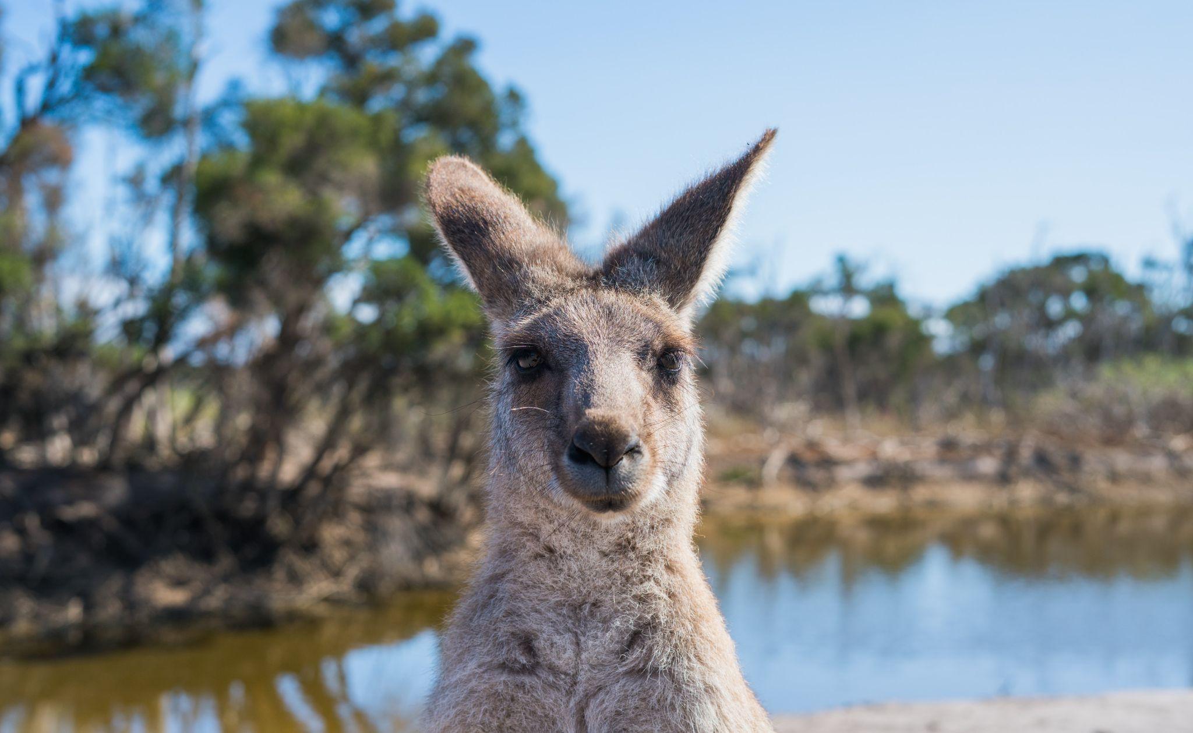
Part 2b:
Case Study: Tourism Australia’s 2030 tourism strategy rethink

Slide 15
Tourism Australia: Thrive 2030
Collaborate
Modernise
Diversify
Notes:
Australia’s national strategy for the long-term sustainable growth of the visitor economy.
THRIVE 2030 aims to return the sector to pre-pandemic visitor spend and sustainable growth:
returning it to $166 billion by 2024
growing it to $230 billion by 2030.

Slide 16
Tourism Australia: Thrive 2030
Priority 6: build markets and attract visitors
“Attract high-value visitors through coordinated, innovative, focused and personalised visitor attraction strategies that are targeted at a re-balanced mix of domestic and international markets. Unique circumstances mean we must adopt a unique and targeted approach to market development. Targeted and nuanced marketing appropriate for different markets, and developing appropriate product, will be needed. In the longer term, improved data and market research will support a strategy to build a diversified portfolio of core markets, balanced by new and emerging markets. Indicative success measures: Increase in visitor spend (yield) from selected geographic markets and visitor segments; increase in visitor dispersal; changes in market share; return on investment from new marketing strategies.”

Slide 17
No | Action | Action lead (Partners)
6.3 | Develop an International Diversification Strategy for the visitor economy to identify emerging markets for travel and education; and strengthen key bilateral relationships in the Indo-Pacific region and beyond through the growth of people-to-people links and Brand Australia marketing. | Austrade, TA (S&TG)
 | The diversification strategy will also look at attraction of certain growing (and higher yield) traveller cohorts including people seeking luxury, nature and cultural experiences.
6.4 | Implement a coordinated marketing strategy to re-establish core markets and grow emerging international markets. | TA, S&TG
6.5 | Develop and implement a coordinated approach for direct, affordable, long-haul flights to Australia. | VE industry
6.6 | Ensure Australia has a safe, affordable, and competitive visitor visa system to maintain and grow market share. | Home Affairs

Slide 18
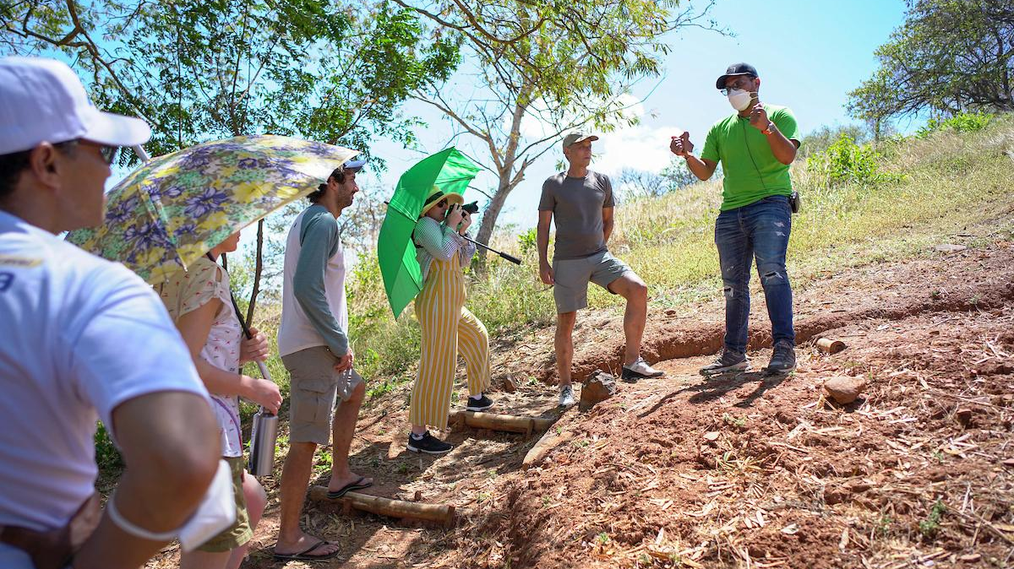
Part 3:
What to consider when looking at a new source market
© ATTA / Daniel Santos
© ATTA / Daniel Santos

Slide 19
Considerations when looking at new source markets
Consider | Impact | Example
Accessibility | Effects how much potential a market could have in reality | Number of flights/ connections from a source market, visa policy
Religion | Can impact food, dress and activities | Halal, Kosher and vegetarian foods
Pace | Needs to be faster for some visitors | East Asian travellers typically like to travel faster
Punctuality | Some markets need more reinforcement | Indian market is known for being late, German market punctual
Notes:
Partnerships with other tour operators
Attending ITB Berlin with own stand

Slide 20
Considerations when looking at new source markets
Consider | Impact | Example
Language | Communications with the guest | Must ensure that all safety guidelines are understood
Market intermediaries | Impacts which travel partners to make contact with | Some markets prefer to use more local wholesalers than others
Sensitivities | Need to be aware of cultural sensitivities, e.g. alcohol, clothing | Muslims, Jain will traditionally not drink alcohol
Food & Dining | Can impact what to provide | e.g. Asian travellers may have more lactose intolerances
Notes:
Partnerships with other tour operators
Attending ITB Berlin with own stand

Slide 21
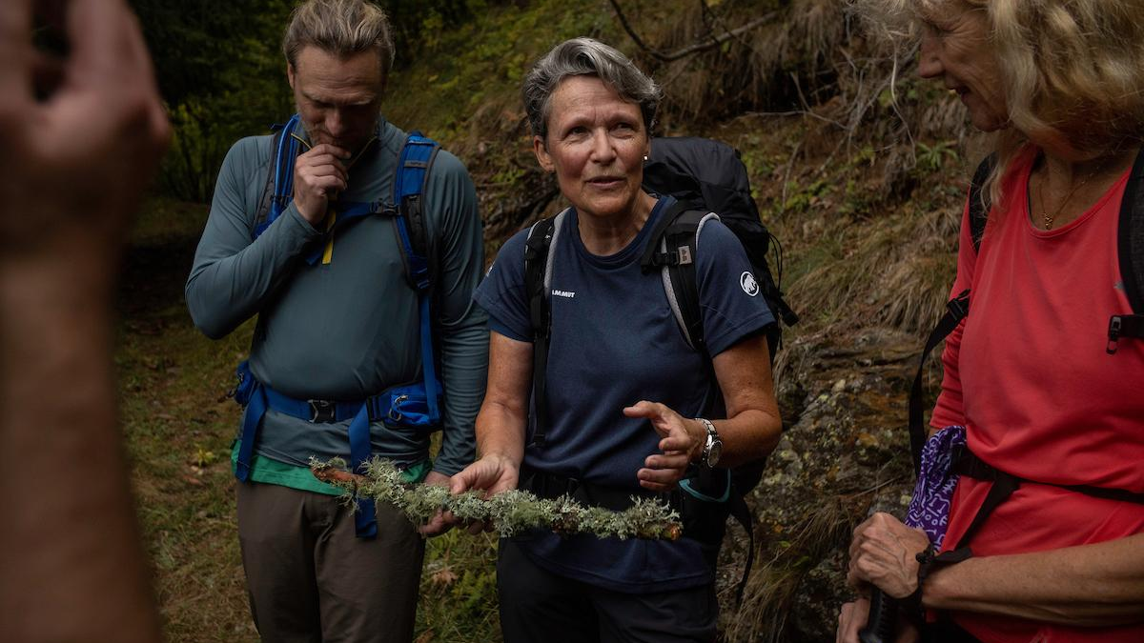
Part 4:
Key Global Trends
© ATTA / Matt Corliss

Slide 22
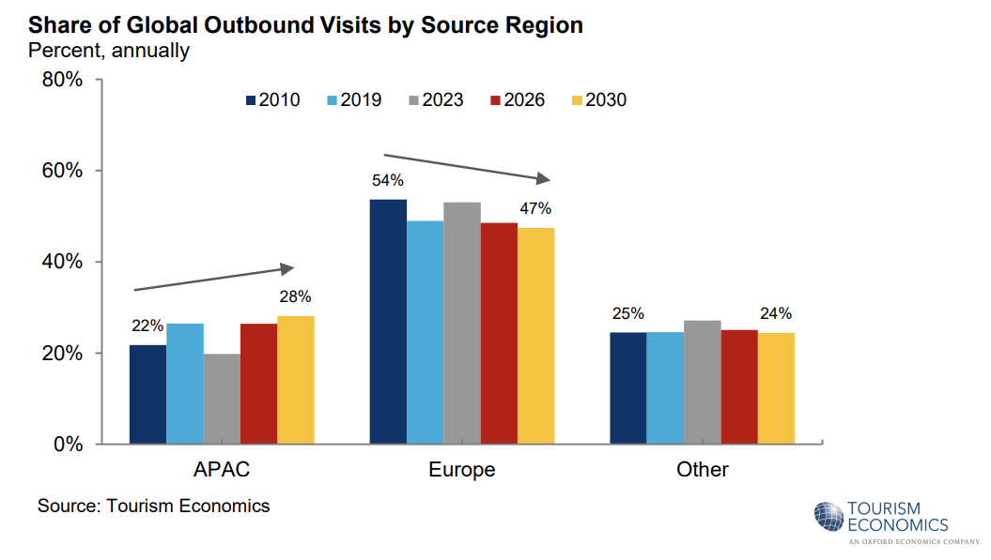

Slide 23
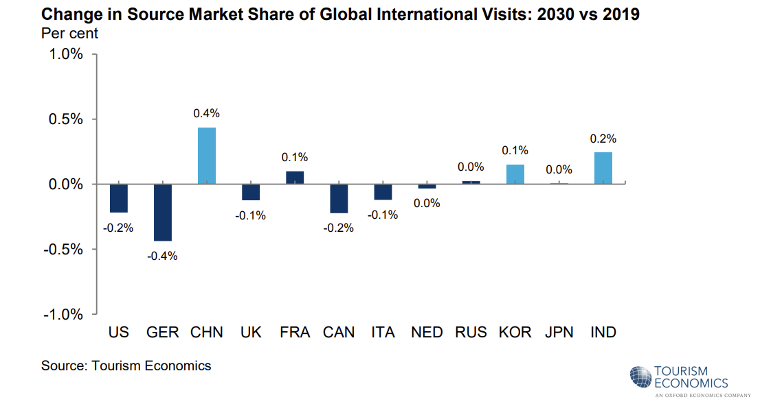

Slide 24
Booking.com 2025 trends
Noctourism
Passports to Immortality
Men-only wellness retreats
Alternative itineraries
Spending the kids’ inheritance
Adventures for all ages
Neuro-inclusivity
Vintage voyaging
The gate escape

Slide 25
Euromonitor 2025 trends
Slow travel
Immersive experiences
Travel with intent
Value alignment
Connected trips
People-centric

Slide 26
Expedia: Unpack 25
Detour Destinations
Goods Getaways
All-Inclusive Era
Hotel Restaurant Renaissance
JOMO travel
The Phenomena-List
Set-jetting
One Click Trips

Slide 27
Amadeus 2025
New Heydays
Personalised flying
Trailblazer hotels
Asia uplift
Connections IRL

Slide 28
TripAdvisor Trendcast 2025
Waterculturalism
Play it forward
Written in the stars
New ‘Moons
Dynamically sensorial
Global Gaming
Investigative eating
Family Vacays 2.0
Nano Neighbourhoods
Solo-Social
Beauty Voyagers
Sports Trek
Time Tripping
Slow Going

Slide 29
Still huge say-do gap for sustainability
45%
28%
Feel travelling sustainably is important but not a primary consideration when planning a trip
Travellers report they are tired of hearing about climate change all the time
Source: Booking.com Sustainable Travel Report 2024

Slide 30
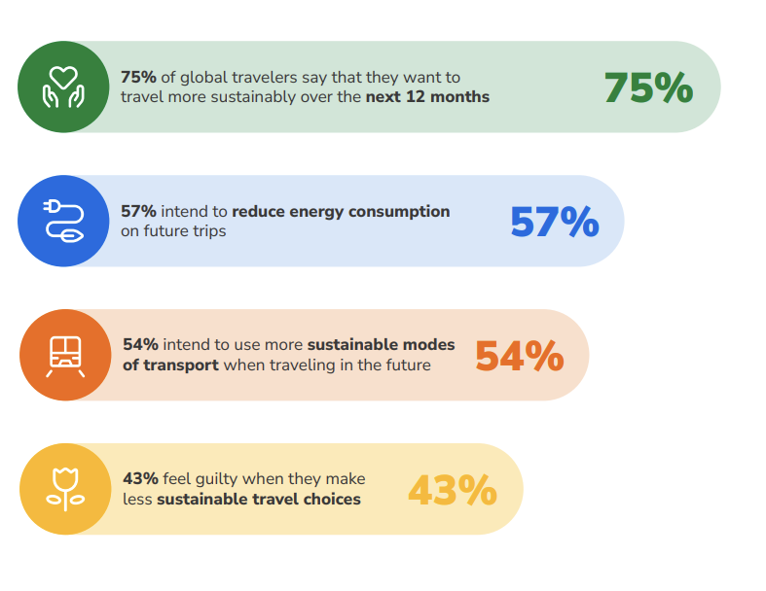
Source: Booking.com Sustainable Travel Report 2024

Slide 31
Travel intent is high for 2025
Will you be travelling in 2025? Percentage answering “yes definitely”
Skift Research Travel Outlook, n= 258 (US), 324 (UK), 261 (Germany), 257 (China), 529 (India), Data as of December 2025

Slide 32
Safety, costs, climate change and overcrowding top of mind
Skift Research Travel Outlook, n= 258 (US), 325 (UK), 261 (Germany), 257 (China), 529 (India), Data as of December 2025

Slide 33
Part 5:
Key trends by source market

Slide 34
Couples without children
5% luxury travellers
NEEDS
MOTIVATIONS
Having fun
Exploring new destinations
Experiencing a sense of adventure
Exploration
Reconnection
Source: Tourism Australia, Nov 2022; Future of Global Tourism Demand

Slide 35
PREFERRED EXPERIENCES
IMPORTANCE OF SUSTAINABILITY
Natural environments
Aquatic and coastal
F&B experiences
Wildlife
Treatment of local people
Wildlife
Respecting cultural practices
Does not shape travel choices for most
Source: Tourism Australia, Nov 2022; Future of Global Tourism Demand

Slide 36
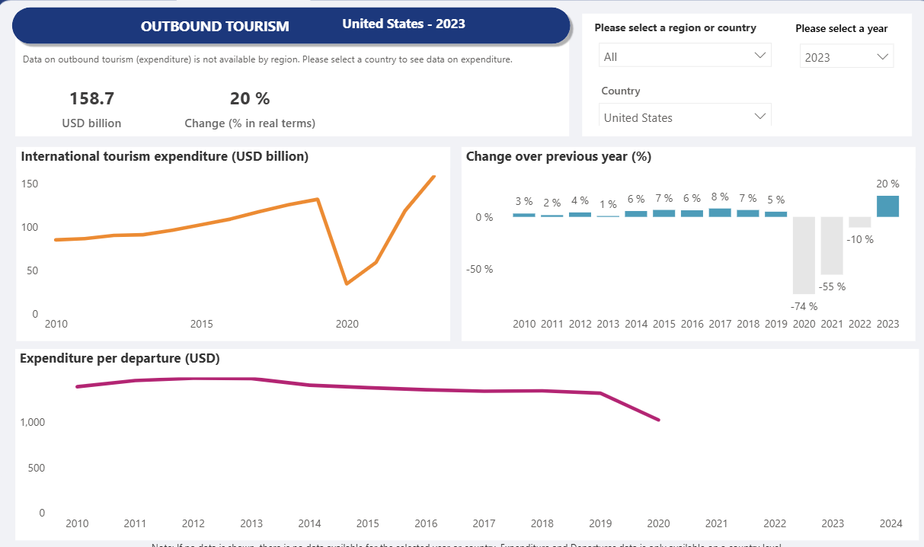
Source: UNWTO

Slide 37
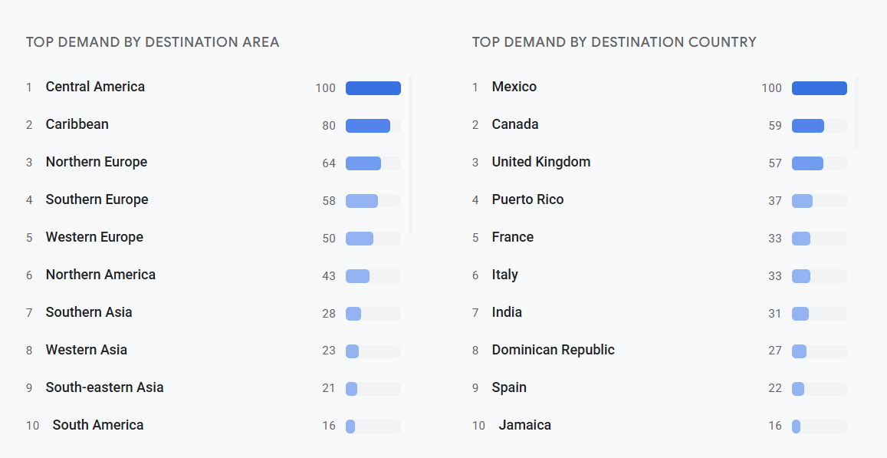
Source: Google Destination Insights, from 2 Aug 2024-2 Feb 2025, outbound travel demand

Slide 38
Couples without children/ family with children
13% high-yield travellers
NEEDS
MOTIVATIONS
Exploring new destinations
Learning and experiencing new things around the world
Relaxing
Having fun
Exploration
Source: Tourism Australia, Nov 2022; Future of Global Tourism Demand

Slide 39
PREFERRED EXPERIENCES
IMPORTANCE OF SUSTAINABILITY
Natural environment
Journeys
Aquatic and coastal
Wildlife
Ethical treatment of animals
Respecting & preserving cultural heritage
Protecting land/ natural environment
Cost major barrier
Source: Tourism Australia, Nov 2022; Future of Global Tourism Demand
Notes:
, journeys (includes walking, hiking, rail),

Slide 40
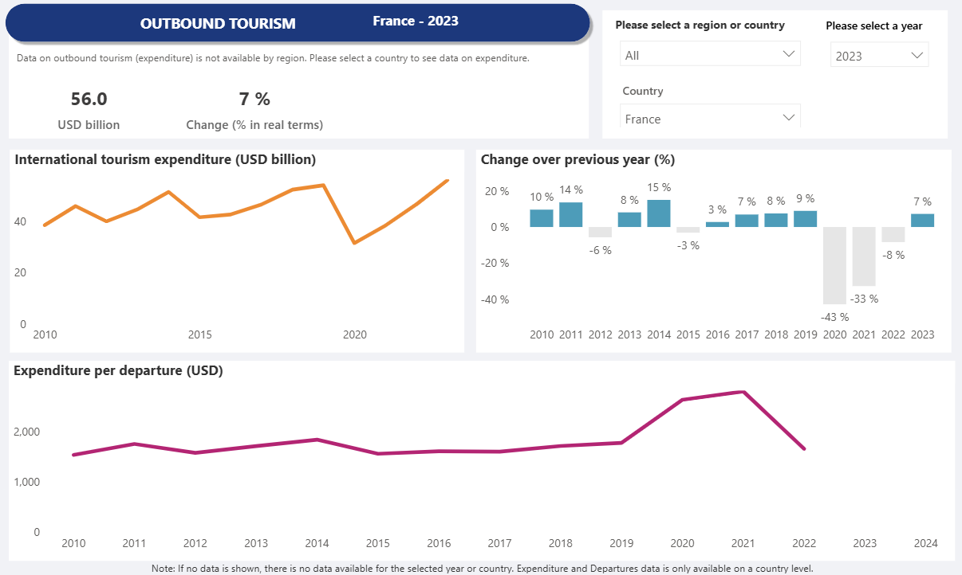
Source: UNWTO

Slide 41
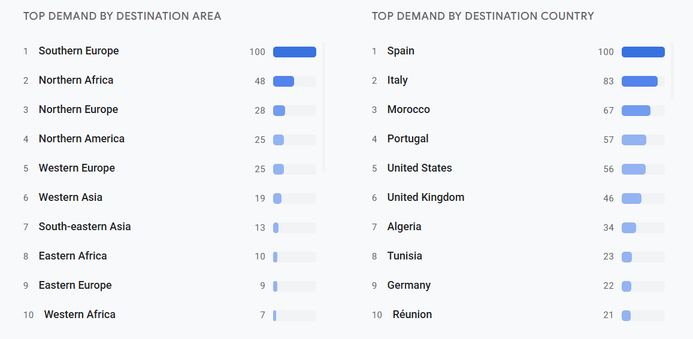
Source: Google Destination Insights, from 2 Aug 2024-2 Feb 2025, outbound travel demand

Slide 42
Couples without children
25% high-yield travellers
NEEDS
MOTIVATIONS
Relaxing and escaping everyday life
Immersing in different cultures
Having fun & exploration
Learning and experiencing new things
Exploration
Adventure
Passion
Source: Tourism Australia, Nov 2022; Future of Global Tourism Demand

Slide 43
PREFERRED EXPERIENCES
IMPORTANCE OF SUSTAINABILITY
Natural environments
Aquatic and coastal
Journeys
Wildlife
Ethical treatment of animals
Respecting cultural heritage & practices of destination
Interest in/ willingness to pay for these lower than global average
Source: Tourism Australia, Nov 2022; Future of Global Tourism Demand

Slide 44
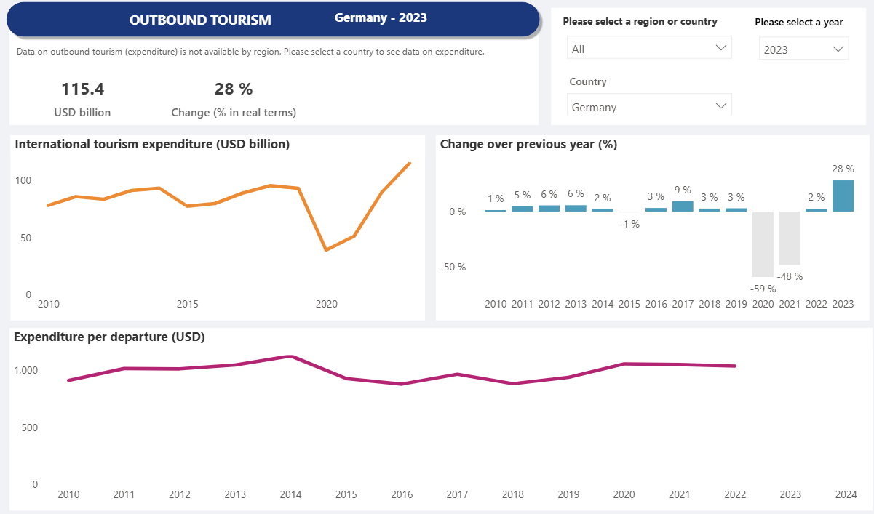
Source: UNWTO

Slide 45
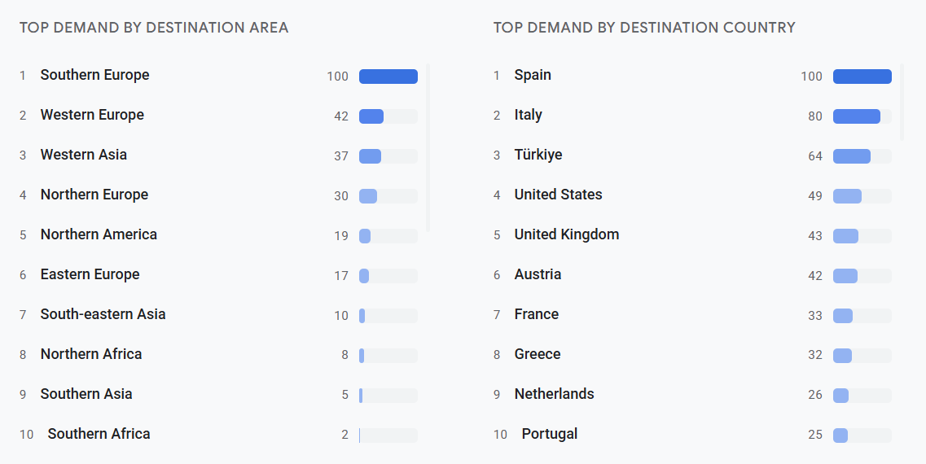
Source: Google Destination Insights, from 2 Aug 2024-2 Feb 2025, outbound travel demand

Slide 46
Couples without children
25% high-yield travellers
NEEDS
MOTIVATIONS
Having fun
Relaxing and escaping everyday life
Reconnection
Exploration
Adventure
Source: Tourism Australia, Nov 2022; Future of Global Tourism Demand

Slide 47
PREFERRED EXPERIENCES
IMPORTANCE OF SUSTAINABILITY
Natural environments
Wildlife
Aquatic and coastal
F&B
Ethical treatment of wildlife
Respecting cultural heritage & practices of destination
Greater availability of affordable options important
Source: Tourism Australia, Nov 2022; Future of Global Tourism Demand

Slide 48
Source: UNWTO

Slide 49
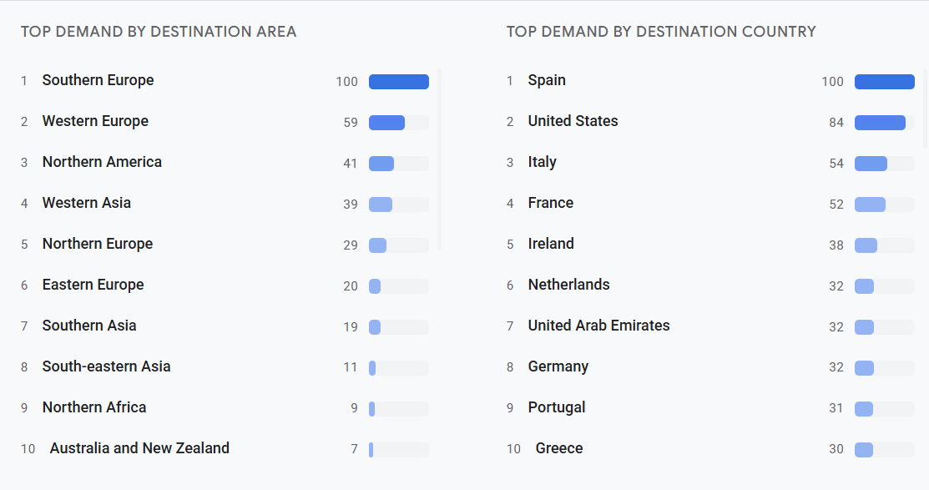
Source: Google Destination Insights, from 2 Aug 2024-2 Feb 2025, outbound travel demand

Slide 50
Couples without children
NEEDS
MOTIVATIONS
Getting in touch with nature
Learning & experiencing new things
Immersing themselves in different cultures
Relaxing and escaping everyday life
Transformation
Get into Nature
Source: Tourism Australia, Nov 2022; Future of Global Tourism Demand

Slide 51
PREFERRED EXPERIENCES
IMPORTANCE OF SUSTAINABILITY
F&B
Natural environment
Aquatic and coastal
Journey
Respecting, preserving cultural heritage & natural environment
See personal benefits of choosing sustainable travel, makes the trip more enjoyable
Source: Tourism Australia, Nov 2022; Future of Global Tourism Demand

Slide 52
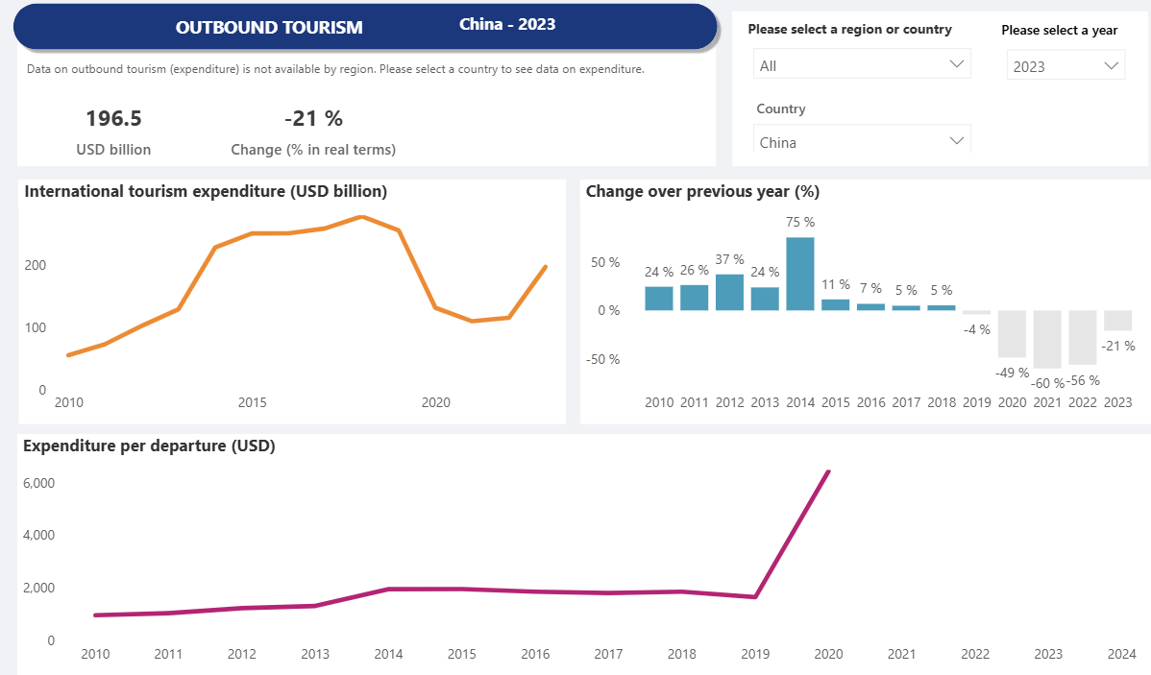
Source: UNWTO

Slide 53
With friends or alone
4% luxury market
NEEDS
MOTIVATIONS
Having fun and enjoying themselves
Pampering themselves
Indulging
Passion/ Hobbies
Source: Tourism Australia, Nov 2022; Future of Global Tourism Demand

Slide 54
PREFERRED EXPERIENCES
IMPORTANCE OF SUSTAINABILITY
F&B
Heritage
Journeys
Hobbies
Respecting cultural heritage
Ethical treatment of animals
Interest in/ willing to pay for sustainable options lower than global average
Cost big barrier
Source: Tourism Australia, Nov 2022; Future of Global Tourism Demand

Slide 55
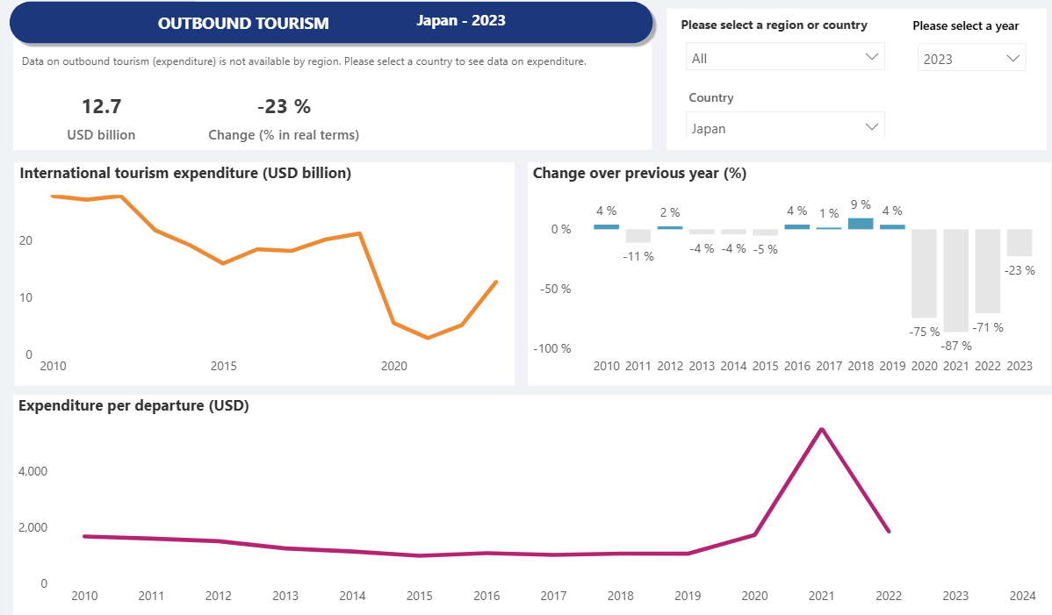
Source: UNWTO

Slide 56
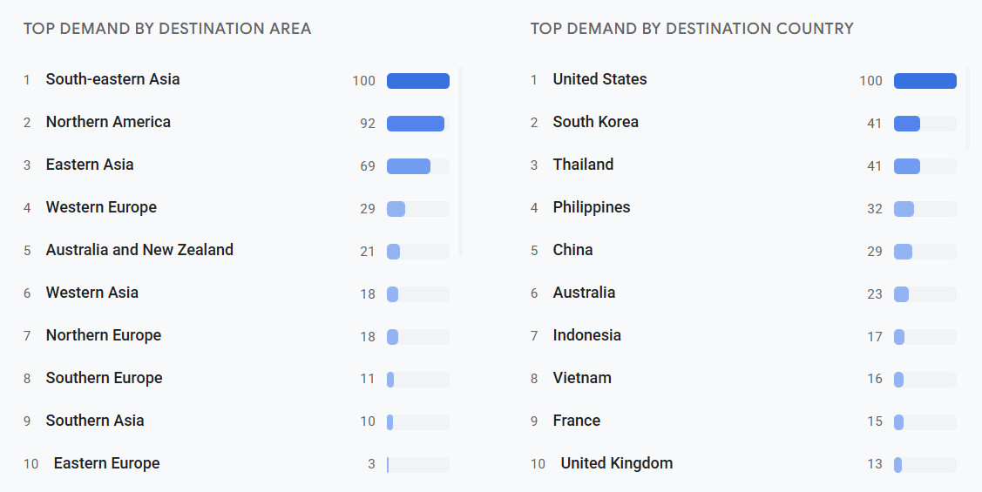
Source: Google Destination Insights, from 2 Aug 2024-2 Feb 2025, outbound travel demand

Slide 57
With friends, parents or family with adult children
38% high-yield
NEEDS
MOTIVATIONS
Relaxing
Having fun
Escaping everyday life pressures
Exploring new destinations
Exploration
Reconnection
Source: Tourism Australia, Nov 2022; Future of Global Tourism Demand

Slide 58
PREFERRED EXPERIENCES
IMPORTANCE OF SUSTAINABILITY
F&B
Natural environment
Protection of natural environment
Respecting cultural heritage
Acknowledge right thing to do, but limited willingness to pay
Source: Tourism Australia, Nov 2022; Future of Global Tourism Demand

Slide 59
Source: UNWTO

Slide 60
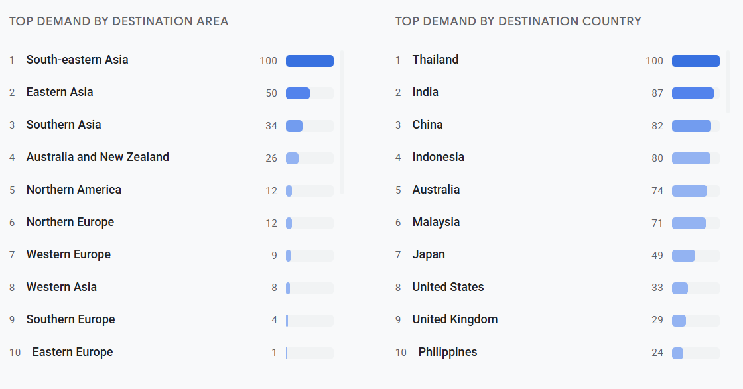
Source: Google Destination Insights, from 2 Aug 2024-2 Feb 2025, outbound travel demand

Slide 61
With friends or family with adult children
NEEDS
MOTIVATIONS
Getting in touch with nature
Feeling secure and comfortable
Leaning, experiencing new things
Focusing on wellbeing
Escaping everyday life pressures
Having fun
Into Nature
Transformation
Source: Tourism Australia, Nov 2022; Future of Global Tourism Demand

Slide 62
PREFERRED EXPERIENCES
IMPORTANCE OF SUSTAINABILITY
Natural environment
F&B
Place higher emphasis than global average
1 in 2 Thais devoted to sustainable tourism practices
Cost, extra effort, main barrier
Source: Tourism Australia, Nov 2022; Future of Global Tourism Demand

Slide 63
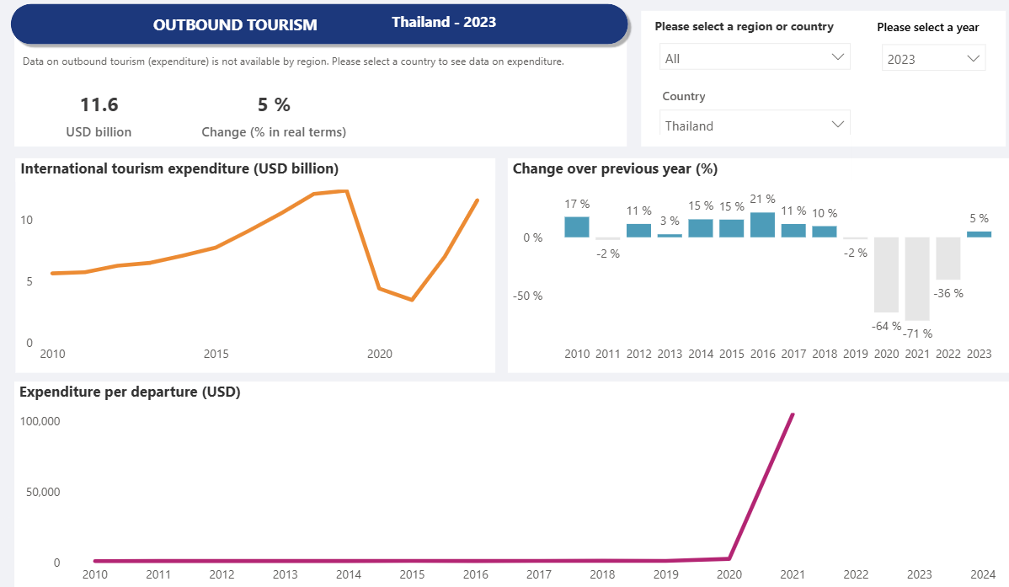
Source: UNWTO

Slide 64
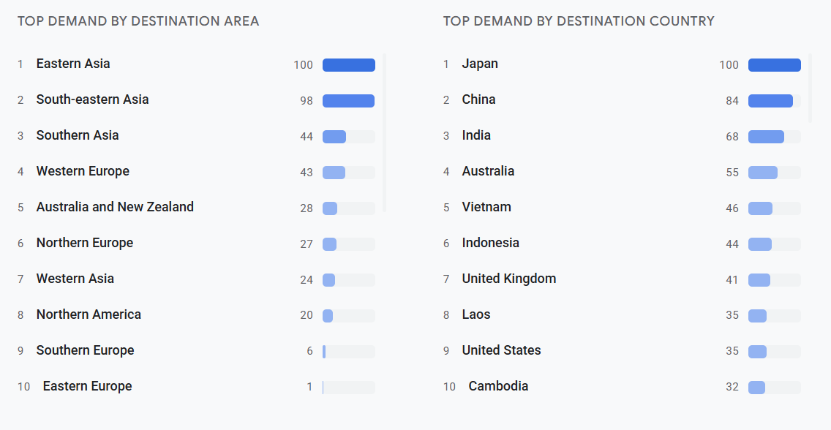
Source: Google Destination Insights, from 2 Aug 2024-2 Feb 2025, outbound travel demand

Slide 65
As a couple without children or as a family with adult children
NEEDS
MOTIVATIONS
Having fun & enjoying themselves
Sense of adventure
Exploration
Reconnection
Adventure
Source: Tourism Australia, Nov 2022; Future of Global Tourism Demand

Slide 66
PREFERRED EXPERIENCES
IMPORTANCE OF SUSTAINABILITY
Natural environment
F&B
Wildlife
Heritage
Aquatic & coastal
Ethical treatment of wildlife
Protection of land, natural environment
Respecting cultural heritage
Ethical treatment of local people
Cost and limited options limiting facvtors
Source: Tourism Australia, Nov 2022; Future of Global Tourism Demand

Slide 67
Source: UNWTO

Slide 68
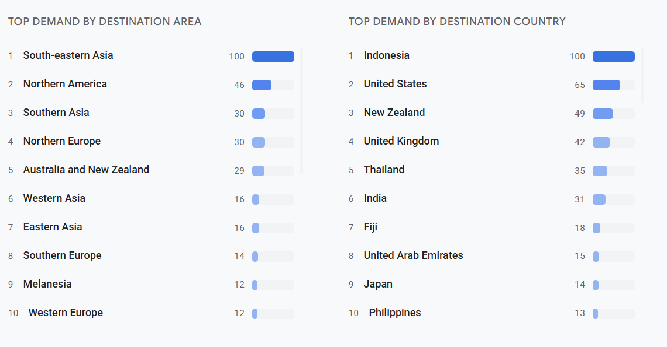
Source: Google Destination Insights, from 2 Aug 2024-2 Feb 2025, outbound travel demand

Slide 69
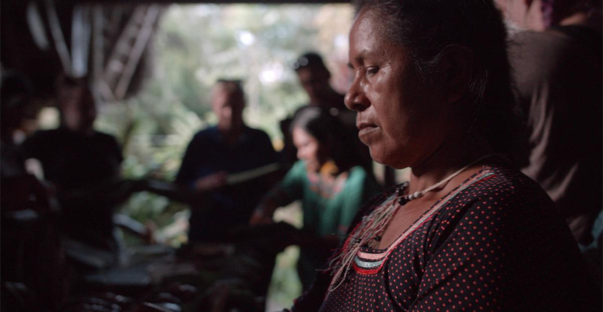
Part 6:
Key Takeaways
© ATTA / Matt Corliss
© ATTA / Daniel Santos

Slide 70
KEY TAKEAWAYS
1
A diverse mix of source destinations is key for an economically sustainable tourism industry
2
Look for different niches within key source markets
3
Sustainability is of growing importance to global source markets, but not – yet – a driving factor for decision making
4
Outbound travel is increasingly strong from Asia, driven by China and India
Successful partnerships in new markets take time, and ideally evolve over time - there are no quick wins!
5
Notes:
So what are the 3 takeaways I’d like you to go away with?
Adventure travel contributes hugely, not only in terms of revenue, but also to nature and communities
Adventure travellers will travel again, are safety conscious - and sustainability is high on their agenda and
ATWS 2023 will be a wonderful opportunity to showcase what makes adventure travel in Japan so unique - and I hope that you all take advantage of that opportunity
Many thanks for your time!

Slide 71
Thank You!
Come join the ATTA community
HANNAH PEARSON
hannah.p@adventuretravel.biz
Regional Director, APAC
© ATTA| Hassen Salum
© ATTA| Hassen Salum

