Slide 1
Trending on Tripadvisor

Slide 2
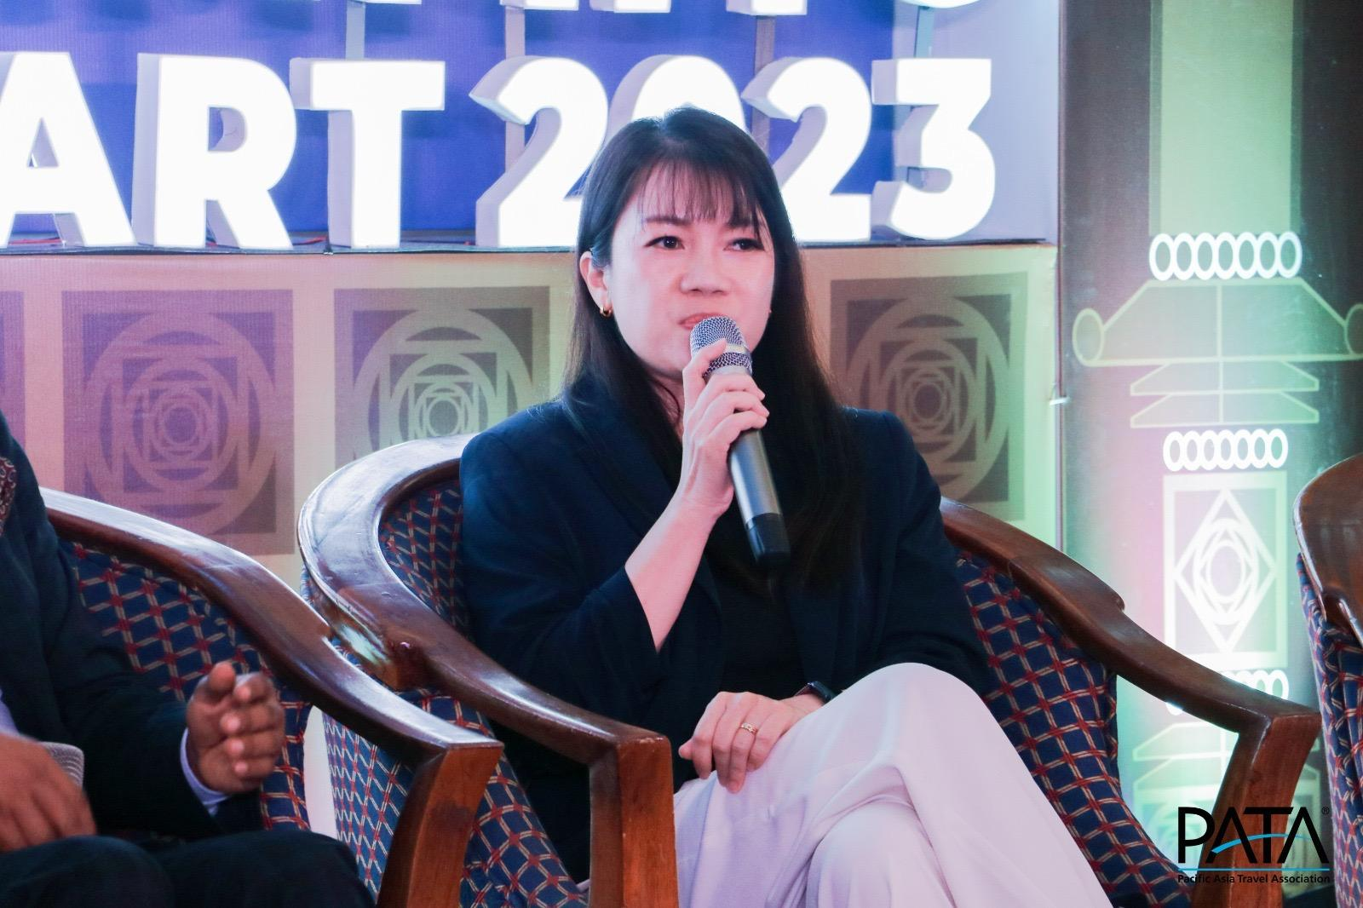
"Saim baitsgaa-noo!”
My name is
Ros Ong
Ms Rosabella Ong
Principal Client Partner, APAC
rong@tripadvisor.com

Slide 3
Hello, we’re
Tripadvisor.
490M
2.2B
Monthly unique visits
Page Views
1 billion
No.1
Our mission is to provide the World’s Most Essential Travel Advice.
With over 20+ years of traveller insights, we are the only full-service travel guidance company that can do it. And that makes our content, commerce, and community one-of-a-kind.
Reviews and moments
Travel site in the world
93%
190
Plan on travelling over the next 12 months
Countries across the globe

Slide 4
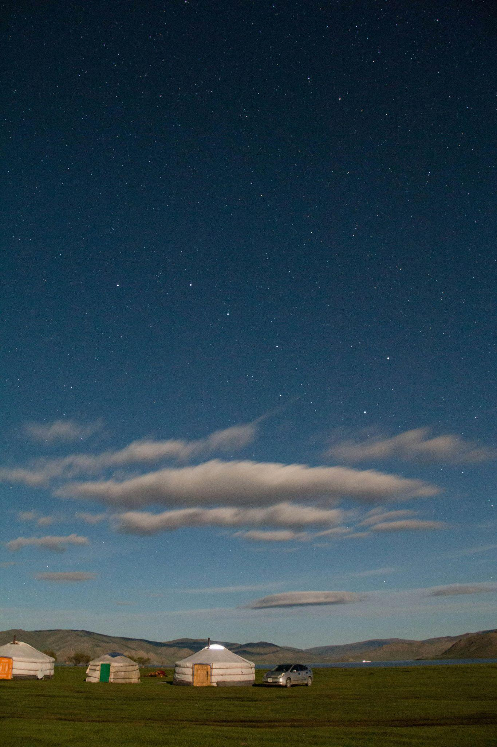
05
Traveler Insights(Global)
Who, Where, What destinations (January 2025 insights)
13
Traveler Insights(Mongolia)
Top source markets, Booking Window, Top geos, Forum Topics
CONTENTS
31
New User Journey
Tripadvisor AI initiatives
40
Key Takeaways

Slide 5
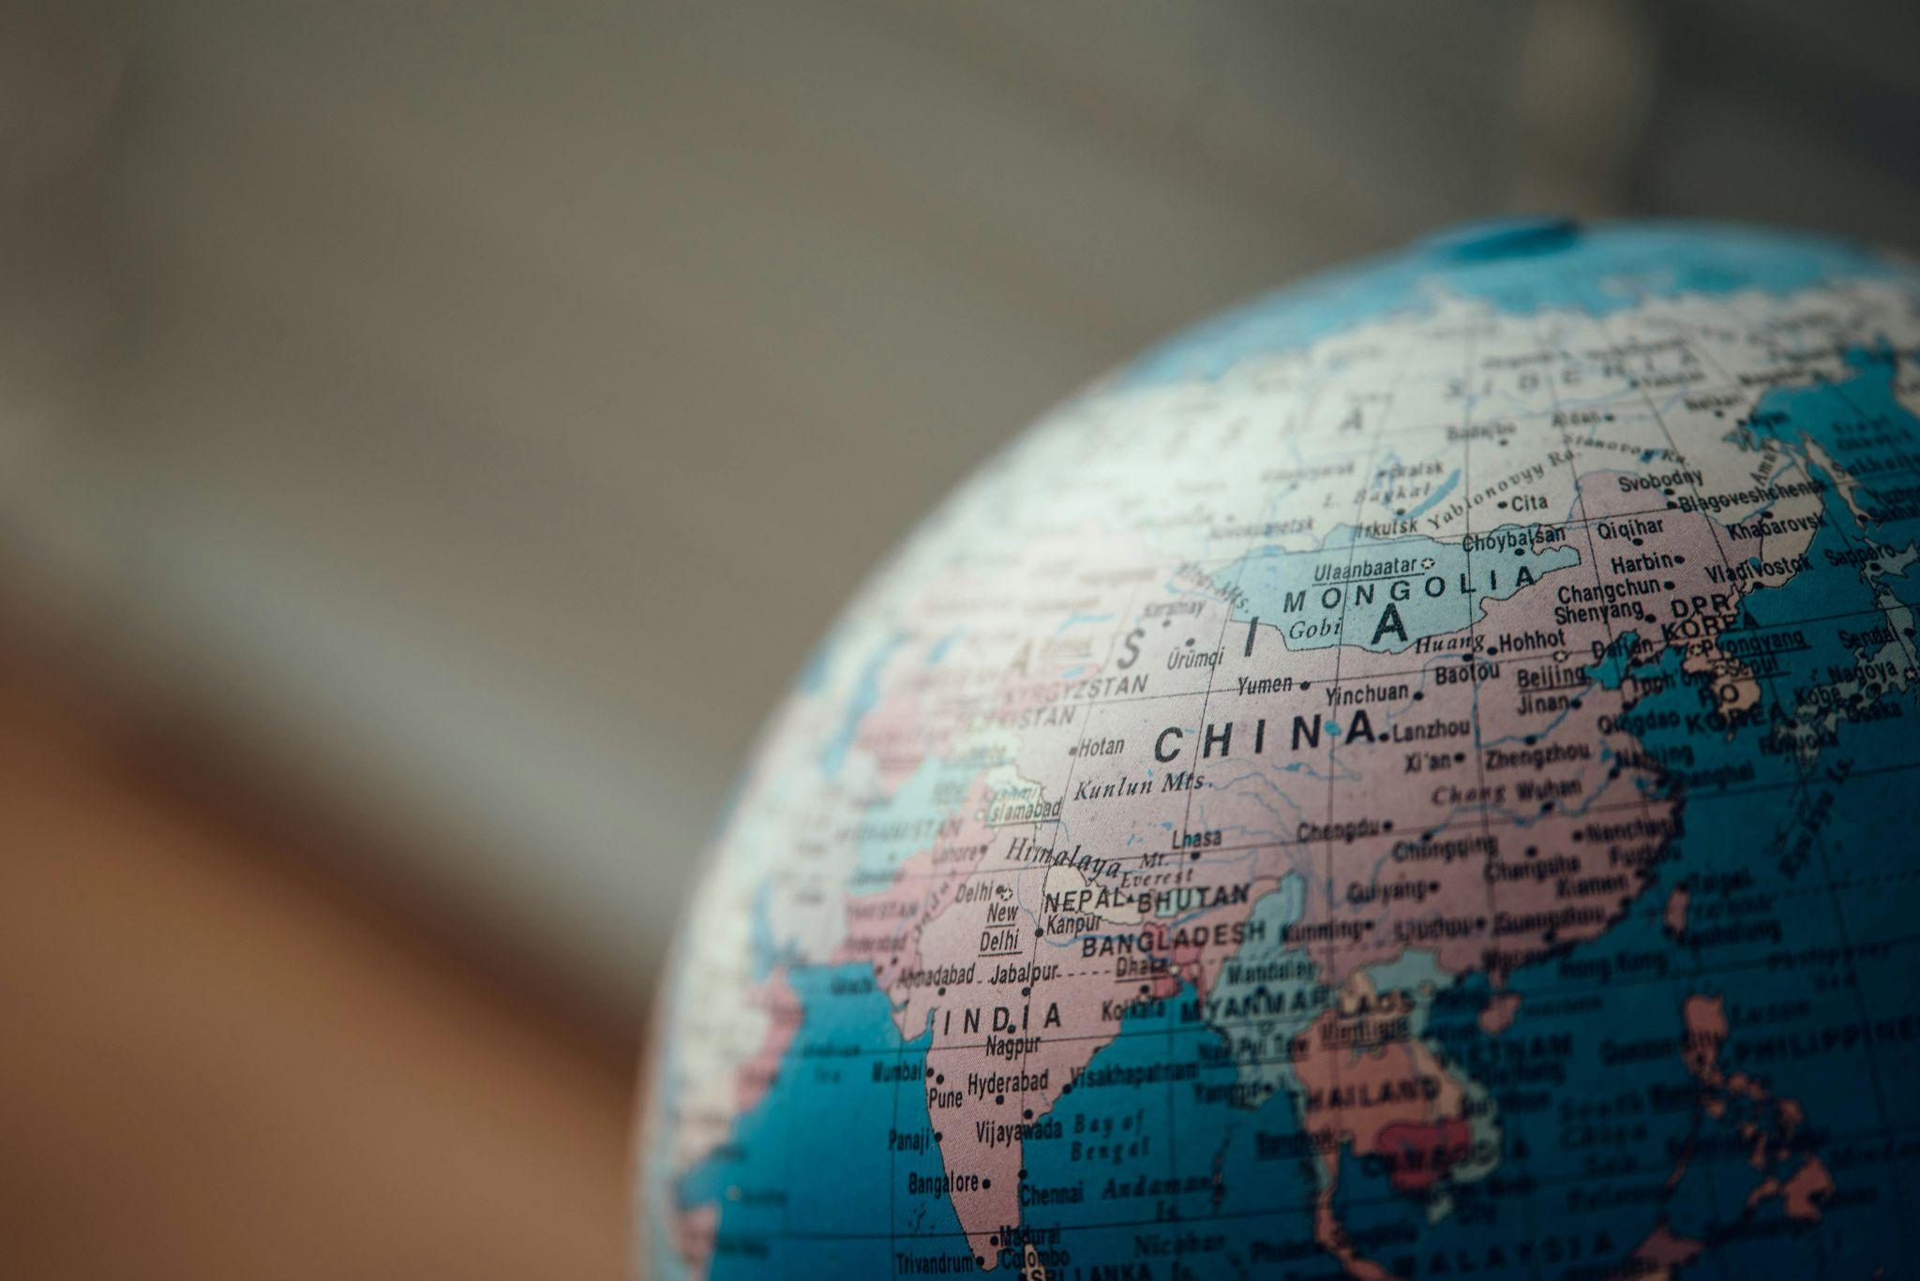
Who is traveling (Jan 2025)

Slide 6
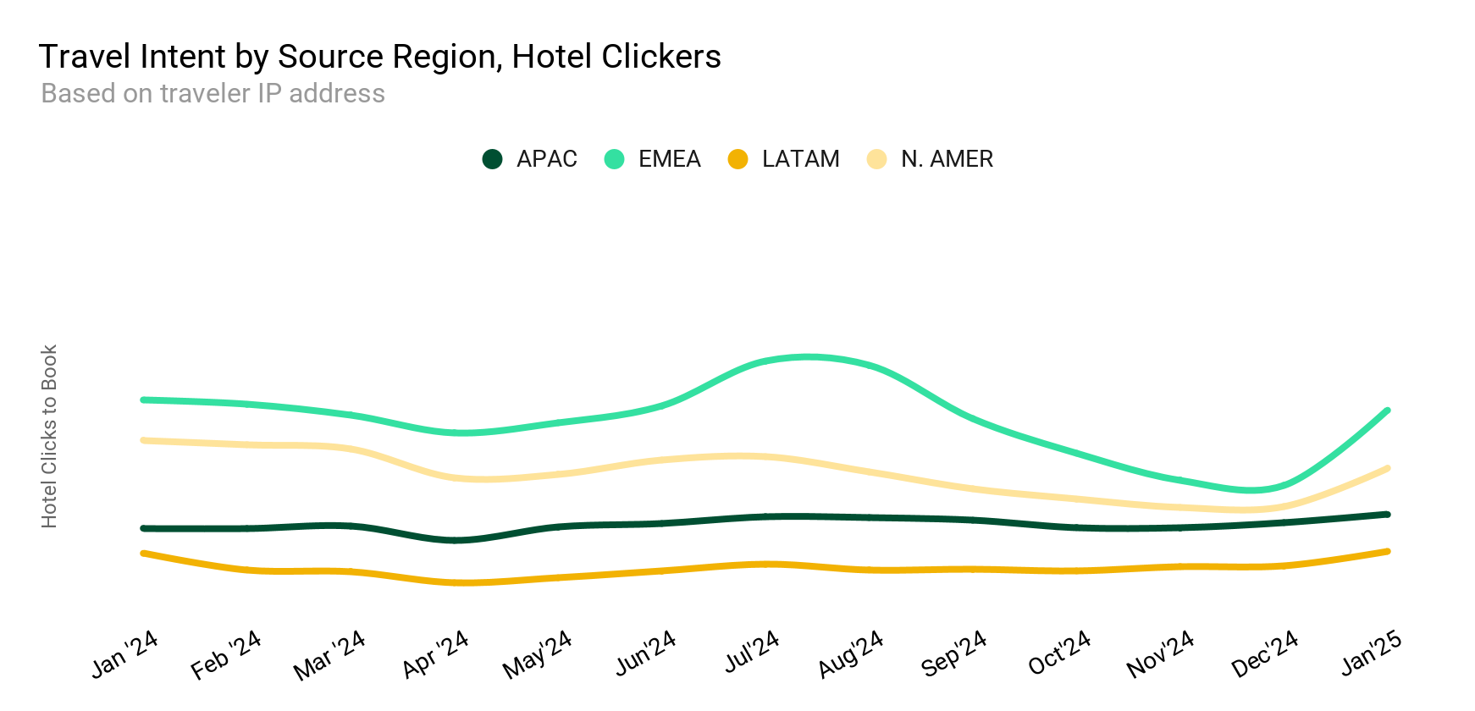
37% MoM rise in January travel intent with growth in all regions
Travel intent (based on metasearch clicks to book) in the month of January rose in all regions since last month, led by EMEA with 59% MoM rise. N. AMER and LATAM also witnessed double-digit growth month-over-month (MoM) whereas APAC showed single digit growth MOM
Who is traveling (Jan 2025)
Traffic by Source Region, Hotel Clicks
Source: Tripadvisor internal data, based on user IP, 1/1/25 - 1/31/25

Slide 7
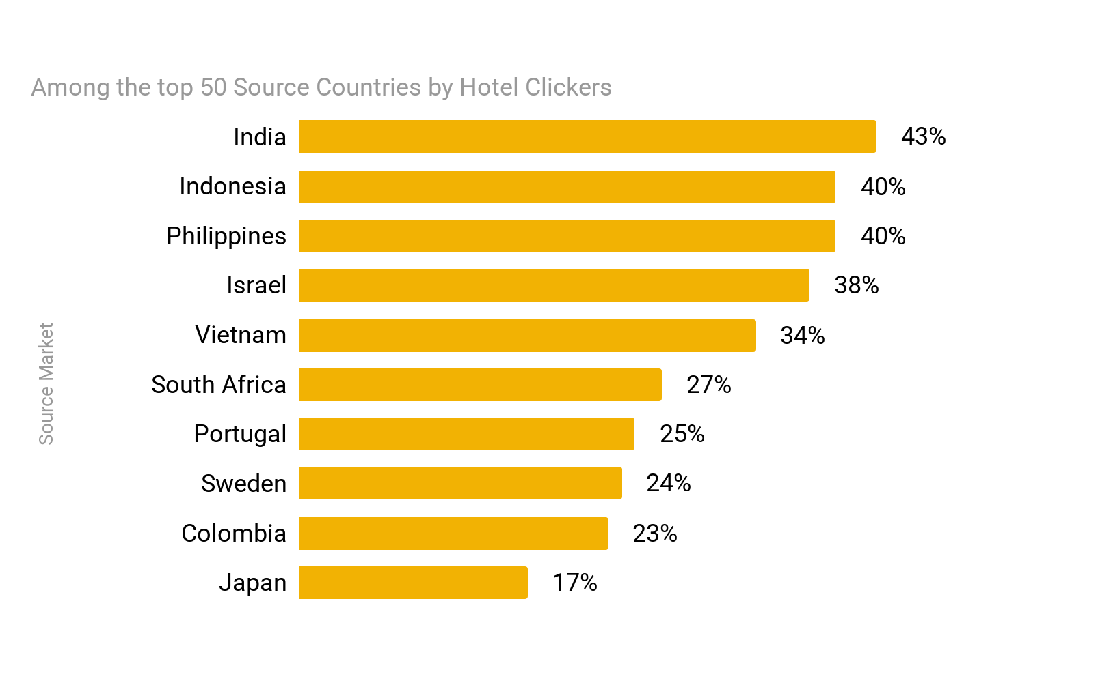
Top Source Countries, by YoY Growth & Volume
For the month of January, top 4 list remain the same in comparison to last year. India picked up to fifth position this January and showed biggest growth YOY among top 50 source markets
Top 15 Largest Source Markets, Clicks to Book, January
Rank | 2024 | 2025
1 | United States | United States
2 | United Kingdom | United Kingdom
3 | Germany | Germany
4 | Brazil | Brazil
5 | Italy | India
6 | Canada | Japan
7 | France | Canada
8 | Japan | Italy
9 | Spain | France
10 | India | Spain
11 | Argentina | Australia
12 | Australia | Argentina
13 | Mexico | Mexico
14 | Ireland | The Netherlands
15 | The Netherlands | Ireland
Source: Tripadvisor internal data, based on user IP, 1/1/25 - 1/31/25

Slide 8
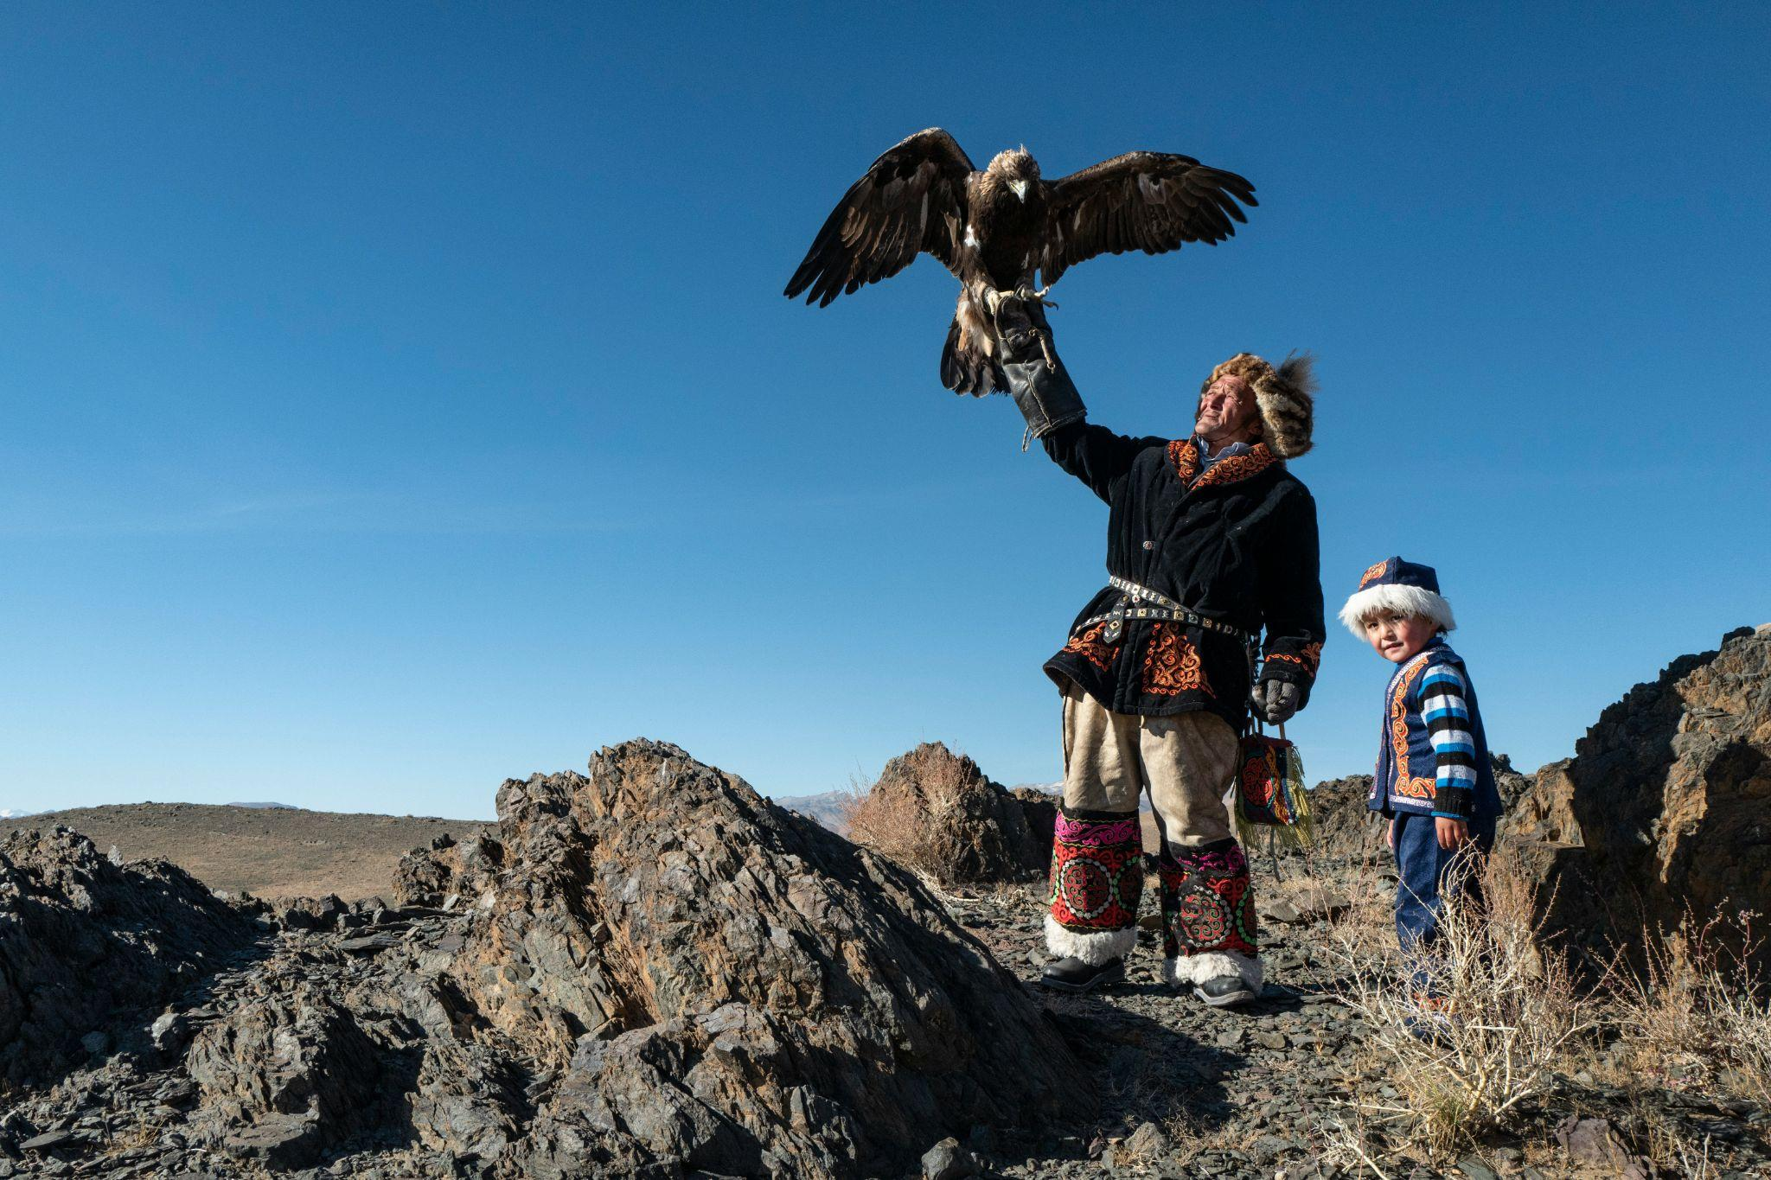
Where they go

Slide 9
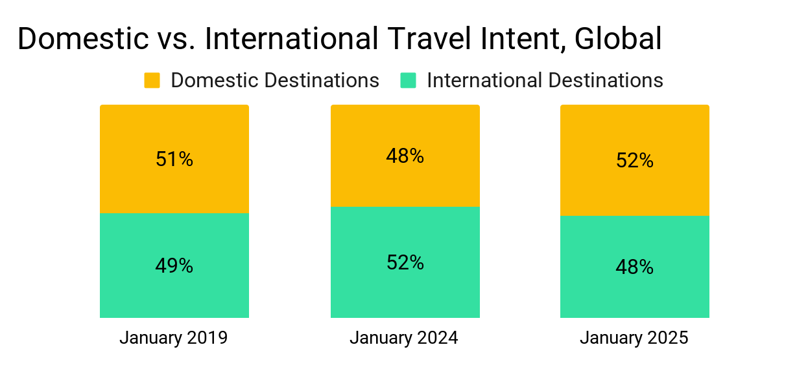
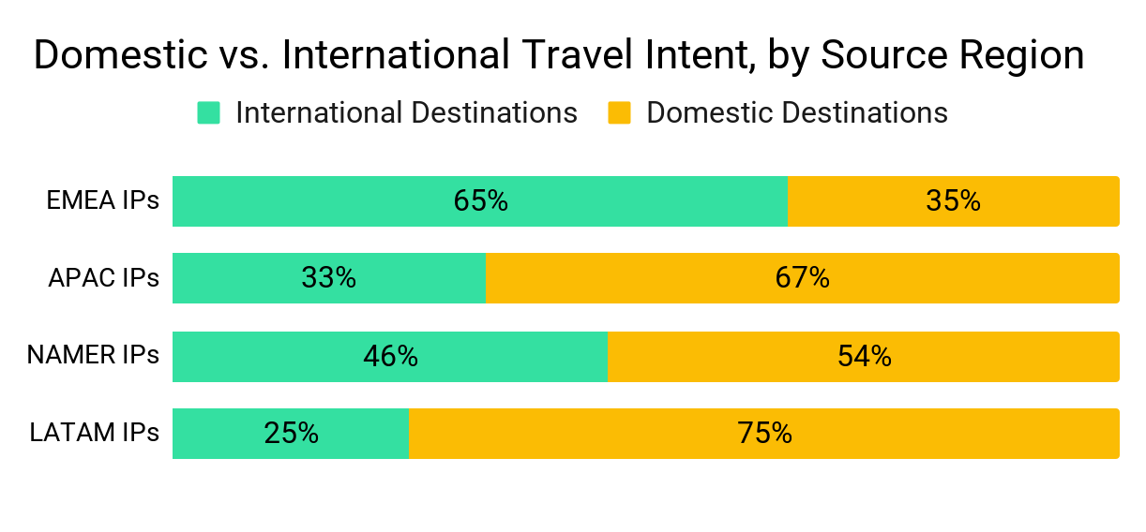
Domestic vs. international travel
Who is traveling (Jan 2025)
Globally, international share in January this year is almost equivalent to pre-pandemic time in January 2019. Its 2 ppt less than last year.
International share of traffic increase for EMEA and AMER this month compared to last month.
Source: Tripadvisor internal data, based on hotel clickers’ IPs, January 2019, 2024, 2025

Slide 10
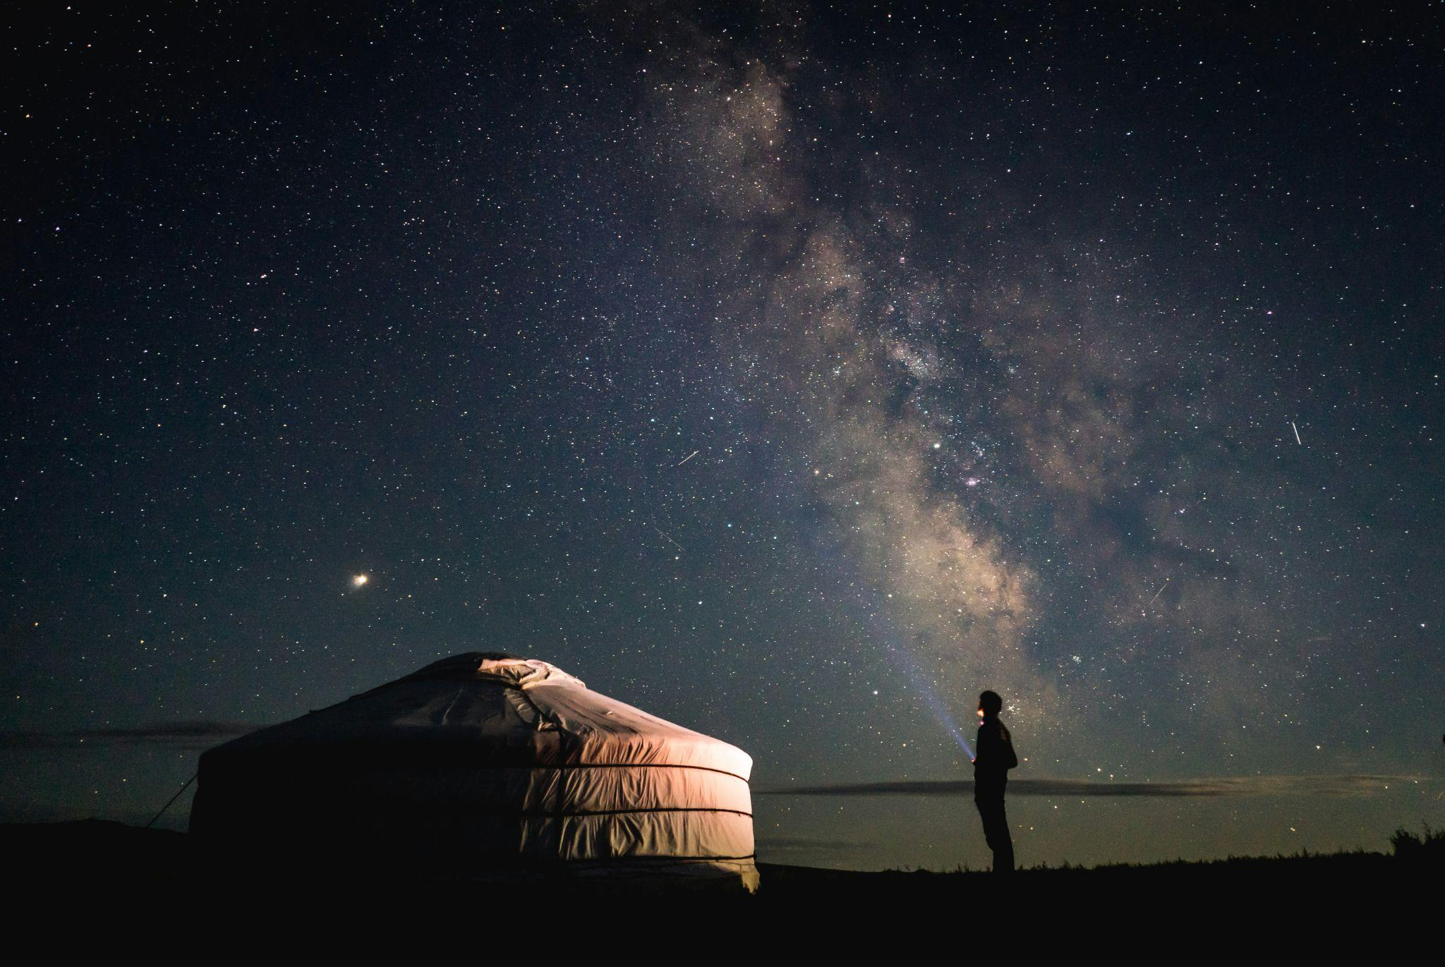
What destinations

Slide 11
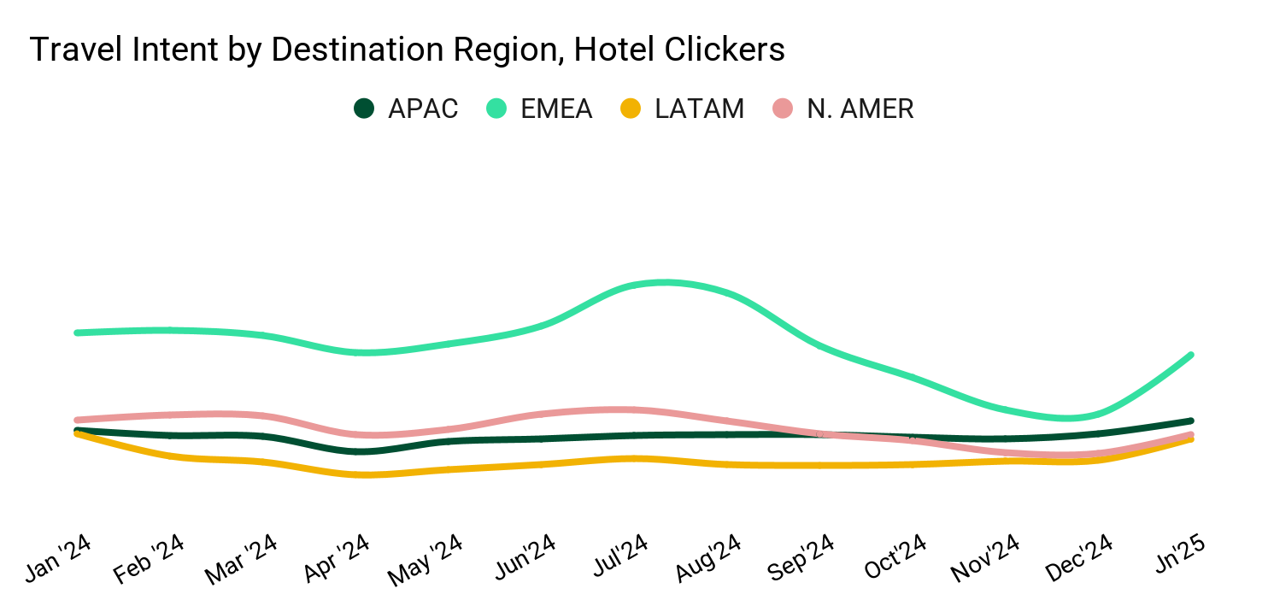
All destination regions benefit from seasonal demand increase in January
Who is traveling (Jan 2025)
Destinations in all regions gained in the month of January from prior month, led by EMEA destinations increasing 57% MoM. EMEA attracted the largest share of demand (39%) in January, followed by APAC (23%).
Traffic for Destination Region, Hotel Clicks
Source: Tripadvisor internal data, 1/1/25 - 1/31/25

Slide 12
Top 10 Destinations in APAC seen by Domestic vs International IPs
Top APAC Destinations
Rank | Domestic visitors (IP) | International visitors (IP)
1 | Tokyo, JP | Tokyo, JP
2 | Seoul, SK | Bangkok, TH
3 | Busan, SK | Singapore. SG
4 | Chuo, JP | Bali, ID
5 | Seogwipo, SK | Chuo, JP
6 | Prayagraj, IN | Hong Kong, CN
7 | Jeju, SK | Patong, TH
8 | Incheon, SK | Seoul, SK
9 | Gangneung, SK | Pattaya, TH
10 | Jakarta, ID | Dhaalu Atoll, MV
Who is traveling (Jan 2025)
Source: Tripadvisor internal data, 1/1/25 - 1/31/25

Slide 13
Tripadvisor Insights - Mongolia

Slide 14
Global Travelers

Slide 15
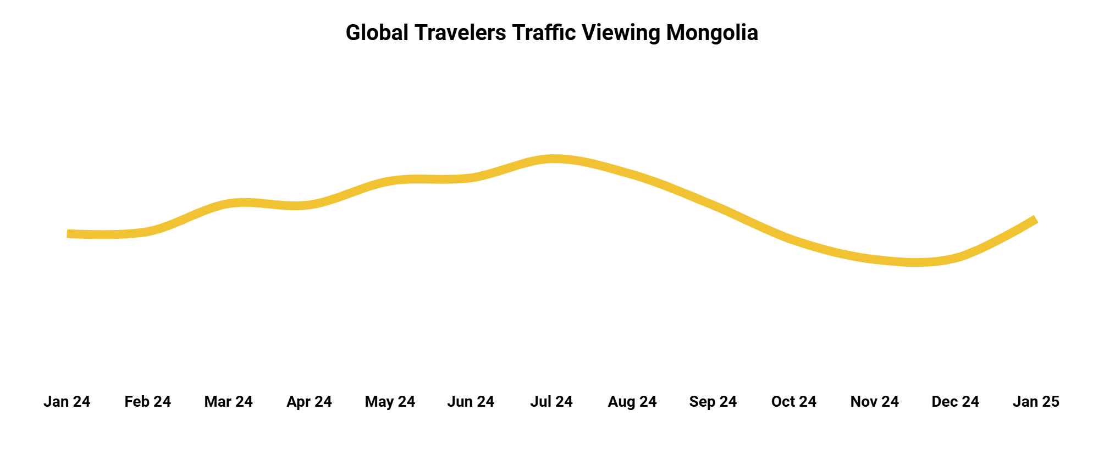
Global unique user traffic to Mongolia steadily increases from the start of the year, reaching its peak in July. However, traffic declines during the final quarter before rebounding in January 2025, marking a 10% year-over-year increase compared to January 2024.
Who is traveling (Jan 2025)
Source: Tripadvisor Internal Data, Data Scope- Jan 2024 - Jan 2025

Slide 16
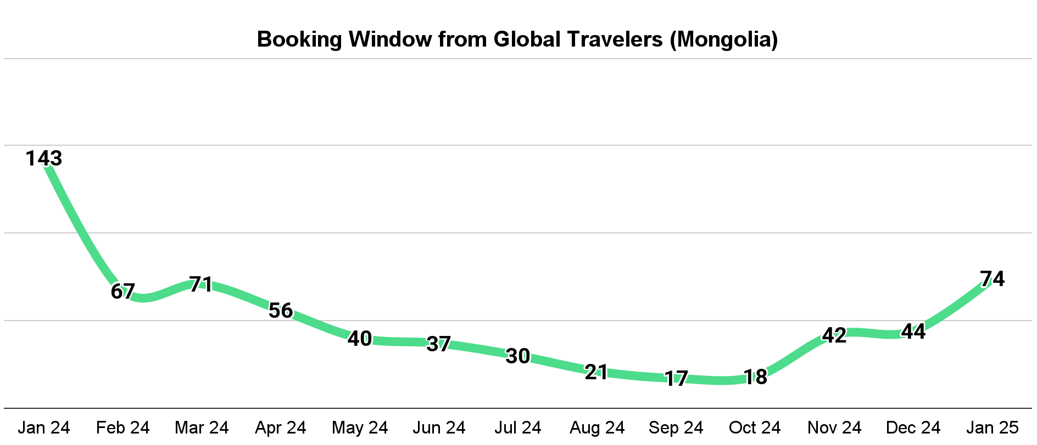
The global booking window significantly shortened from February 2024, with this trend continuing through approximately October
Who is traveling (Jan 2025)
Source: Tripadvisor Internal Data, Data Scope- Jan 2024 - Jan 2025

Slide 17
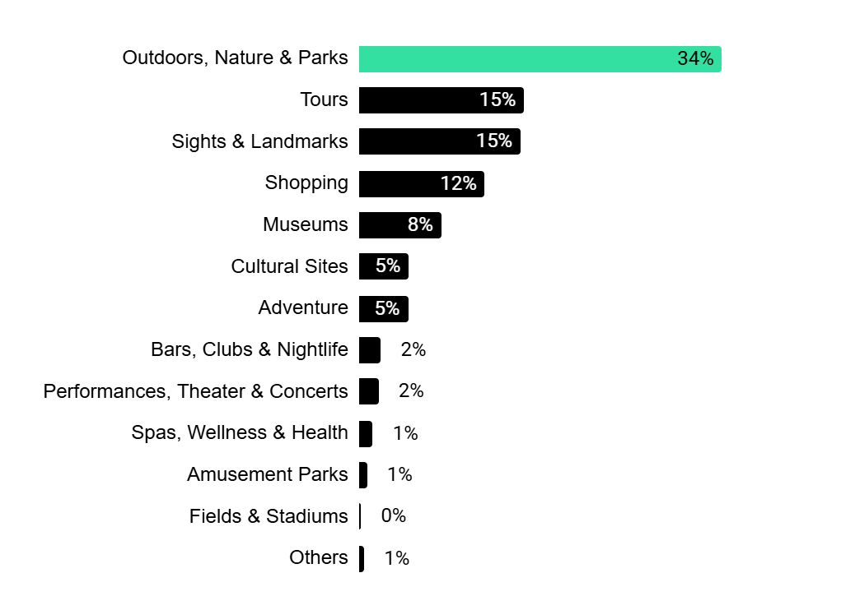
Attraction category share (%) viewed by Global travelers
Most viewed experience types in Mongolia by Global travelers
Who is traveling (Jan 2025)
Outdoor activities, nature, and parks are among the top attractions for travelers exploring Mongolia, with key destinations such as Gorkhi-Terelj National Park and Hustai National Park drawing significant interest.
Close behind is the tours category, highlighting the strong demand among global travelers for guided experiences in Mongolia.
Source: Tripadvisor Internal Data, Data Scope- Jan 2024 - Jan 2025

Slide 18
Top 10 geos in Mongolia viewed by Global travelers
Who is traveling (Jan 2025)
Rank | Geo Name
1 | Ulaanbaatar
2 | Gorkhi Terelj National Park
3 | Olgiy
4 | Kharkhorin
5 | Gobi Gurvansaikhan National Park
6 | Dalanzadgad
7 | Khatgal
8 | Darhan
9 | Dalanzadgad
10 | Bayan-Olgii Province
Source: Tripadvisor Internal Data, Data Scope- Jan 2024 - Jan 2025

Slide 19
Top 10 attractions in Mongolia viewed by Global travelers
Who is traveling (Jan 2025)
Rank | Property Name | Attraction Type
1 | Gorkhi-Terelj National Park | National Parks
2 | Chinggis Khan Statue Complex | Monuments/ Statues
3 | Gobi Desert | Deserts
4 | Narantuul Market | Specialty Shops
5 | Hustai National Park | National Parks
6 | Galleria Ulaanbaatar | Malls
7 | Sukhbaatar Square | Monuments/ Statues
8 | Sunpath Mongolia | 4WD, ATV & off-road tours
9 | Gobi Cashmere Flagship Store | Specialty Shops
10 | National History Museum | History Museums
Source: Tripadvisor Internal Data, Data Scope- Jan 2024 - Jan 2025

Slide 20
APAC Travelers

Slide 21
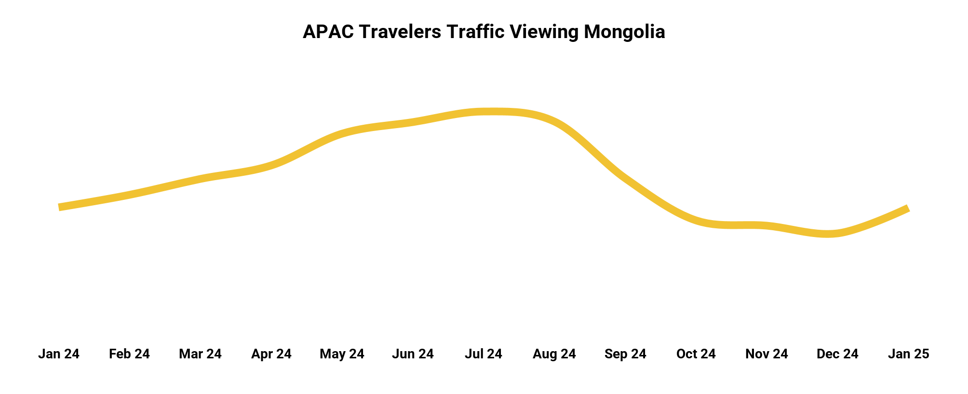
For APAC travelers, the peak season occurs around August, aligning closely with global trends. Traffic then declines in the final quarter of the year before experiencing a slight rebound in January 2025. However, visitor numbers in January 2025 remained largely unchanged compared to January 2024.
Who is traveling (Jan 2025)
Source: Tripadvisor Internal Data, Data Scope- Jan 2024 - Jan 2025

Slide 22
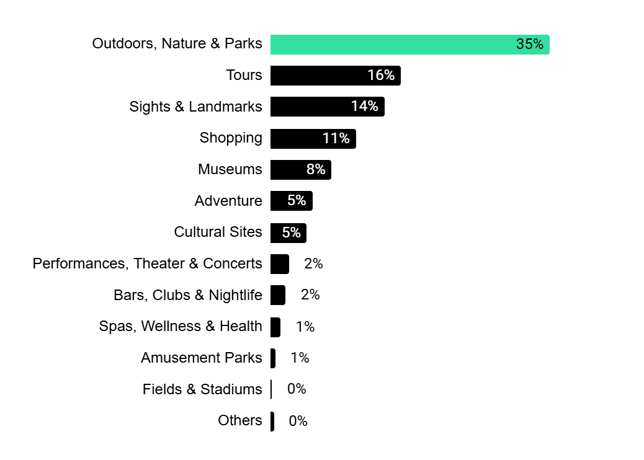
Most viewed experience types in Mongolia by APAC travelers
Attraction category share (%) viewed by APAC travelers
Nature-focused experiences and outdoor adventures rank among the top draws for visitors to Mongolia, with Gorkhi-Terelj National Park and Hustai National Park standing out as key destinations.
Additionally, guided tours are in high demand, reflecting the interest of global travelers in curated experiences across the country.
Who is traveling (Jan 2025)
Source: Tripadvisor Internal Data, Data Scope- Jan 2024 - Jan 2025

Slide 23
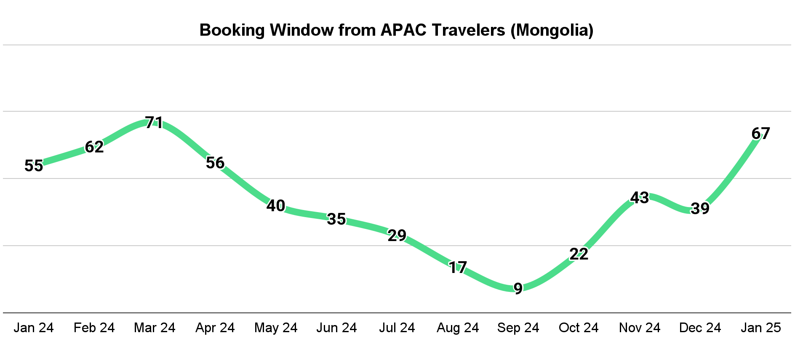
For APAC travelers, the booking window reached its peak around March 2024 before steadily declining through September
Who is traveling (Jan 2025)
Source: Tripadvisor Internal Data, Data Scope- Jan 2024 - Dec 2024

Slide 24
Top 10 geos in Mongolia viewed by APAC travelers
Who is traveling (Jan 2025)
Rank | Geo Name
1 | Ulaanbaatar
2 | Gorkhi Terelj National Park
3 | Olgiy
4 | Kharkhorin
5 | Gobi Gurvansaikhan National Park
6 | Dalanzadgad
7 | Hatgal
8 | Nalaikh
9 | Tsetserleg
10 | Khatgal
Source: Tripadvisor Internal Data, Data Scope- Jan 2024 - Jan 2025

Slide 25
Top 10 attractions in Mongolia viewed by APAC travelers
Who is traveling (Jan 2025)
Rank | Property Name | Attraction Type
1 | Gorkhi-Terelj National Park | National Parks
2 | Chinggis Khan Statue Complex | Monuments/ Statues
3 | Hustai National Park | National Parks
4 | Narantuul Market | Specialty Shops
5 | Galleria Ulaanbaatar | Malls
6 | Sukhbaatar Square | Monuments/ Statues
7 | Sunpath Mongolia | 4WD, ATV & off-road tours
8 | National History Museum | History Museums
9 | Gobi Desert | Deserts
10 | The State Department Store | Specialty Shops
Source: Tripadvisor Internal Data, Data Scope- Jan 2024 - Jan 2025

Slide 26
Top Source Market viewing Mongolia

Slide 27
Top APAC and global source markets viewing Mongolia
Who is traveling (Jan 2025)
Rank | APAC IPs
1 | South Korea
2 | Japan
3 | China
4 | India
5 | Australia
6 | Singapore
7 | Taiwan
8 | Thailand
9 | Philippines
10 | Malaysia
Rank | Global IPs
1 | United States
2 | South Korea
3 | Russia
4 | Japan
5 | China
6 | Germany
7 | United Kingdom
8 | India
9 | Italy
10 | Australia
Source: Tripadvisor Internal Data, Data Scope- Jan 2024 - Jan 2025

Slide 28
Forum Discussions

Slide 29
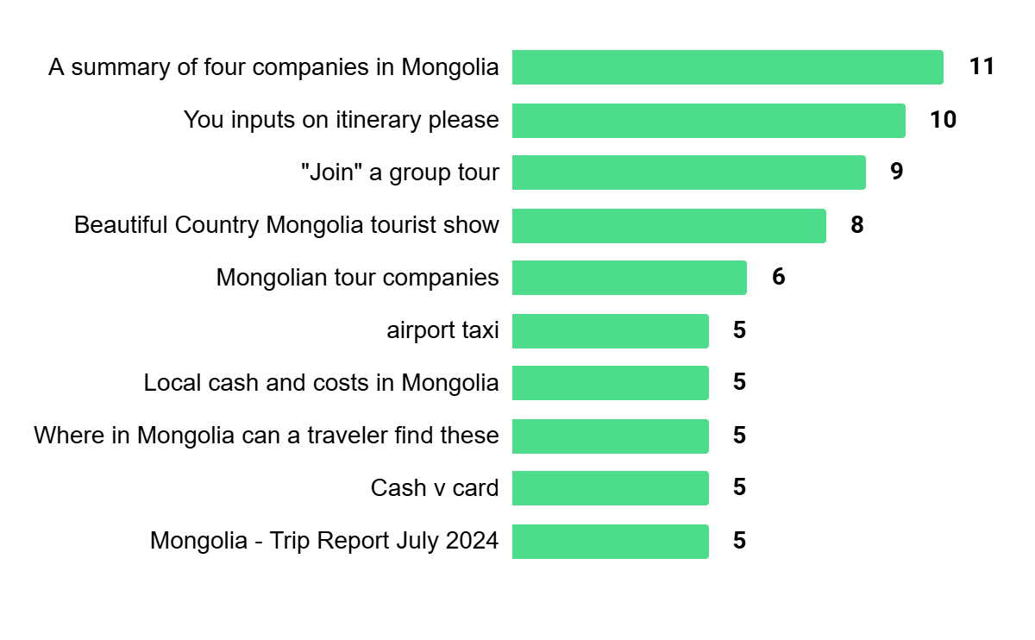
Ranked on number of participants
Top 10 Mongolia Forum Discussions
Who is traveling (Jan 2025)
Source: Tripadvisor Internal Data, Data Scope- Jan 2024 - Jan 2025

Slide 30
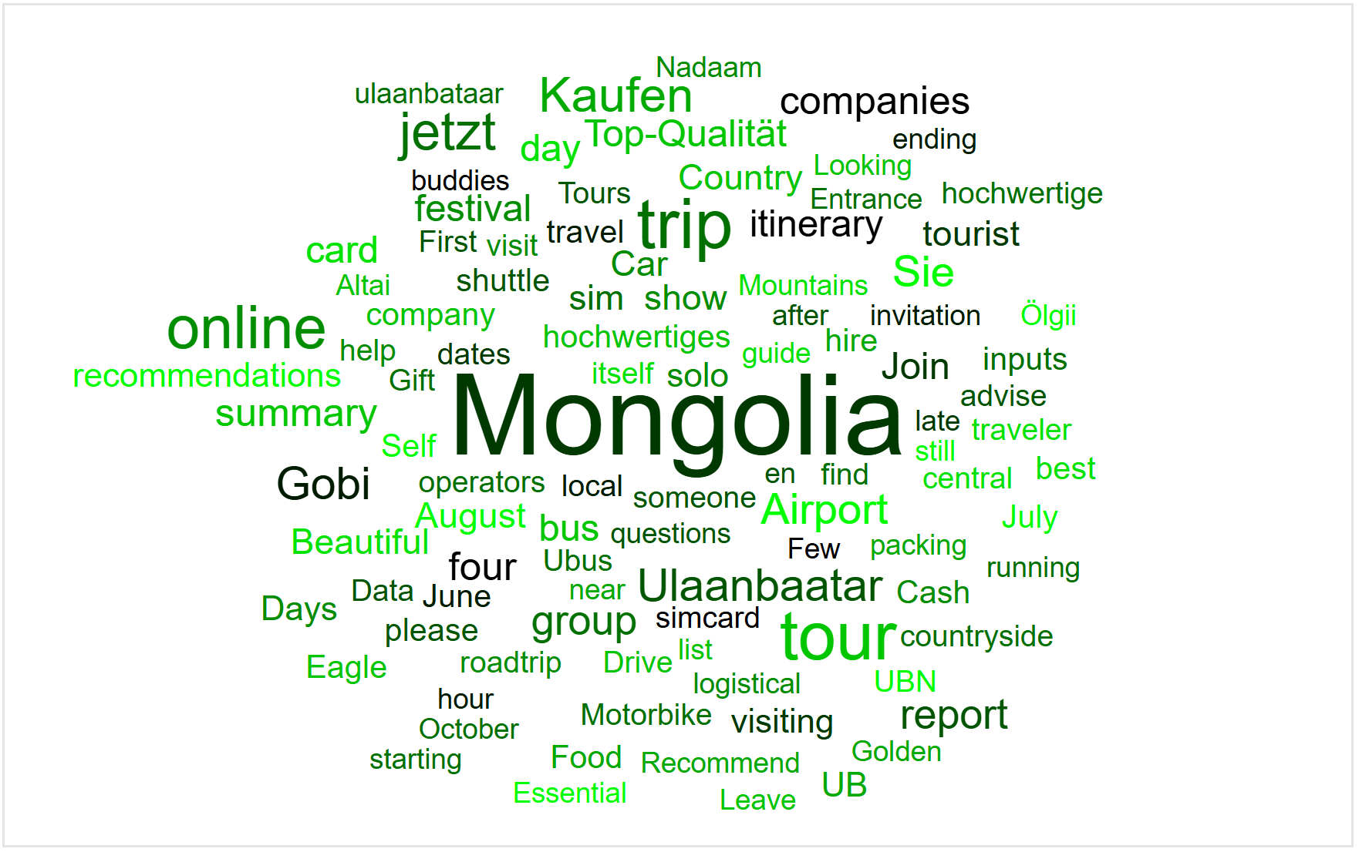
Based on keywords used in forum posts for Mongolia
Who is traveling (Jan 2025)
Keywords Used In Mongolia Forum Discussions
Source: Tripadvisor Internal Data, Data Scope- Jan 2024 - Jan 2025

Slide 31
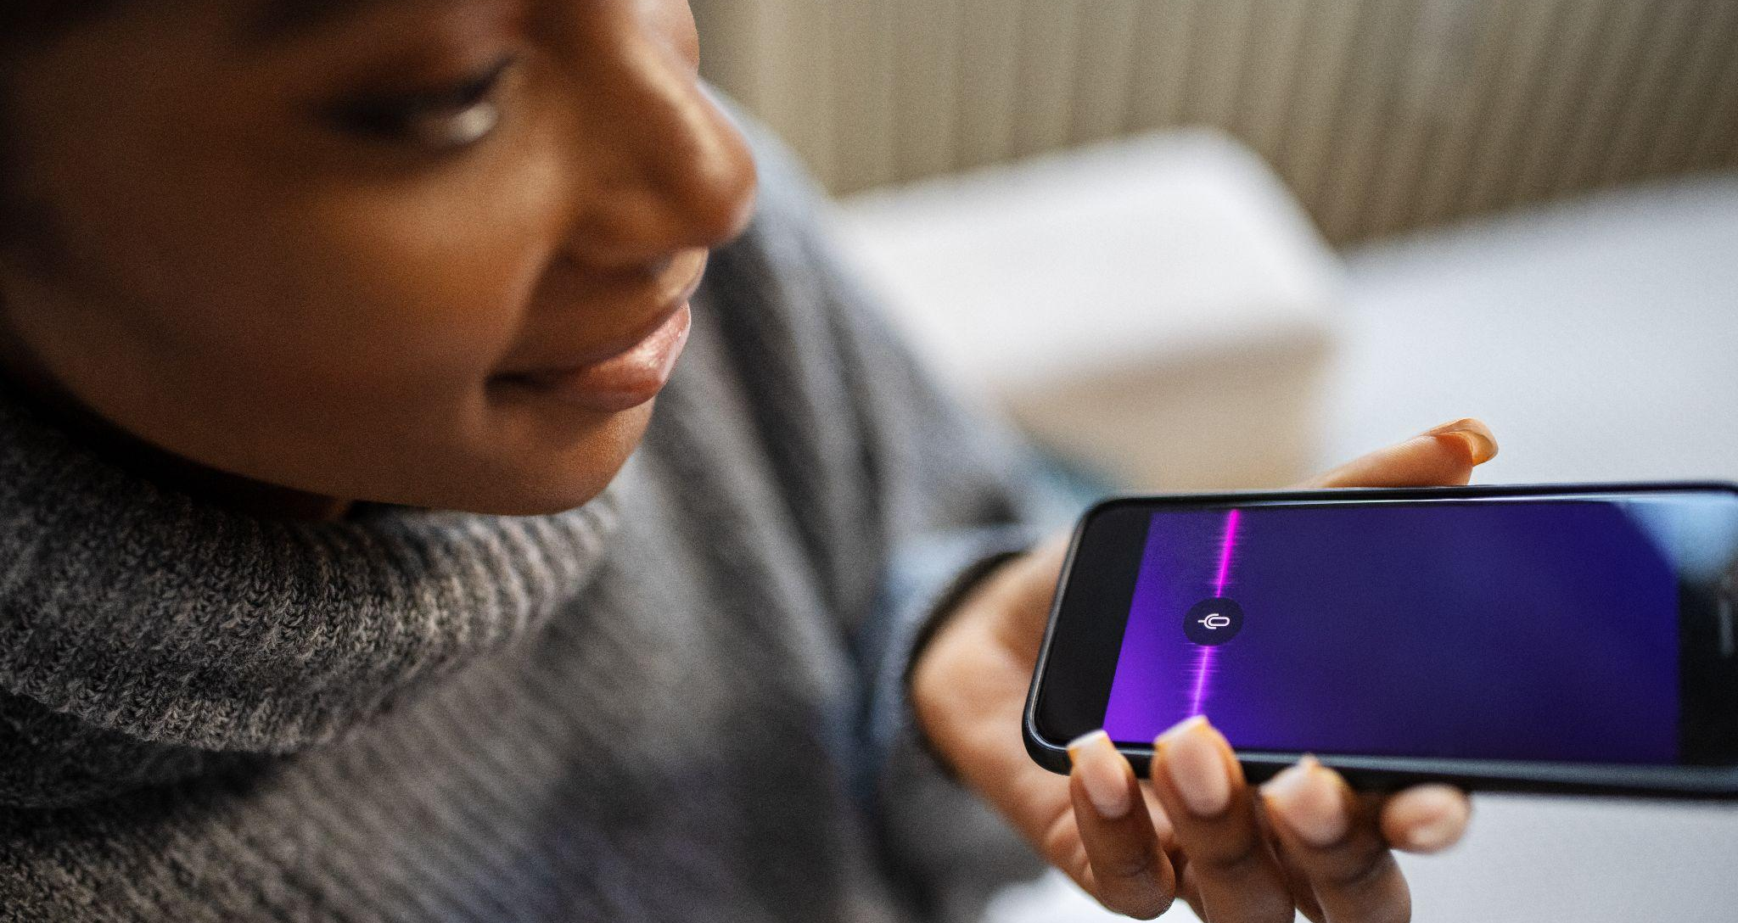
New User Journey

Slide 32
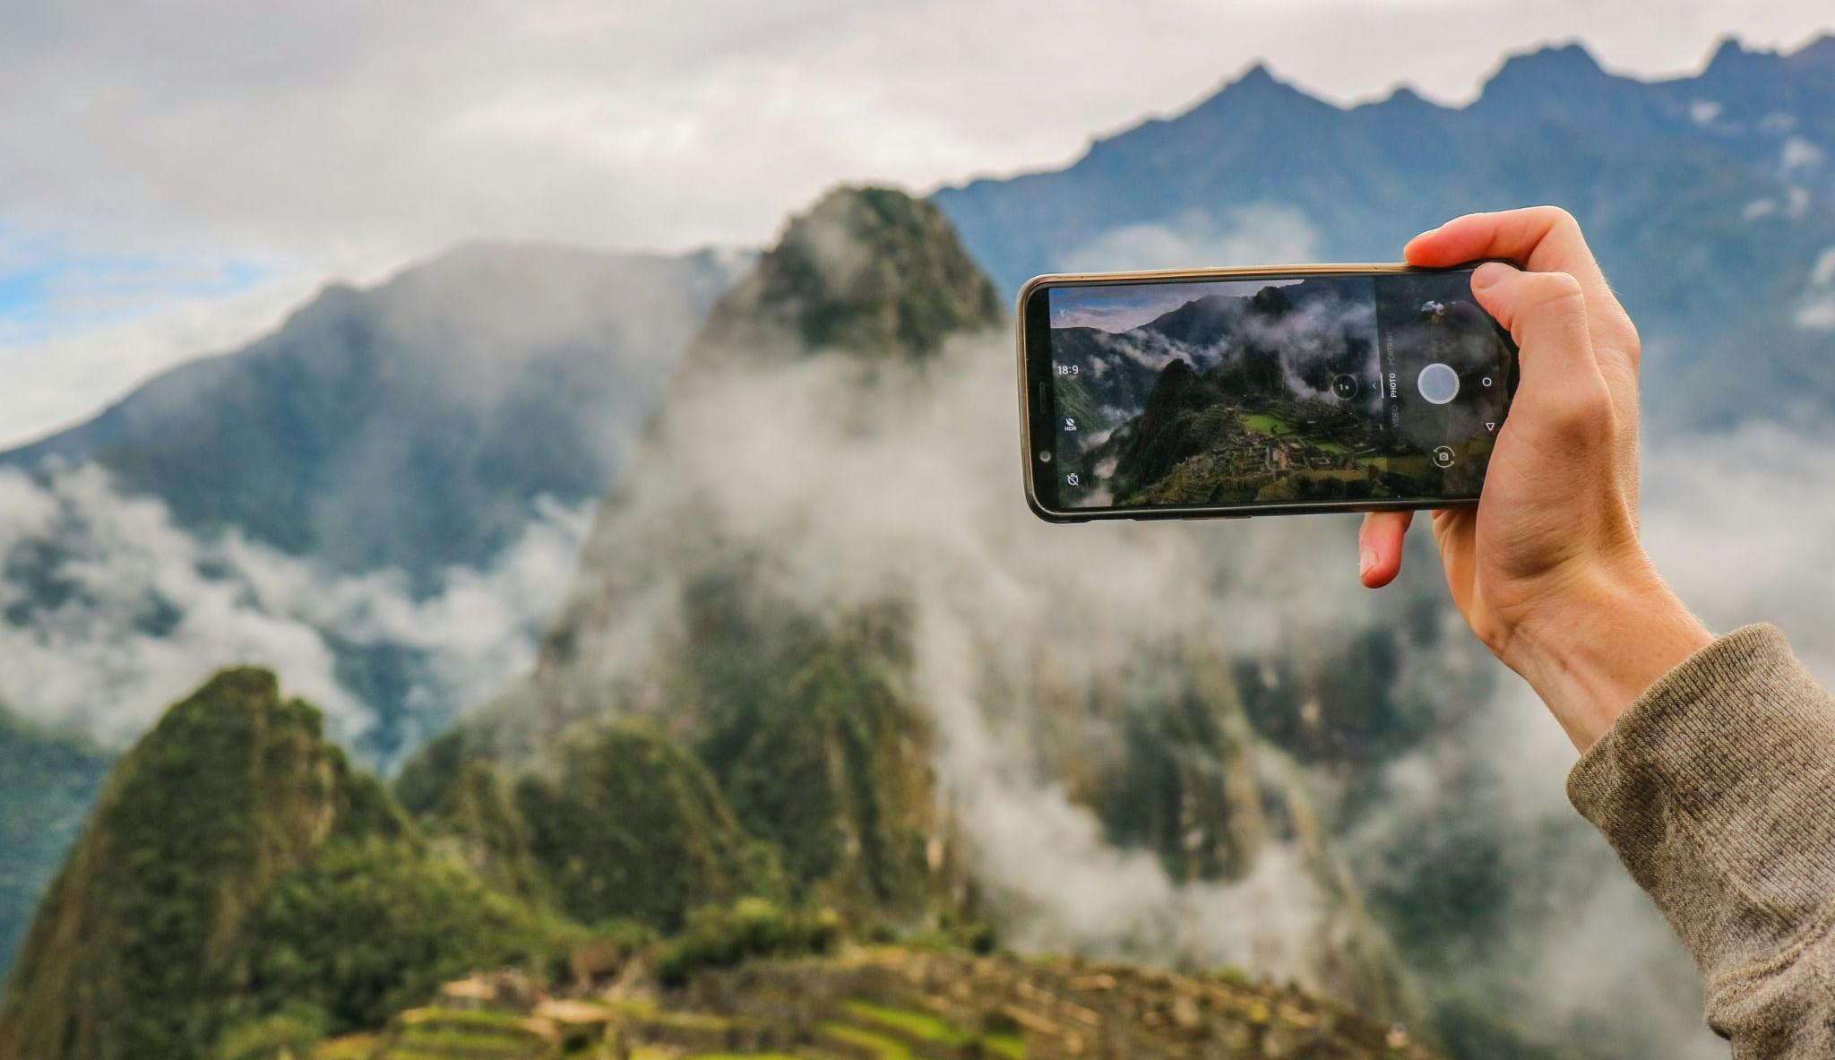
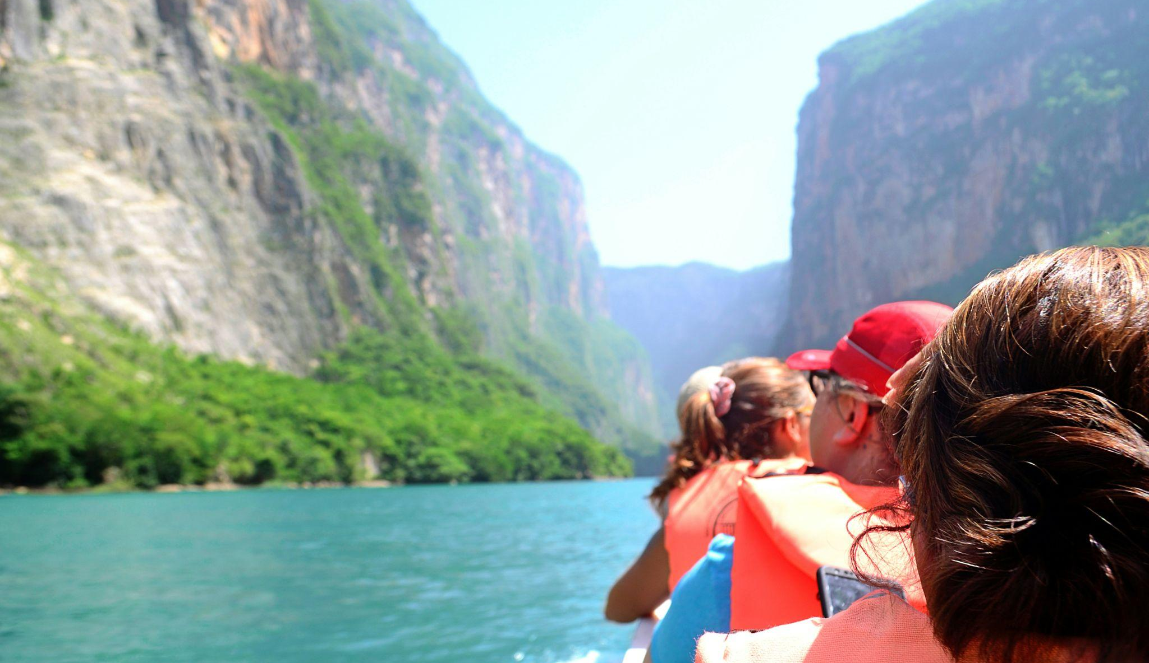
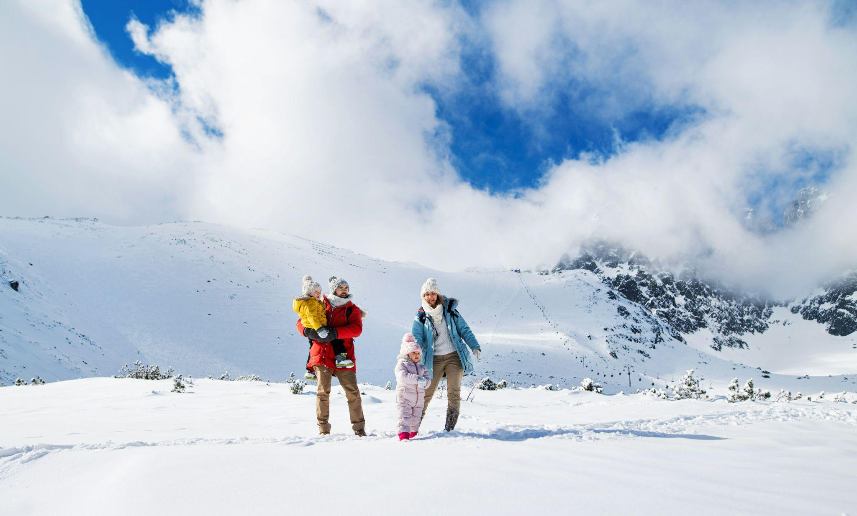
40+
hours
Who is traveling (Jan 2025)
On average, travelers spend 40+ hours on research when planning their trips
Planning a
trip takes effort.
And we mean serious work.
35+
days
On average, travelers spend over 35 days planning their trips
30+
websites
On average, travelers visit 30+ different websites during their travel planning process

Slide 33
New User Journey
62%
of global adult Gen Z travelers said they used AI to help them save money on travel
(EMerchant)
AI is the buzzword heard round the world - and the travel industry is no exception
Who is traveling (Jan 2025)
83%
of travelers using an AI tool to find inspiration and book trips report being satisfied with the experience
(Matador Network)
22%
of global travelers have used ChatGPT or similar AI chatbots to plan travel
(Simple Flying)

Slide 34
Enter
Tripadvisor’s
AI Planning Tool
We simplify trip planning with personalized recommendations, making customizing your itinerary effortless.

Slide 35
Who is traveling (Jan 2025)
And it’s resonating with travelers.
79%
Satisfaction rate with our
AI Trip Planning Tool
recommendations
Source: Internal Data, June 2024.

Slide 36
New User Journey
AI Trip Planning Tool
Conversational AI Agent
And this year, we’ll power up their journey with new & reimagined AI tools

Slide 37
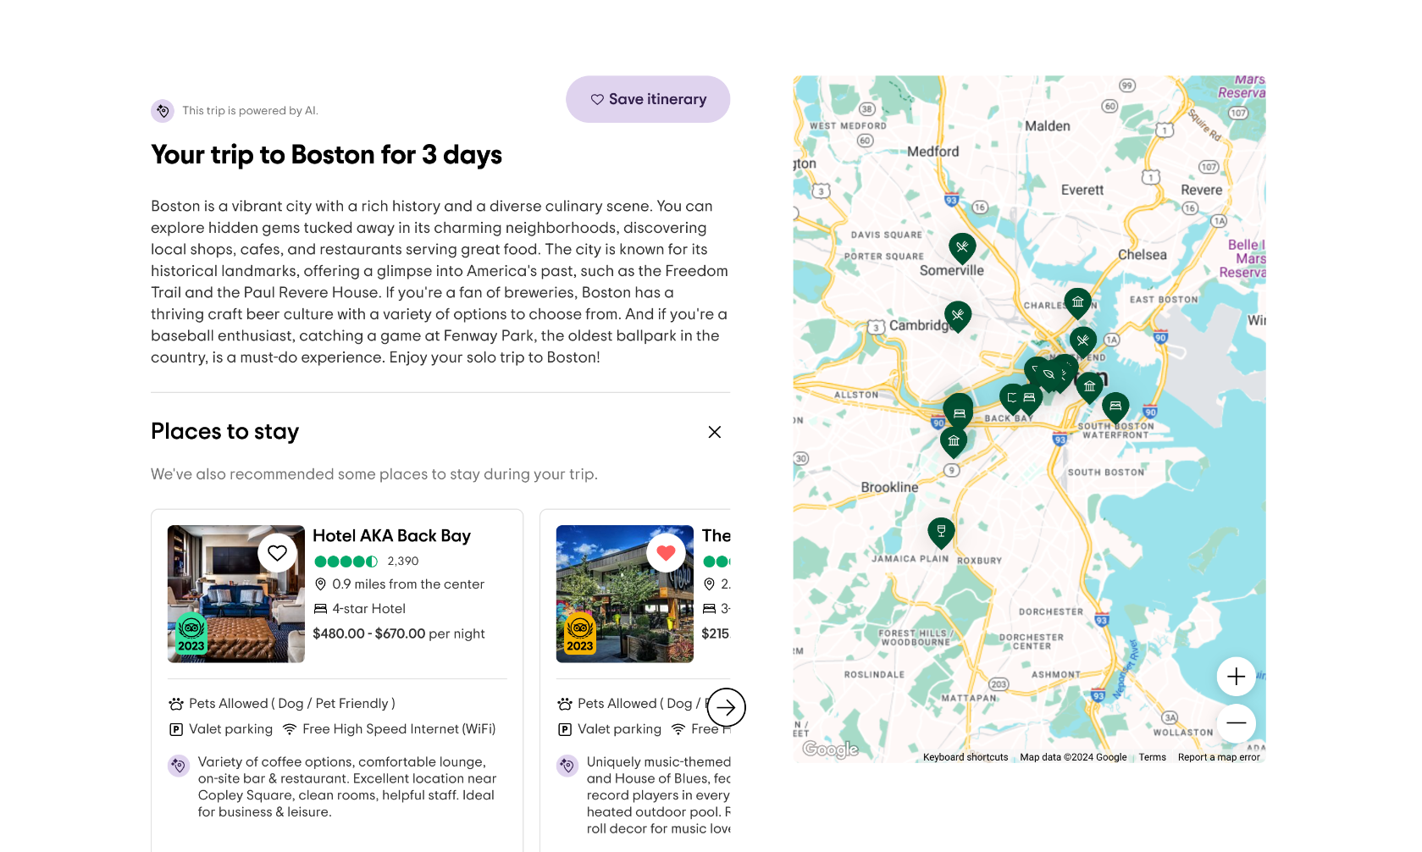
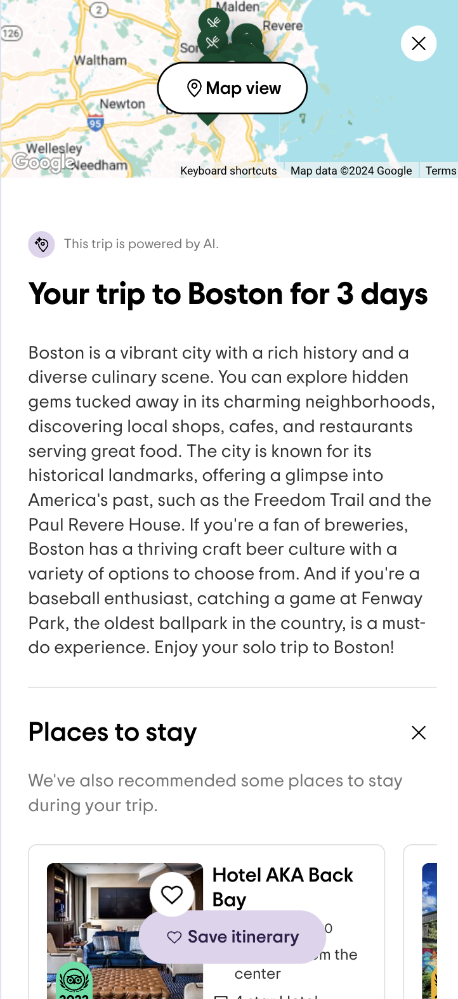
New User Journey
Our AI Trip Planning Tool personalizes the traveler journey
Unique itineraries
Integrated brand relevance
Built on real traveler reviews

Slide 38
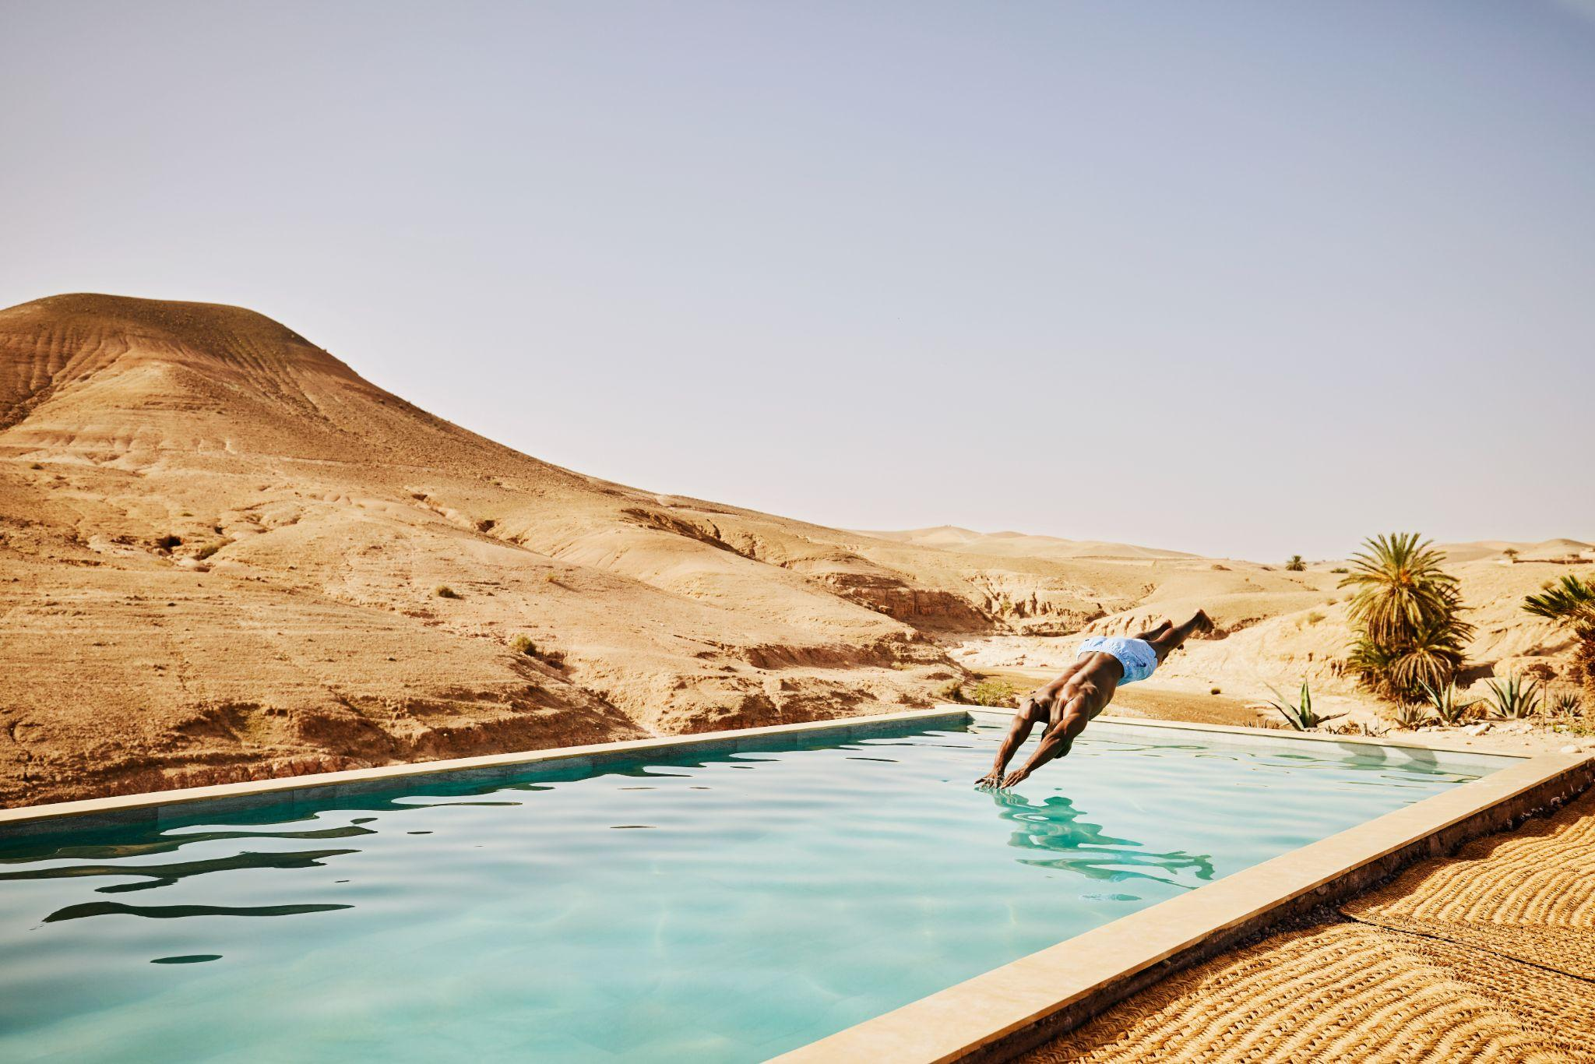
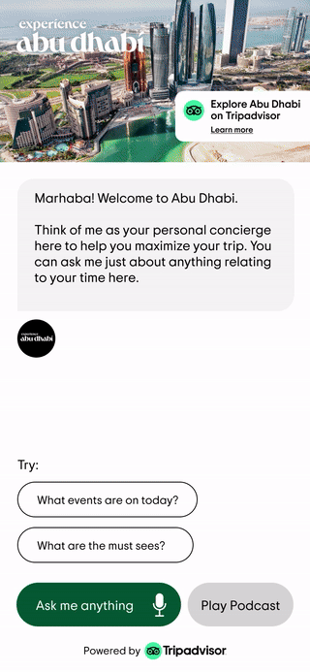
Demo
New User Journey
Our Conversational AI Agent powers seamless travel guidance through a partner lens
Brand Safe & Dynamic Responses
Powered by Tripadvisor Data
Multilingual & Contextual
Smarter Over Time
Unmatched Insights
Flexible Deployment
Notes:
Brand Safe and Dynamic Responses - The agent can be trained on specific partner information and offer a mix of canned and open responses with defined guardrails
Powered by Tripadvisor Data - The agent has full access to Tripadvisor’s API - something no one else can offer
Multilingual and Contextual - Talk to it in any language and receive contextually relevant prompts alongside the response to drive the conversation forward
Smarter over time - Its memory function uses previous interactions with individual users to deliver better, more personalised recommendations the more it is used
Unmatched Insights - We can understand what is being asked and what recommendations are being surfaced to provide invaluable insights back to the partner
Flexible deployment - Multiple input modes (voice, chat and tap) remove any barriers to use. The agent can be deployed through the web, integrated into partner sites/apps and be deployed in rooms for on stay use

Slide 39
AI Travel Assistant
Welcome to your new AI Concierge.
Tripadvisor has debuted a new AI Assistant (beta) which combines site content with generative AI, enabling travelers to access information and build personalized itineraries through seamless conversations.
NEW for 2025

Slide 40
Key Takeaways
Who is traveling (Jan 2025)
1 | International traffic to the Mongolia improved for Jan 2024 vs Jan 2025, with a 10% increase
2 | Top 5 source markets viewing Mongolia (Jan till Sept 24) - US, S. Korea, Russia, Japan and China.
3 | Outdoor experiences, Tours, Sights and Landmarks gained the most interest. E.g. Off the beaten paths, Hidden Gems.
4 | Tripadvisor AI Trip planning tool and Conversational AI Agent continues to break new ground helping travelers plan that effortless perfect trip.
Source: Internal Data, June 2024.

