Slide 1
Country Differences in Tourist Behavior
Seul Ki Lee
Sejong University

Slide 2
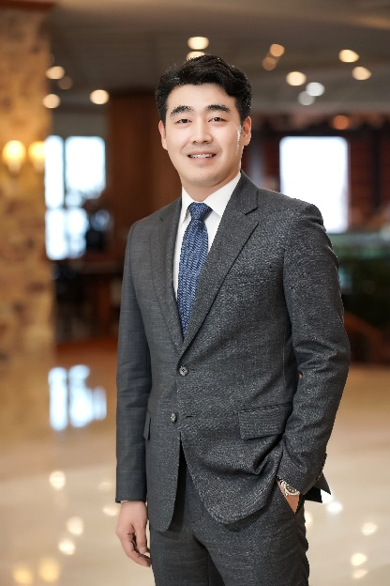
Speaker: Seul Ki Lee
Affiliation / Position
Professor of Hotel and Tourism Management
Director of Tourism Industry Data Analytics Lab (TIDAL)
Sejong University
Educational Background
Purdue University, West Lafayette, IN: MS(2009) / PhD(2012)
Sejong University, Seoul, Korea: BS(2006)
Professional Background
Temple University, Philadelphia, PA: Assistant Professor
Purdue University, West Lafayette, IN: TA/RA
KONICOF, Daejeon, Korea: Specialist of International Cooperation
Research Area
Data Analytics in Tourism and Hospitality:
Location Analysis, Revenue Management, Asset Management

Slide 3
Country Differences
Differences in Travel Behavior
Need and want
One size does not fit all
What works for one group may not for the other
Diversification of services essential
Language
Tour
Food
Products
And many more…

Slide 4
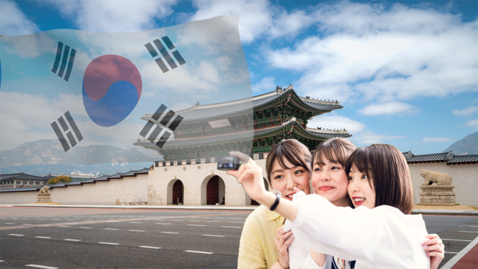
Japanese Tourists
Small groups of friends
Polite, respectful, and considerate of local customs
Well prepared and organized
Like taking photos at scenic spots
reserved and quiet
local crafts or items that reflect the place they’re visiting.
Shy about communicating in English
Very clean

Slide 5
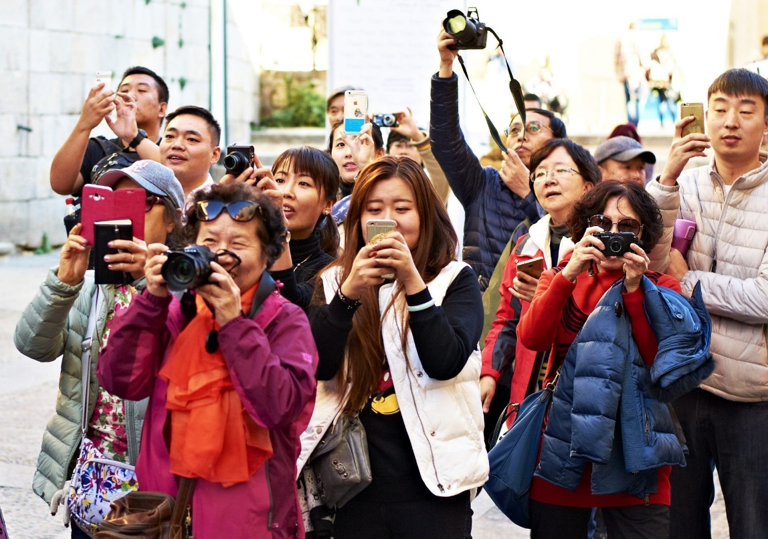
Chinese Tourists
Tend to travel in groups, especially older generations
Enthusiasm for shopping, particularly luxury goods and well-known international brands.
Often use Chinese social media platforms like WeChat and Weibo to share their travel experiences.
Tend to enjoy visiting landmarks
Rely on apps like Alipay or WeChat Pay for payments while traveling, and some may encounter difficulties with language barriers, leading them to rely on digital translation tools.

Slide 6
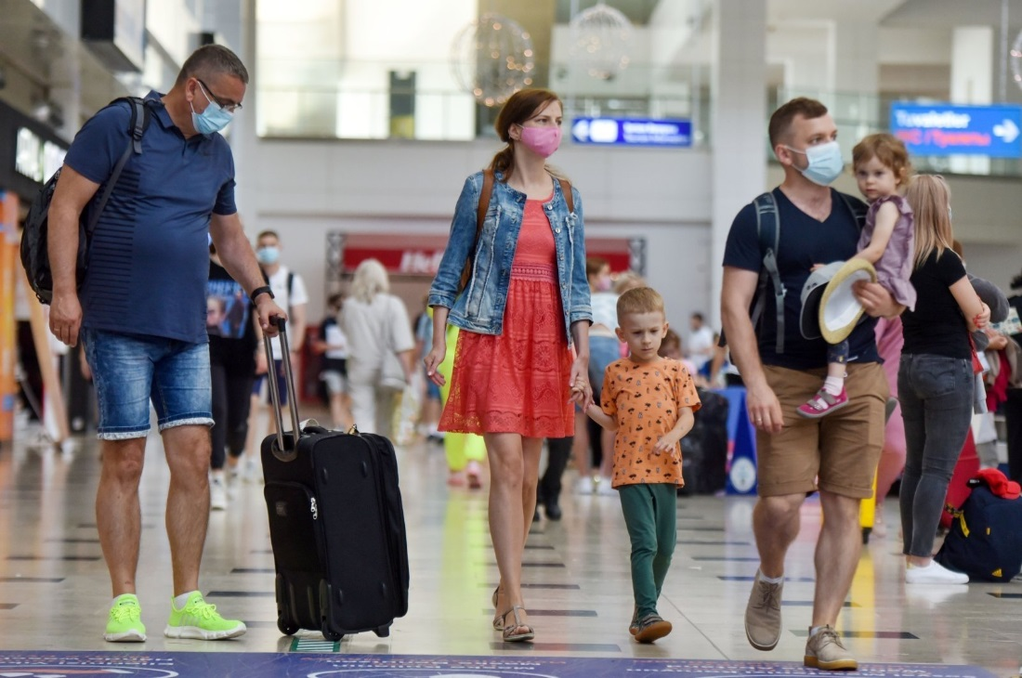
Russian Tourists
Family or groups of families
Eager to explore the history, culture, and traditions
higher expectations for service quality
Russian tourists spend a lot when traveling
More direct in their communication, not afraid to express what they want
Enjoy visiting warmer destinations, particularly during Russia’s colder months

Slide 7
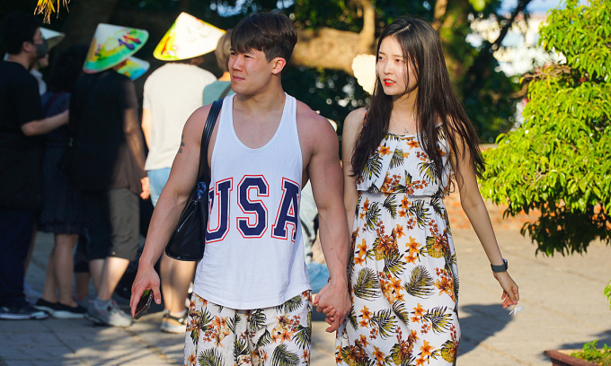
Korean Tourists
Individual travel and small groups increasing
In many ways, Koreans are in between Japan and China
Well prepared and organized
Often researching destinations in advance and having a clear plan
Take lots of photos (especially of food)
Enjoy trying adventurous dishes (like lamb head) and activities (horseback riding and rafting)
Willing to communicate in English

Slide 8
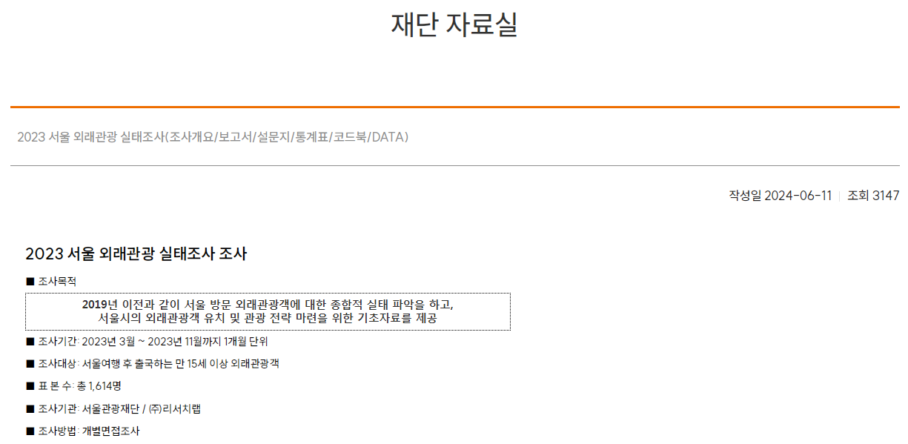
Analysis of Seoul Tourism Organization Data
Analysis of raw data to find insight
2024 data to be released soon

Slide 9
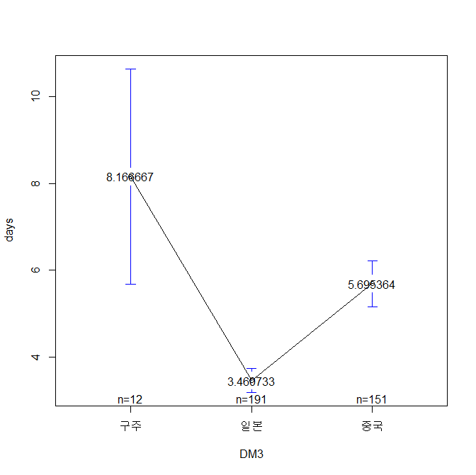
Average days visited
Russians visit the longest, while Japanese visit the shortest
Korean travelers usually 3~5 days (between Japan and China)
Blue line is the 95% confidence interval

Slide 10
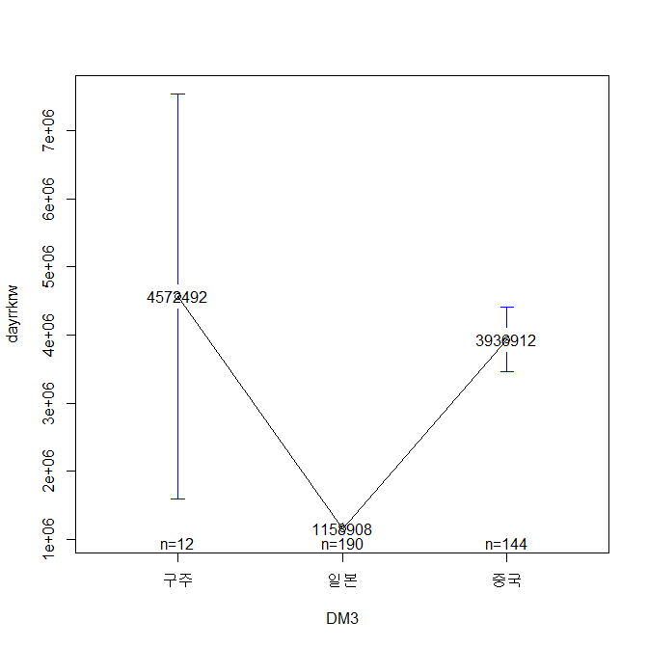
Average Hotel Spending by Country
Russians spend the most, while Japanese spend the least (partly due to the length of stay)
Korean travelers usually spend around 80~100 USD per night
Lowest-spending Russian traveler spent more than highest-spending Japanese traveler!

Slide 11
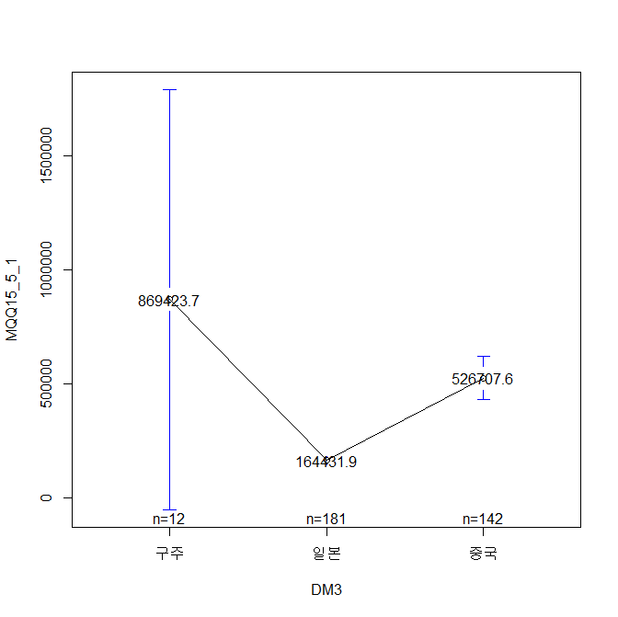
Total Food Expenditure
Russians spend the most, while Japanese spend the least (difference less than rooms)
Korean travelers usually spend around 50~100 USD per day
It is usually seen that Japanese travelers spend relatively less on hotel, but more on food and shopping

Slide 12
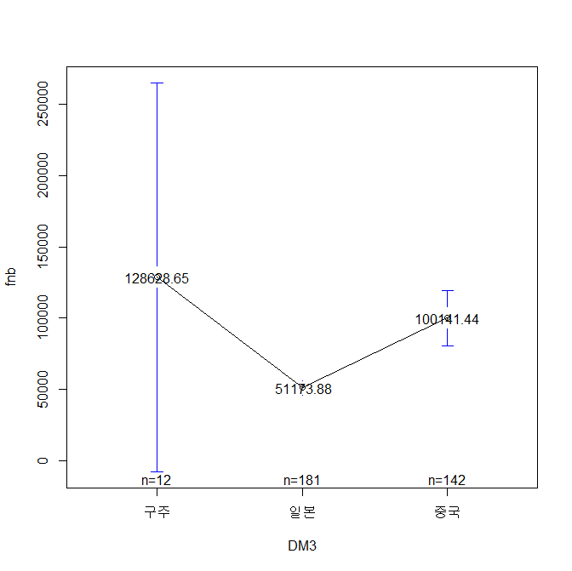
Average Daily Food Expenditure
Russians spend the most, while Japanese spend the least (difference less than rooms)
Korean travelers usually spend around 50~100 USD per day
The standard deviation for Japan is very low

Slide 13
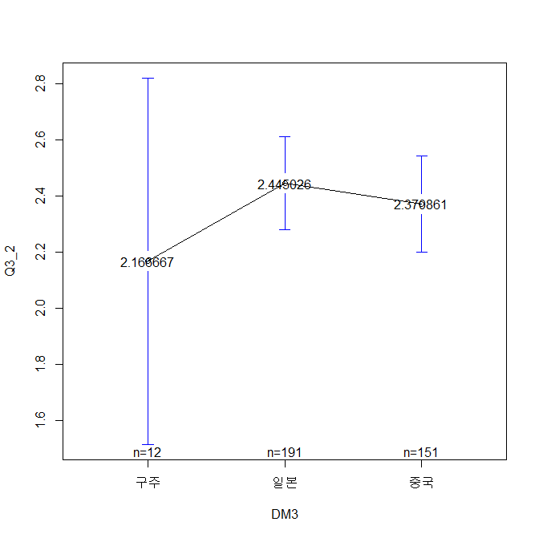
Average Group Size
Russians to Korea were mostly couples, while Japanese/Chinese are mostly groups of two or three
Korean travelers are usually groups of 2~4
Russians traveling to Korea are a bit different from those traveling to SE Asia

Slide 14
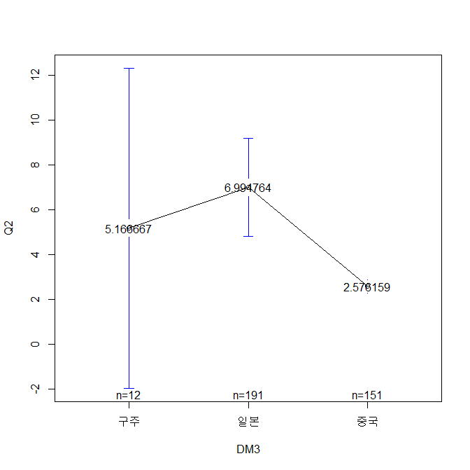
Return Visits
Japanese travelers are most likely to return, whereas Chinese travelers are the least likely to return
Korean travelers would be somewhere in between Japan and China
Surprisingly, Russian visitors return often
Chinese visitors return the least

Slide 15
Total Expenditure
Russian visitors spend the most, consistent with the common understanding
Japanese visitors spend the least
Korean visitors usually spend around 2M~3M KRW
Of course, airfare, length of stay, and exchange rate plays a role here

Slide 16
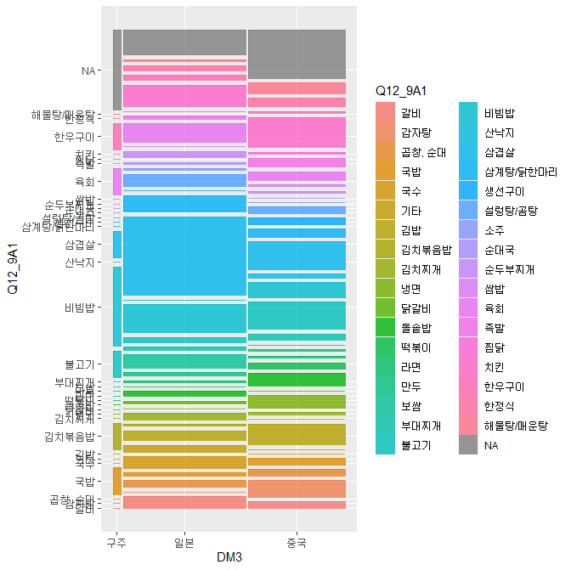
Favorite Food
Russian visitors like rice (Bibimpap, etc.)
Japanese visitors like fresh bacon (Samgyeopsal, etc.)
Chinese visitors like chicken (fried, etc.)

Slide 17
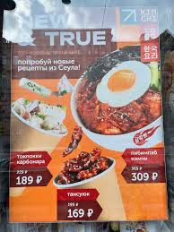
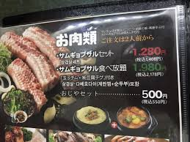
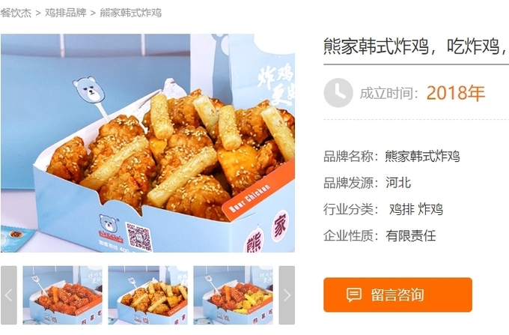
Favorite Food

Slide 18
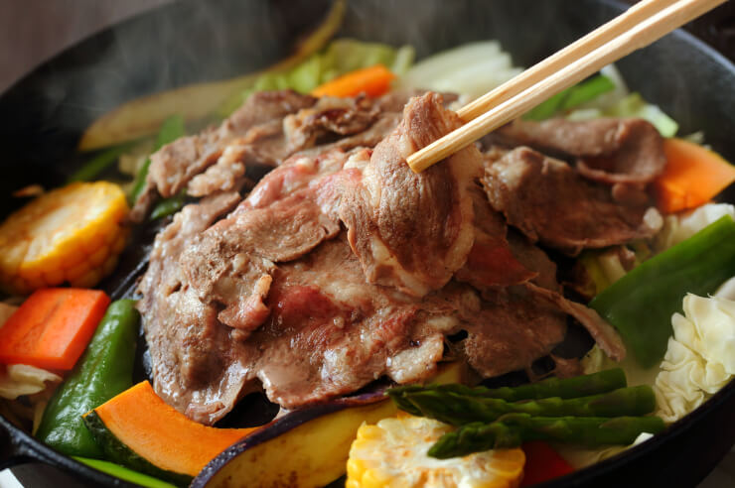
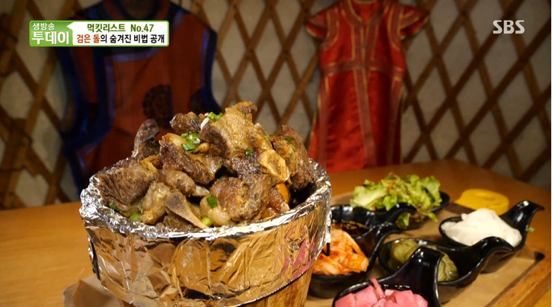
Marketable Food

Slide 19
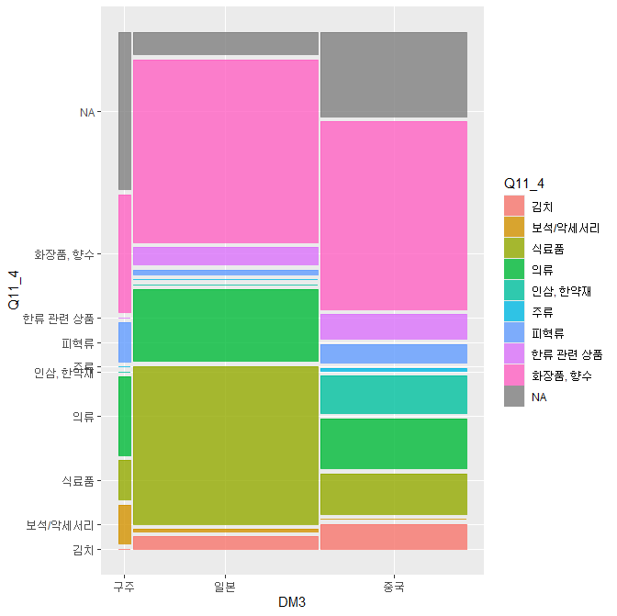
Shopping
Cosmetics is the top product/souvenir
Next is clothes/textile
Japanese travelers like food
Russian travelers like leather goods/jewelry
Koreans – famous local products
In Mongolia, Chinggis vodka and Gobi, mostly

Slide 20
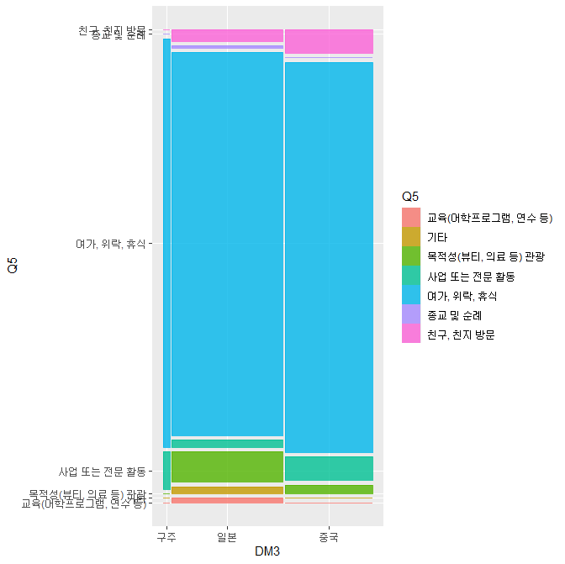
Travel Purpose
Russian visitors are usually for leisure/tourism
Some Japanese visitors for medical tourism

Slide 21
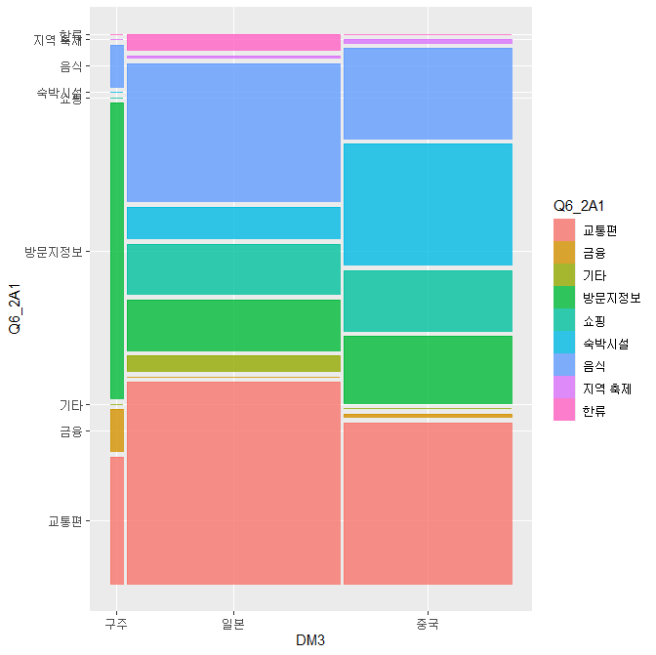
Information Needed
Russian travelers require information on tourist attractions
Japanese travelers require information on food and transportation
Chinese travelers: balanced
Chinese travelers expect e-payments to be accepted. Russians are curious about payments too

Slide 22
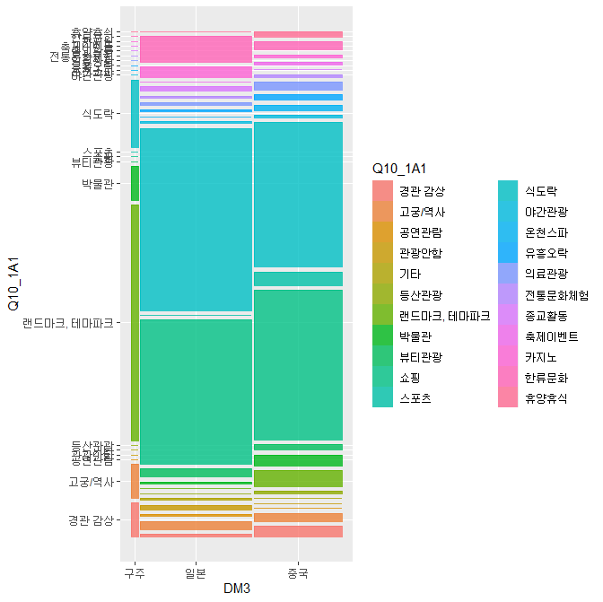
Primary Activity
Russian travelers like landmarks (skyscrapers, square, etc.)
Japanese/Chinese travelers like restaurants and shopping centers
Koreans usually want to do both
Russians display a very different behavior; less shopping and more sightseeing

Slide 23
Summary
Country differences notable
Russia and Japan travelers not likely to increase significantly in the near future
Political & economic situation
Chinese and Korean tourists likely to increase in 2025
Marketing and packaging strategies
Where focus on Chinese market would be larger group tours
And focus on Korean market would be individual/small group tours
Unlike Japan, Chinese and Korean travelers want to make use of e-payment options whenever possible

Slide 24
Thank you for your attention

